Slide 1
Optimizing Mission Concept Development: A Bayesian Approach Utilizing DAGs
Patricia Gallagher
Jet Propulsion Laboratory, California Institute of Technology
2024 DATAWorks Conference
April 16th – 18th, 2024
Patricia.Gallagher@jpl.nasa.gov
© 2024 California Institute of Technology. Government sponsorship acknowledged.

Slide 2
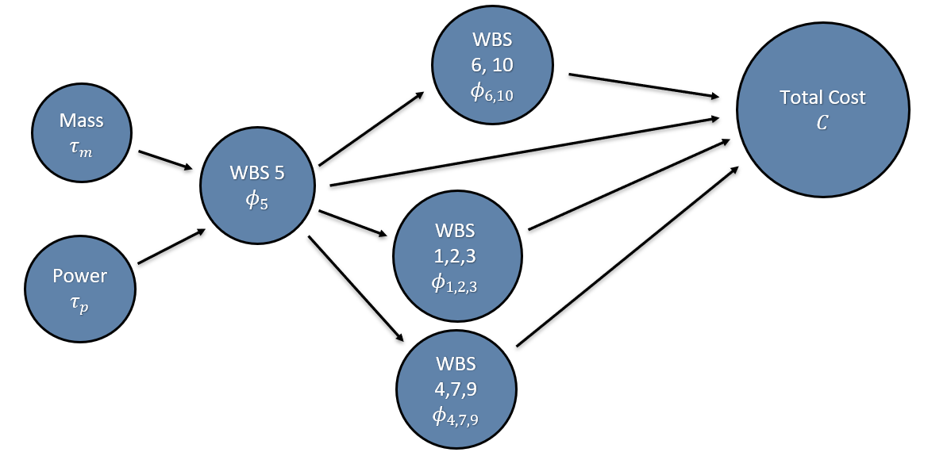
Directed Acyclic Graphs
Model incorporates implied directionality to highlight trickle down effects in mission budgeting from changes in technical parameters
Designed as an intuitive tool to aid engineers and scientists in early mission planning, facilitating informed decision-making
Aims to enhance the early stages of the mission design process by providing insights into cost dynamics
Inspired by the figure on the right, our project interprets non-directional model results to suggest a directional flow, emulating the original structure

Slide 3
Data Discussion
WBS 01 | Project Management | WBS 06 | Flight System / Spacecraft
WBS 02 | Systems Engineering | WBS 07 | Mission Operations System (MOS)
WBS 03 | Safety and Mission Assurance | WBS 08 | Launch Vehicle / Services
WBS 04 | Science / Technology | WBS 09 | Ground Data System (GDS)
WBS 05 | Payload(s) | WBS 10 | System Integration, Assembly, Test & Check
Data from JPL Discovery and New Frontiers missions
Data from ten flown mission and thirteen studies
Includes data from Phases A - F
Payload mass and peak payload power included as predictor variables to WBS 05 (Payload)
Other WBS category includes launch vehicle, bypass, Caltech fees, etc.
It is generally thought that there is a “typical” percent allocation of total mission cost to the Level 2 WBS (Work Breakdown Structure) elements

Slide 4
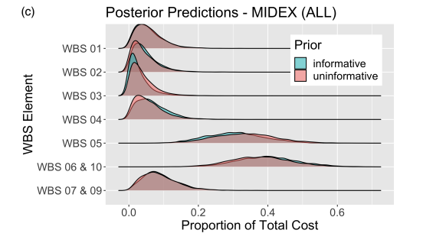
Dirichlet Distribution and Previous Work
The Dirichlet distribution describes the uncertainty of multivariate distributions
Can be understood as the multivariate extension of the Beta distribution
Binomial = model for # successes of n trials with probability p
Beta = model for uncertainty around p
Multinomial = multivariate extension to binomial distribution, defined by vector of probabilities which sum to 1
The Dirichlet distribution is the simplest distribution on the simplex (vectors whose components sum to one)
Applied to model the proportion WBS elements made up of Total Mission Costs
Figure: Cost allocation posterior distributions across WBS from two Dirichlet models with informative and uninformative priors.
(S. R. Fleischer and M. A. Hooke, "Bayesian Rules of Thumb: Robust Uncertainty Quantification in Early Project Cost Estimation” 2022)

Slide 5
Expanded Dirichlet Model
WBS 05 Cost Estimate with Linear Regression
Other WBS Elements Estimated with Dirichlet Model
Total Cost Estimate
Combined results of WBS 05 cost estimate and cost allocation model used to estimate total cost
Cost allocations modeled with mass and power as predictors
Mass
$$τ_{m}$$
WBS 4
Payload Cost (WBS 5)
$M
WBS
1,2,3
Total Mission Cost
$M
WBS 7,9
Power
$$τ_{p}$$
WBS 5
Other
WBS
6,10

Slide 6
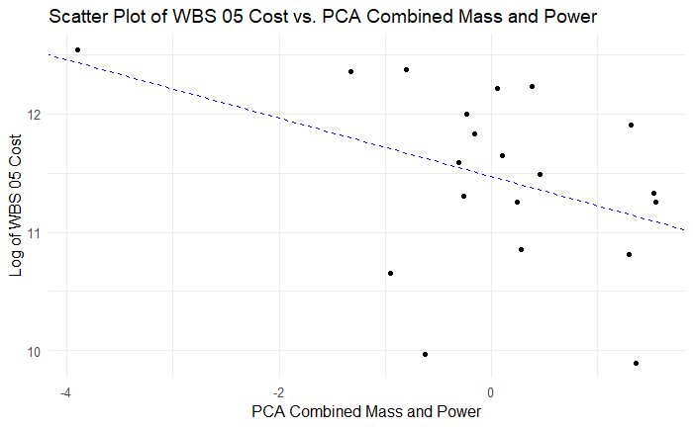
Expanded Dirichlet Model
Linear Regression Component
Utilized Principal Component Analysis (PCA) to combine peak payload power and payload mass into a single, comprehensive variable
Bayesian model estimating log of payload cost as a function of the combined PCA variable
Repeated model training iteratively to refine the model's predictive power
Generated posterior predictions for reasonable values of mass and power

Slide 7
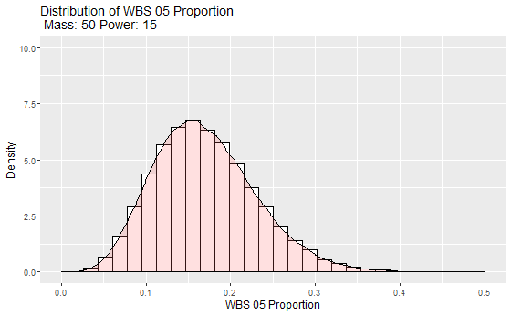
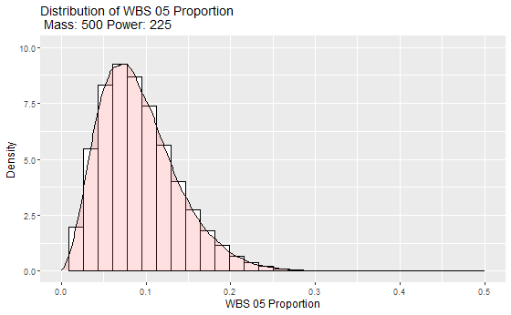
Expanded Dirichlet Model
Dirichlet Model w/ Technical Parameters
Aims for a comprehensive view of how technical changes affect budget distribution
Utilized PCA-transformed mass and power variable as technical parameter
Including technical parameters aligns Dirichlet and linear regression models, allowing for combined posterior
Repeated model training iteratively to refine the model's predictive power
Generated posterior predictions for reasonable values of mass and power

Slide 8
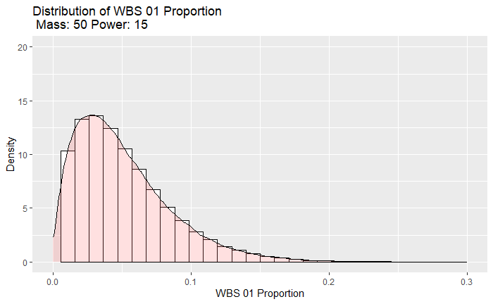
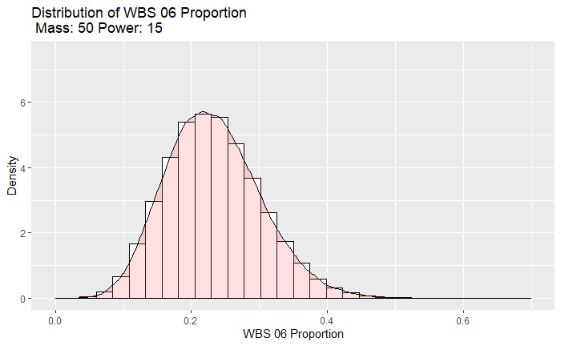
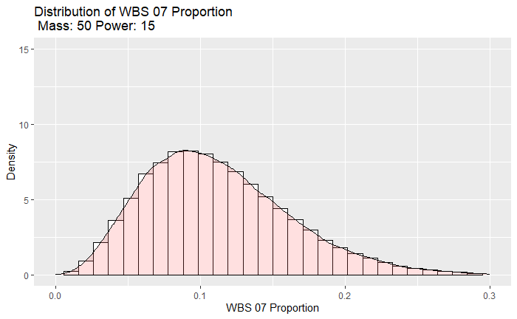
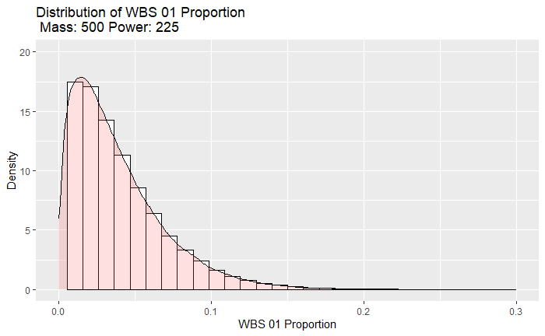
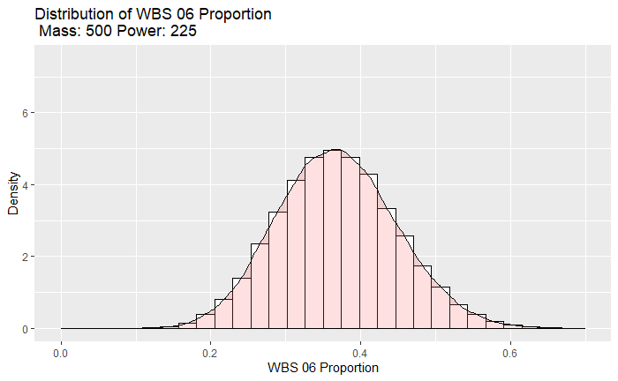
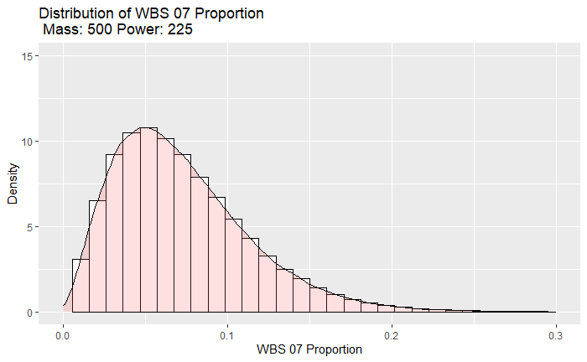
Dirichlet Model – Posterior Distribution Examples

Slide 9
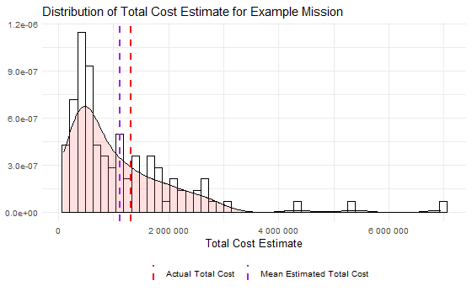
Expanded Dirichlet Model
Combined Results
Posteriors obtained from linear regression and Dirichlet models for varied mass and power levels, enabling scenario analysis for cost estimation
Payload cost estimates from linear regression model are sampled then paired with randomly sampled WBS allocation estimates from Dirichlet model to back into a total cost estimate
Establishes a directional framework where mass and power decisions directly influence payload costs. Mass, power, and payload costs then dictate the overall cost structure, illustrating the cascading effect of technical decisions on project budgeting
Demonstrates how technical decisions drive individual component costs and the overall budget allocation, offering a tool for informed early-stage project planning and cost management

Slide 10
Conclusion & Future Work
Conclusion
Method advances the Dirichlet cost estimating model to incorporate mass and power as technical parameters, enhancing its predictive capability
Model refined to include directionality, offering clearer insights into how changes in parameters influence cost distribution
Maintained a Bayesian approach, ensuring a robust understanding of uncertainty and enabling informed decision-making
Future Work
Expand current work to incorporate directionality from WBS 06 and corresponding technical parameters, such as spacecraft mass and power
Incorporate additional data as more technical parameters, data from different mission types, and synthetically generated data

Slide 11
Special Thanks!
Thank you to Al Nash, Patrick Bjornstad, Trevor Beer, Anto Kolanjian, Michael Saing, and Michael DiNicola for their contributions to this project!

Slide 12
Questions? Contact Patricia Gallagher (Patricia.Gallagher@jpl.nasa.gov)

