Slide 1
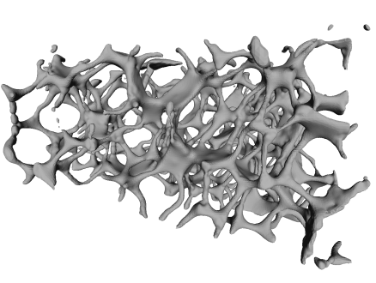
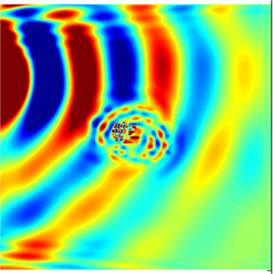
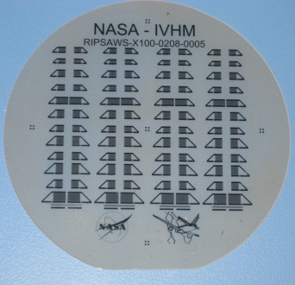
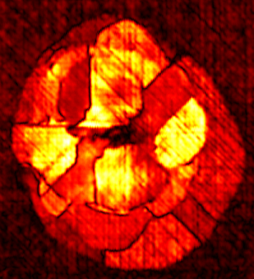
Computational Nondestructive evaluation Case Studies at NASA
Peter D. Juarez
Research Engineer
Nondestructive Evaluation Sciences Branch
NASA Langley Research Center

Slide 2
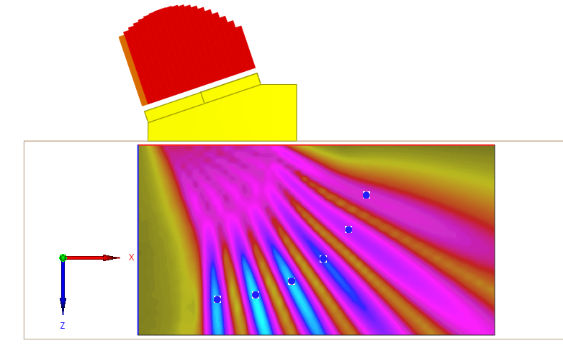
CIVA Simulation software
NASA Langley Research Center - Nondestructive Evaluation Sciences Branch

Slide 3
In house code
NASA Langley Research Center - Nondestructive Evaluation Sciences Branch

Slide 4
Three applications for simulation
You can’t physically perform the inspection yet.
You can perform the inspection, but don’t know how.
You can perform the inspection, you know how you will inspect, but you want to know more about the resulting data.
NASA Langley Research Center - Nondestructive Evaluation Sciences Branch

Slide 5
You can perform the inspection, you know how you will inspect, but you want to know more about the resulting data.
Example: Probability of detection study on friction stir welded panels
NASA Langley Research Center - Nondestructive Evaluation Sciences Branch

Slide 6
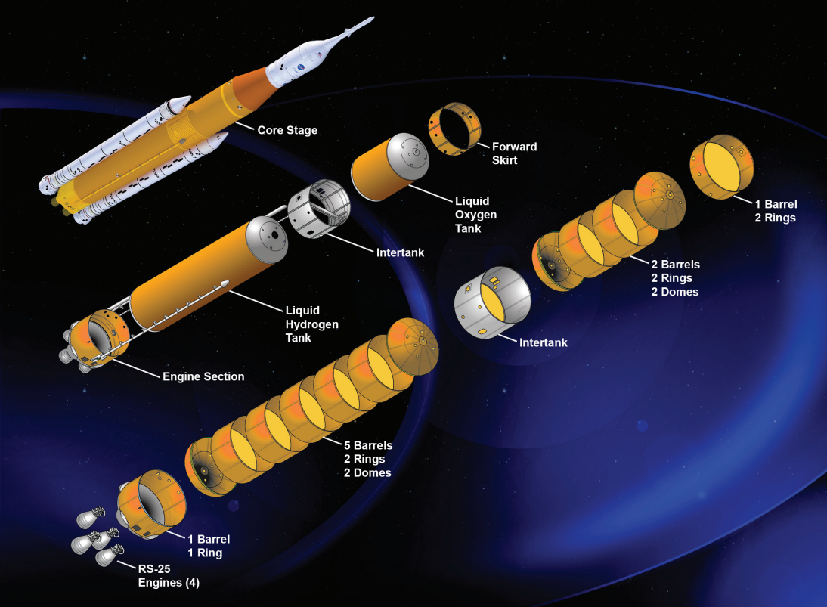
Friction Stir Welding
2
Core stage Space Launch System (SLS)
NASA Langley Research Center - Nondestructive Evaluation Sciences Branch

Slide 7
Probability Of Detection (POD) Curve
2
NASA Langley Research Center - Nondestructive Evaluation Sciences Branch

Slide 8
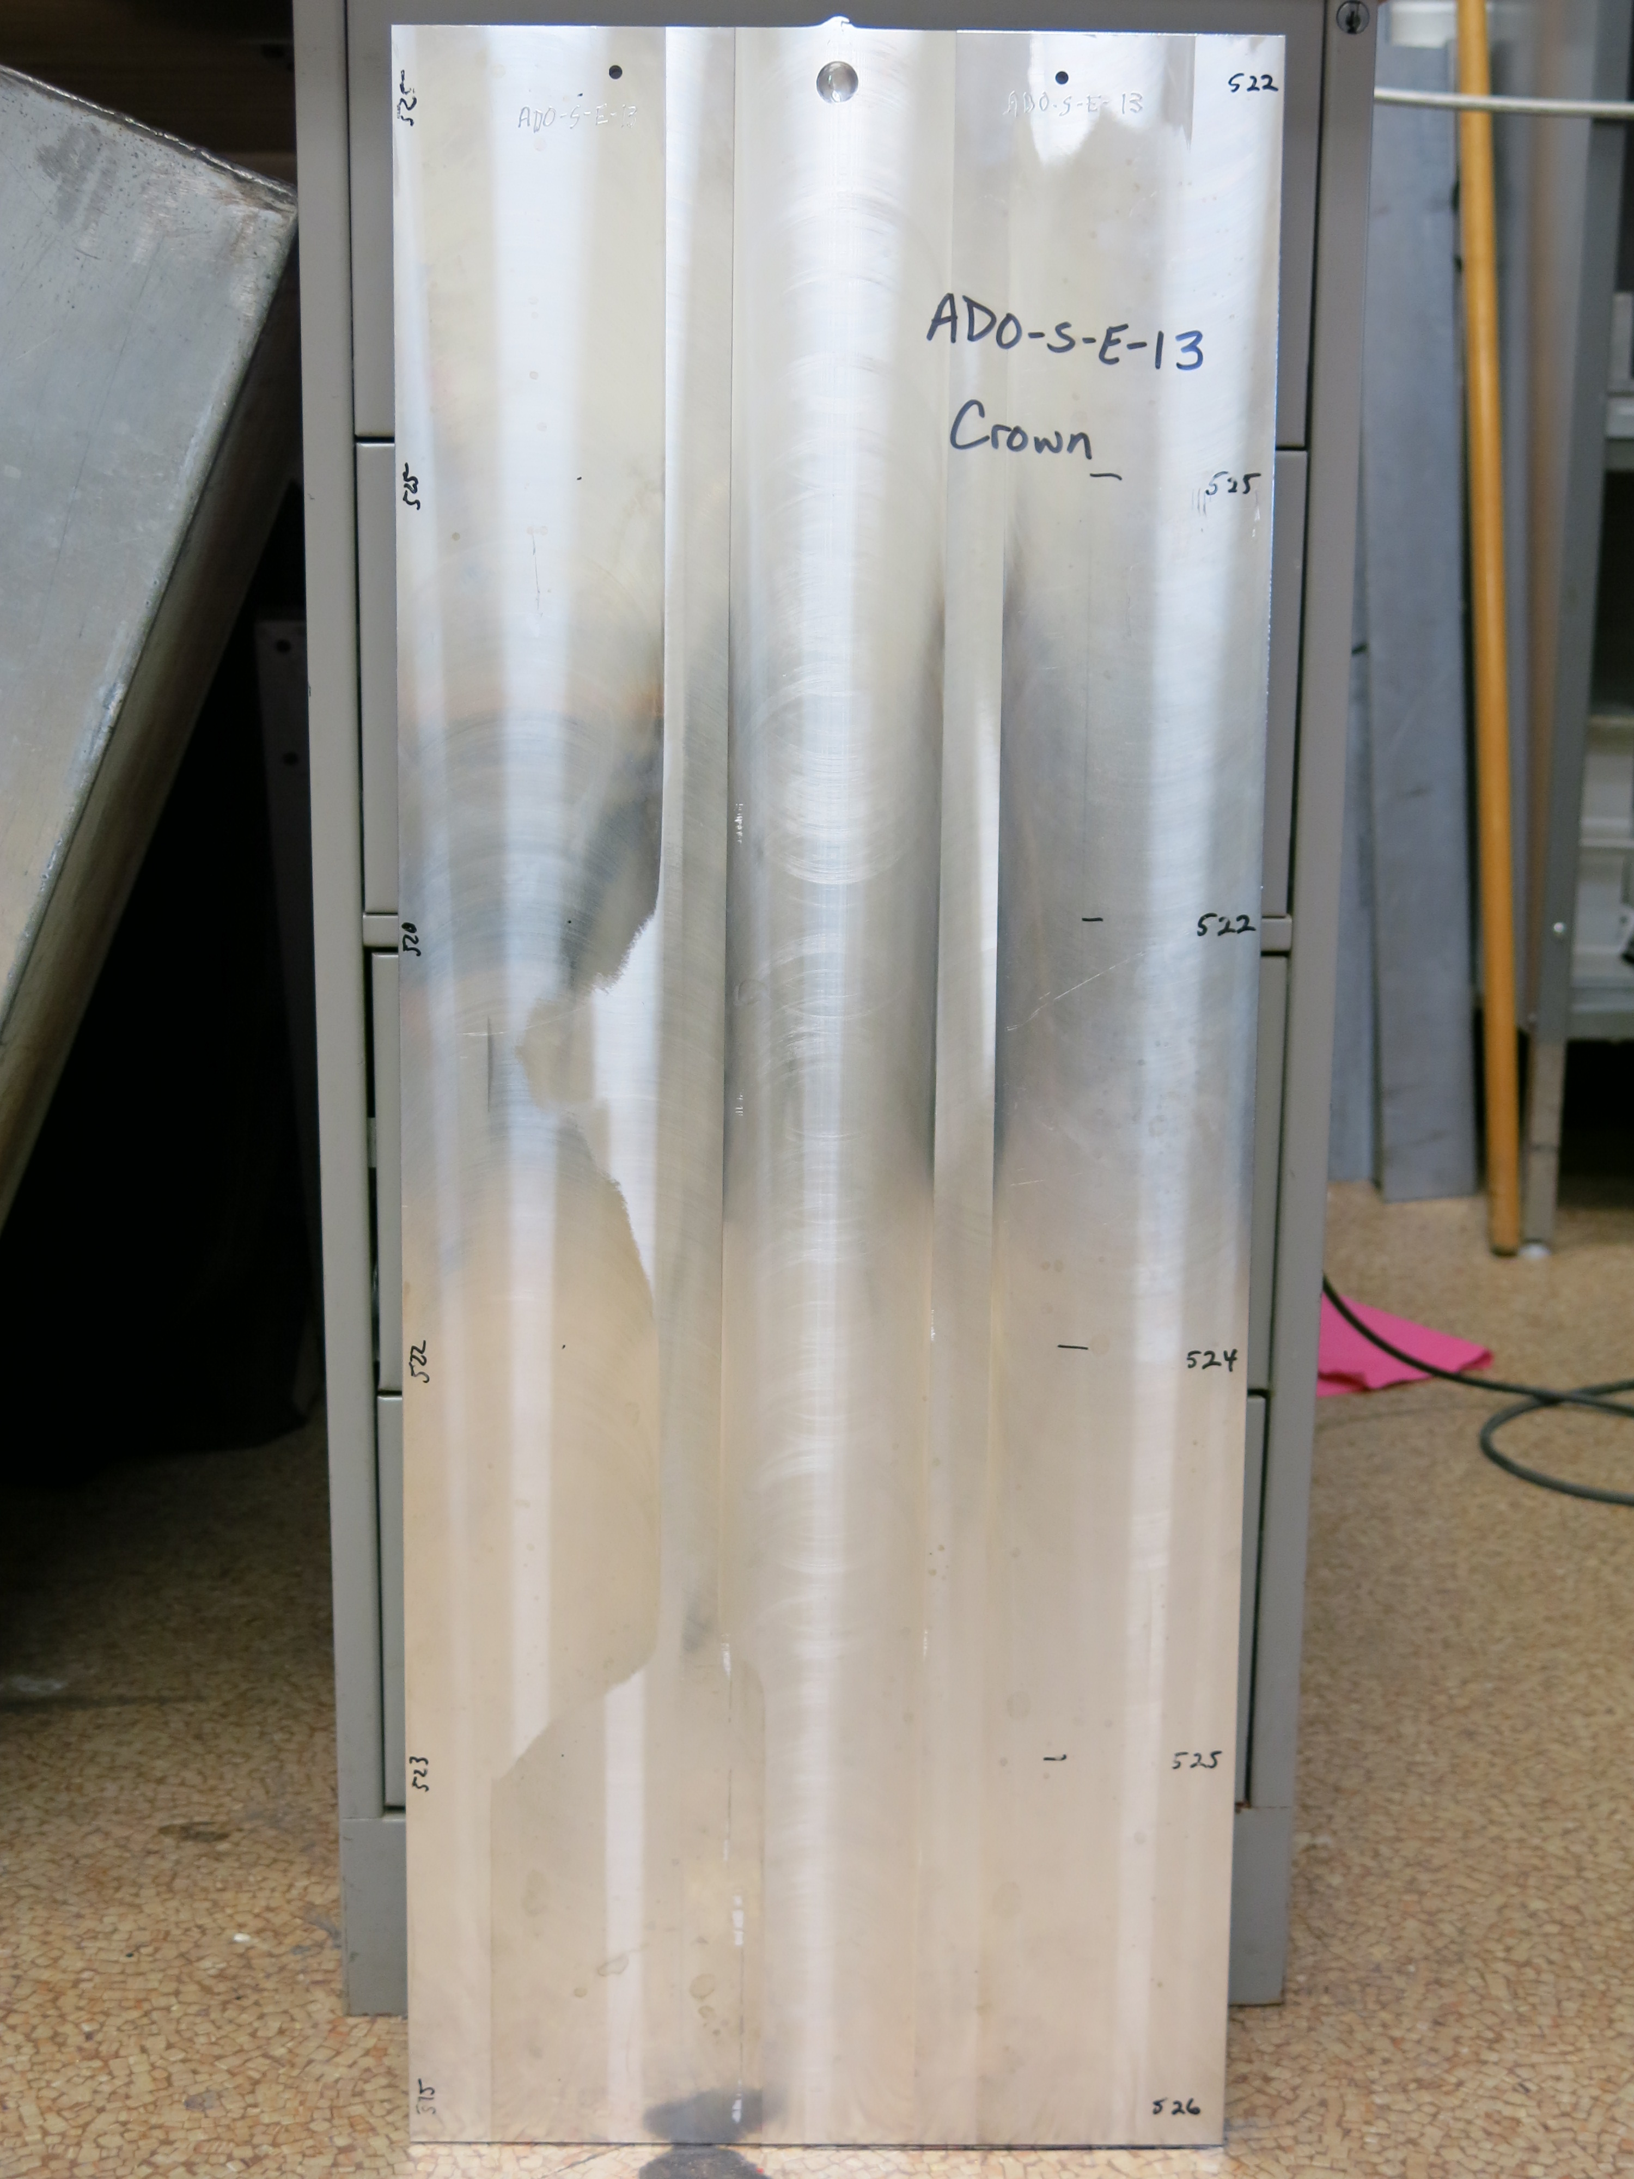
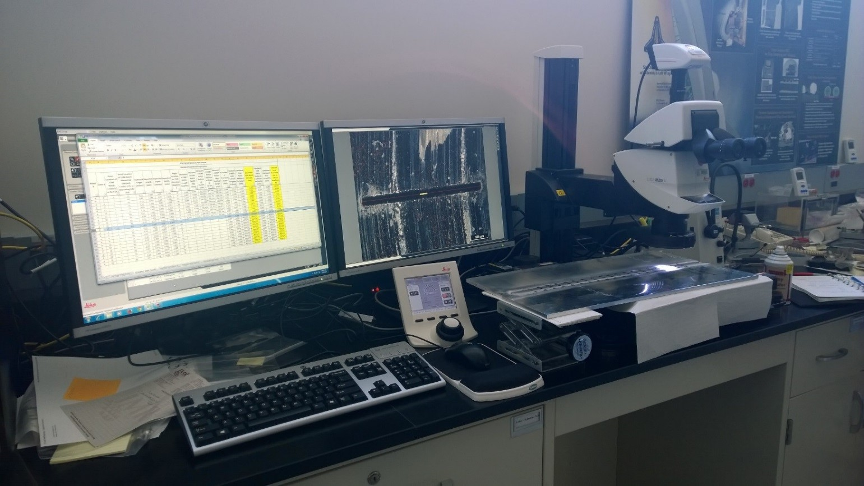
Probability Of Detection (POD) Curve
2
NASA Langley Research Center - Nondestructive Evaluation Sciences Branch

Slide 9
Electric Discharge Machining Notch Geometry
16
NASA Langley Research Center - Nondestructive Evaluation Sciences Branch

Slide 10
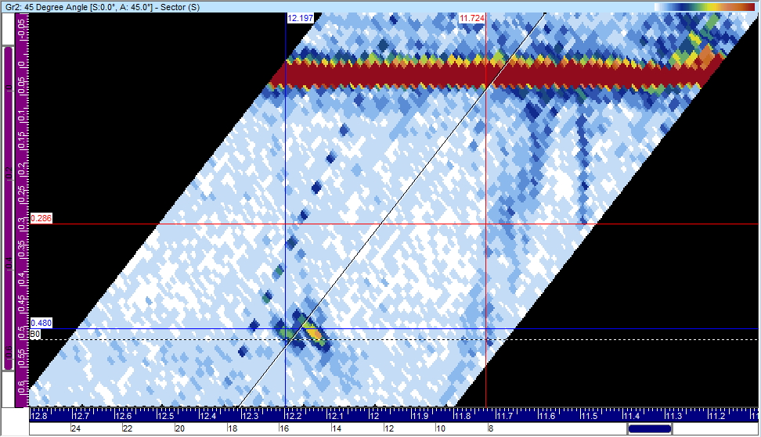
Electric Discharge Machining Notch Geometry
16
NASA Langley Research Center - Nondestructive Evaluation Sciences Branch

Slide 11
Electric Discharge Machining Notch Geometry
16
NASA Langley Research Center - Nondestructive Evaluation Sciences Branch

Slide 12
You can perform the inspection, but don’t know how.
Example: Inspection of high capacity multi layer pressure vessels
NASA Langley Research Center - Nondestructive Evaluation Sciences Branch

Slide 13
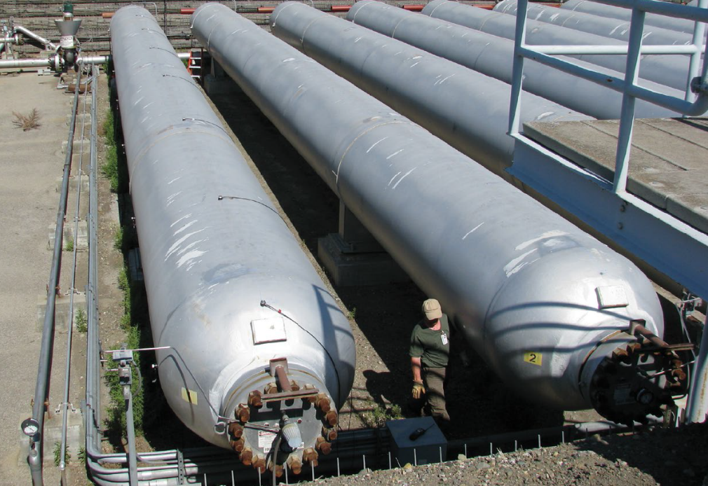
High Capacity Multi Layer Pressure Vessels

Slide 14
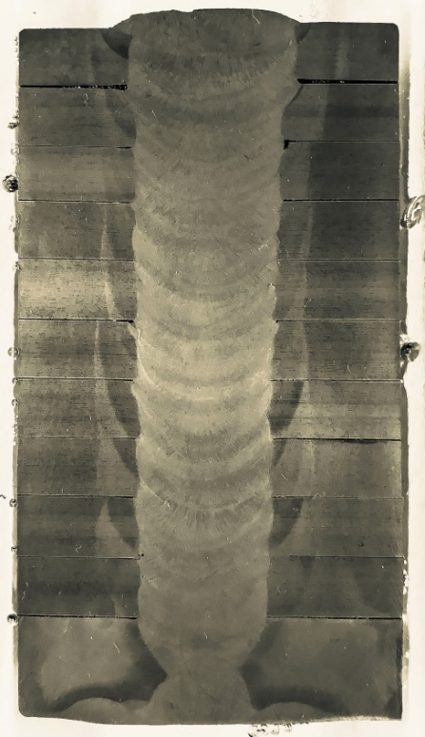
Layered Pressure Vessel
Shell to shell weld cross section
Head to shell weld
Shell to shell weld
Head
Layered Pressure Vessel
NASA Langley Research Center - Nondestructive Evaluation Sciences Branch

Slide 15
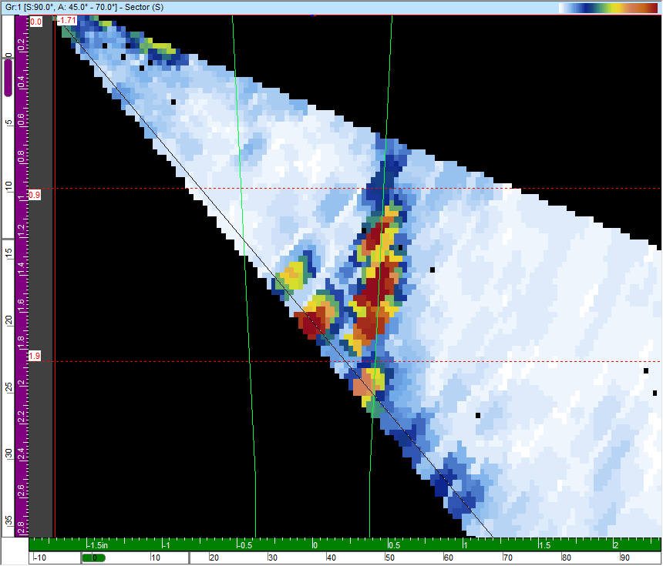
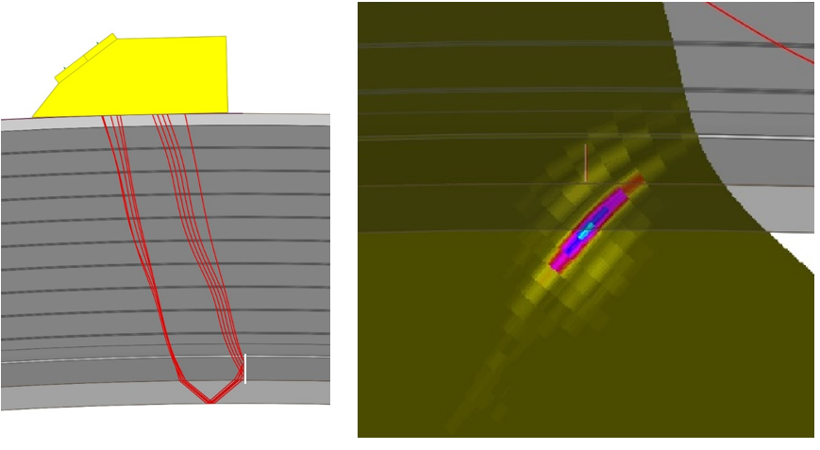
LPV Simulation Results
Simulating PAUT for finding a weld crack in a head to shell weld.
Simulation
Experimental
Validating simulation against experimental results
0°
0 dB
10°
-15.1 dB
20°
-15.5 dB
Branched
+8.9 dB
-10°
-11.3 dB
-20°
-14.7 dB
Simulating finding a weld crack in a shell to shell weld.
Testing effects of crack angle on signal response strength
NASA Langley Research Center - Nondestructive Evaluation Sciences Branch

Slide 16
You can’t physically perform the inspection yet
Example: On orbit inspection of welds on the International Space Station
NASA Langley Research Center - Nondestructive Evaluation Sciences Branch

Slide 17
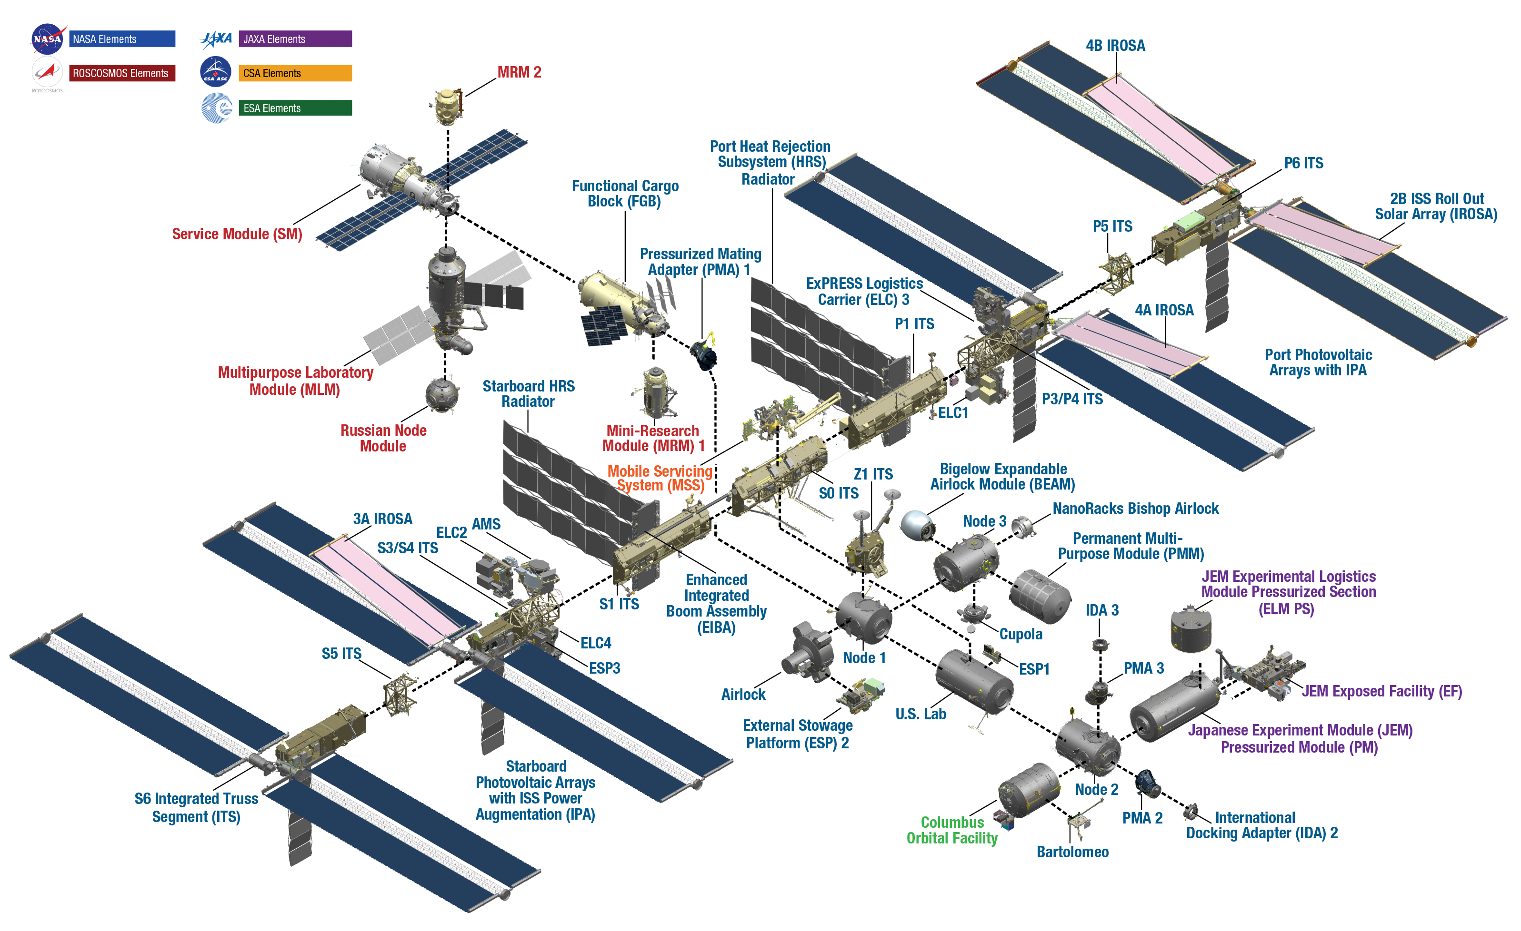
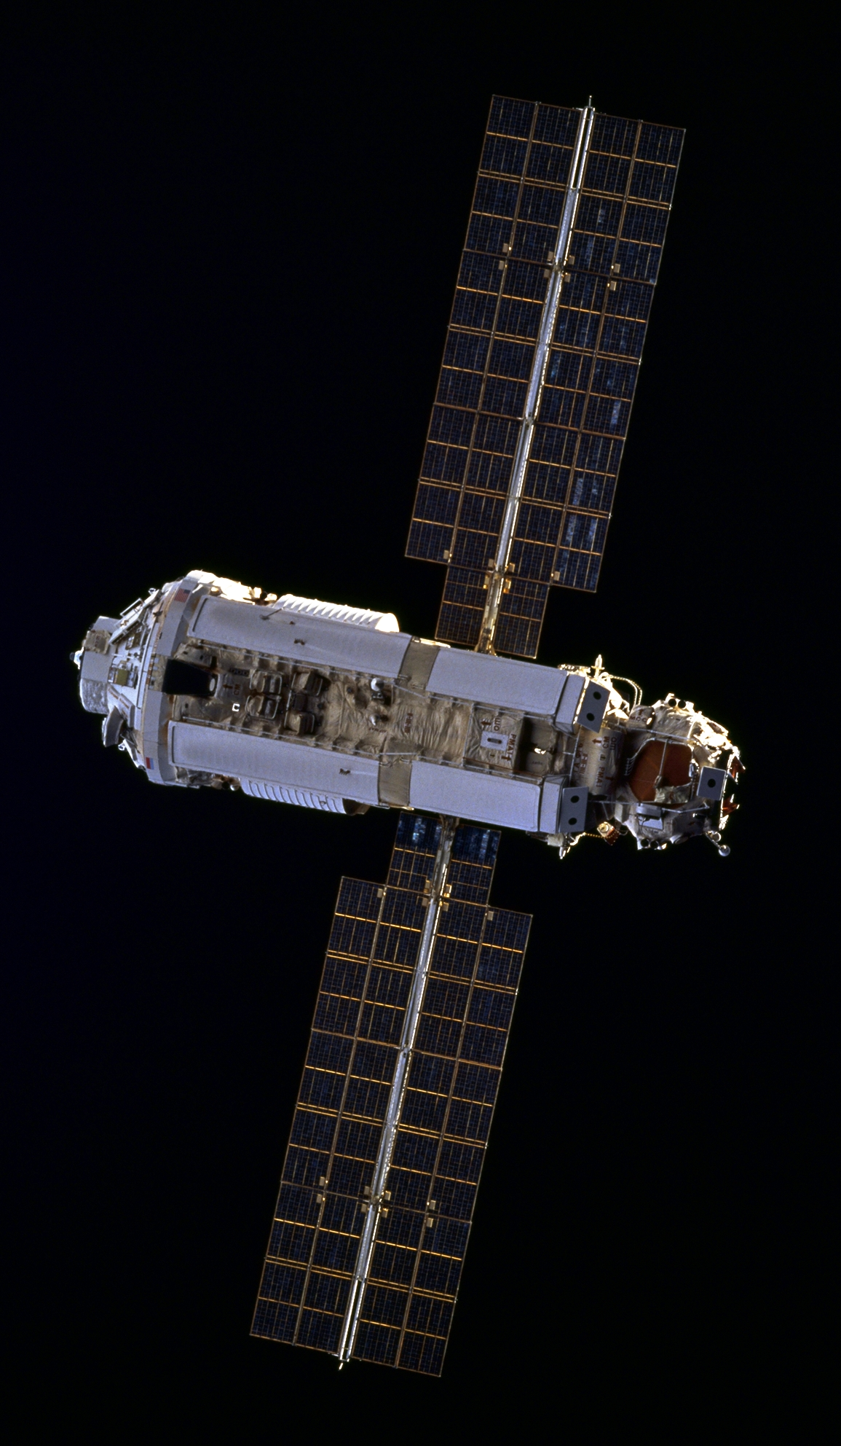
On-Orbit Inspection for the International Space Station
Testing effects of crack angle on signal response strength
NASA Langley Research Center - Nondestructive Evaluation Sciences Branch

Slide 18
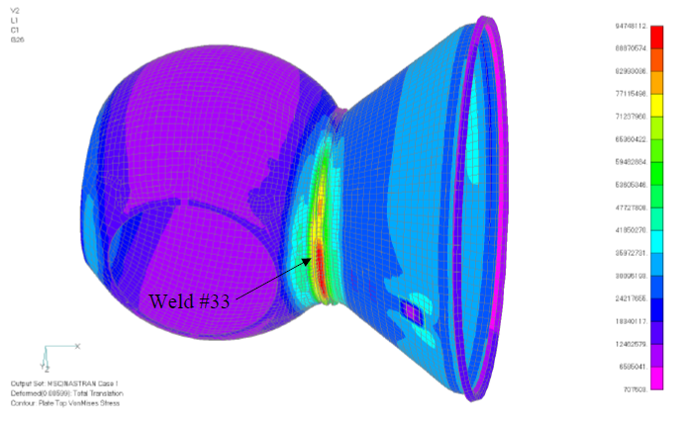
On-Orbit Inspection for the International Space Station
NASA Langley Research Center - Nondestructive Evaluation Sciences Branch

Slide 19
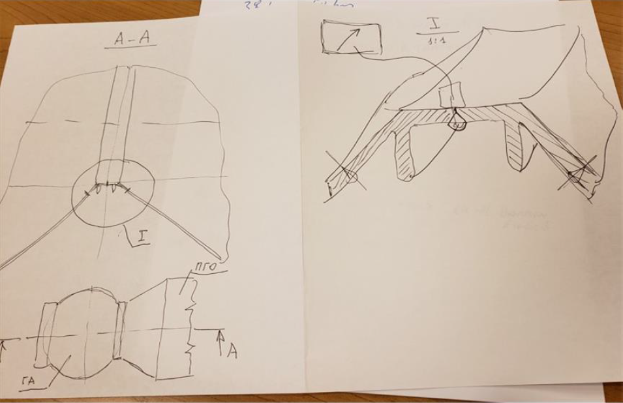
Working with incomplete information
NASA Langley Research Center - Nondestructive Evaluation Sciences Branch

Slide 20
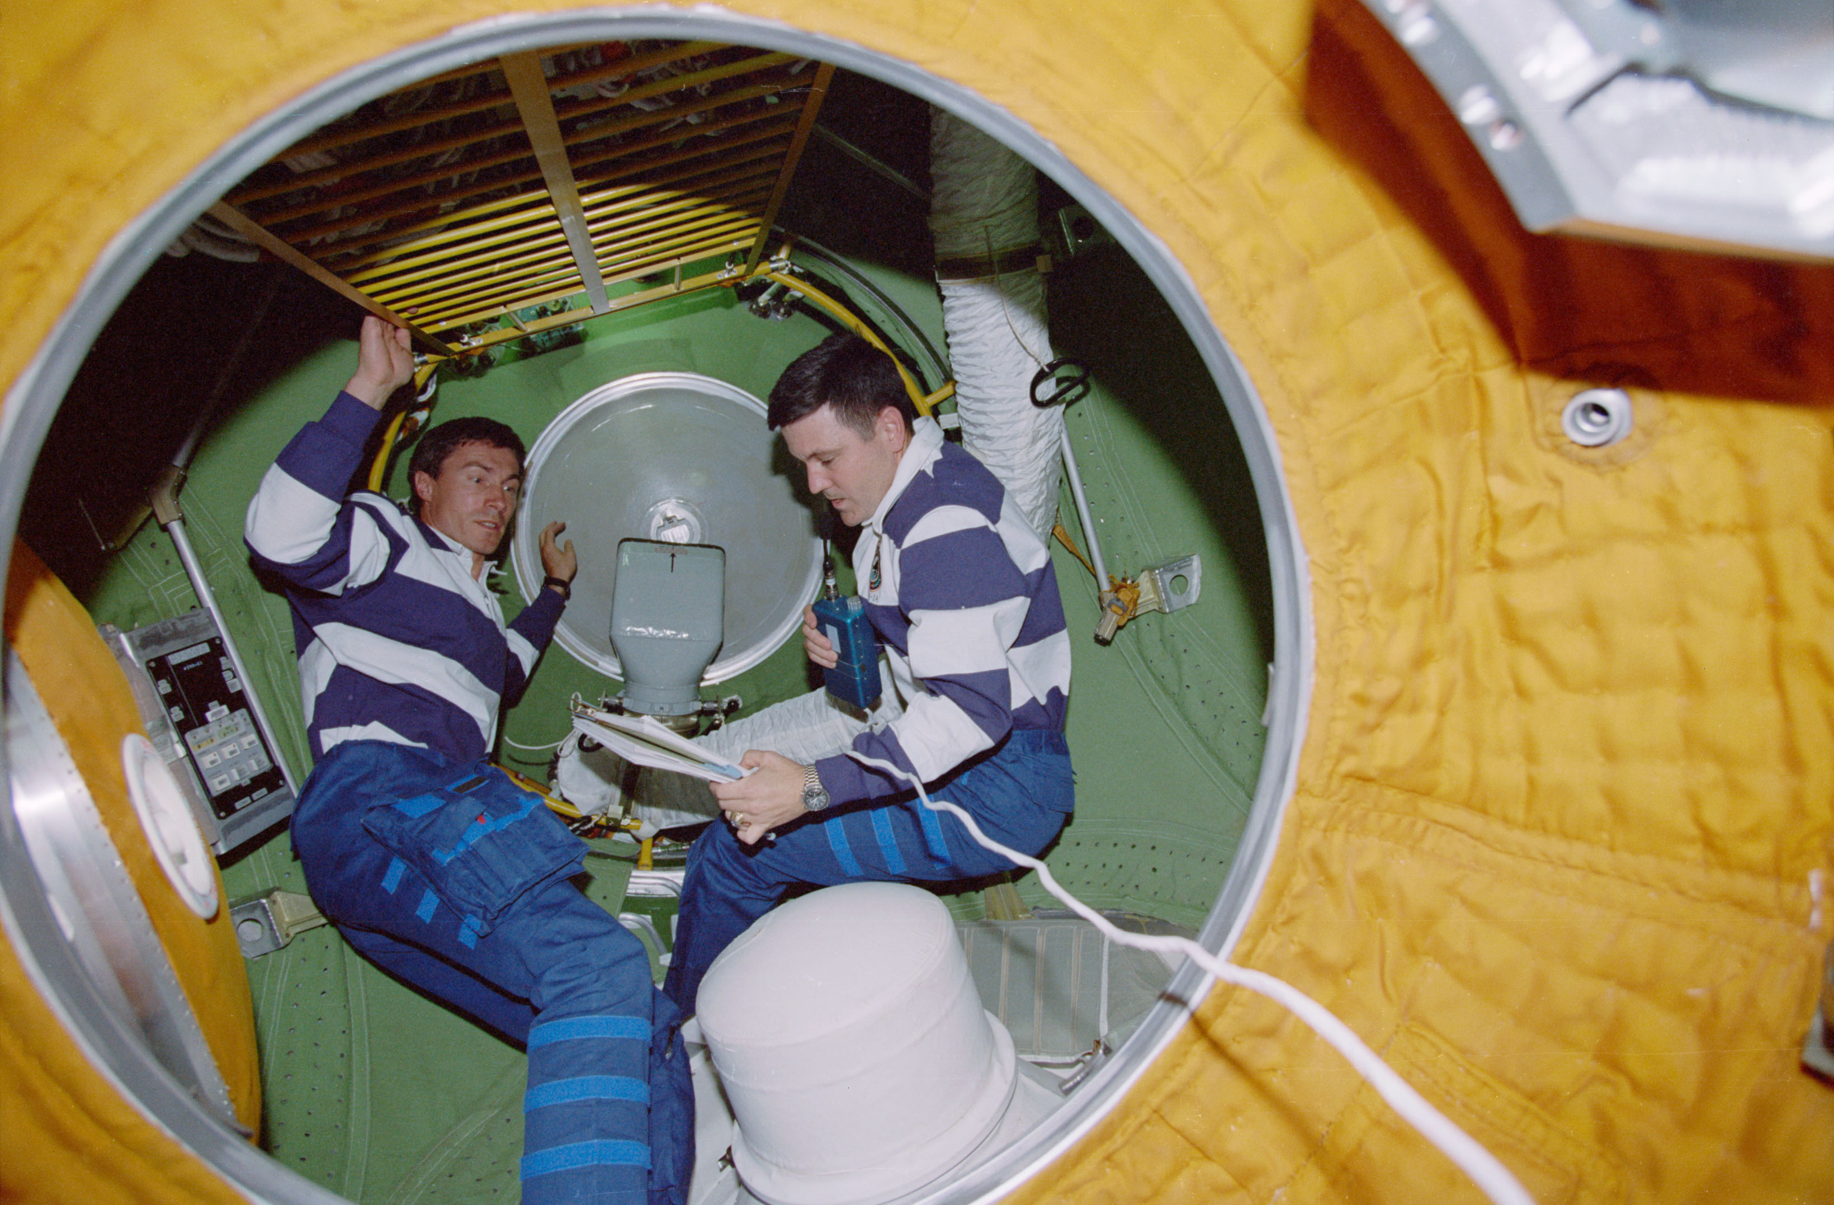
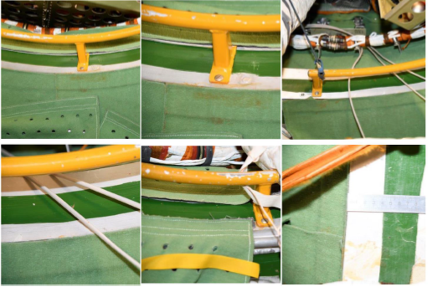
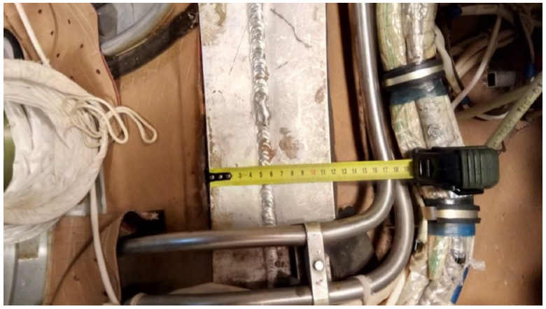
Working with incomplete information
NASA Langley Research Center - Nondestructive Evaluation Sciences Branch

Slide 21
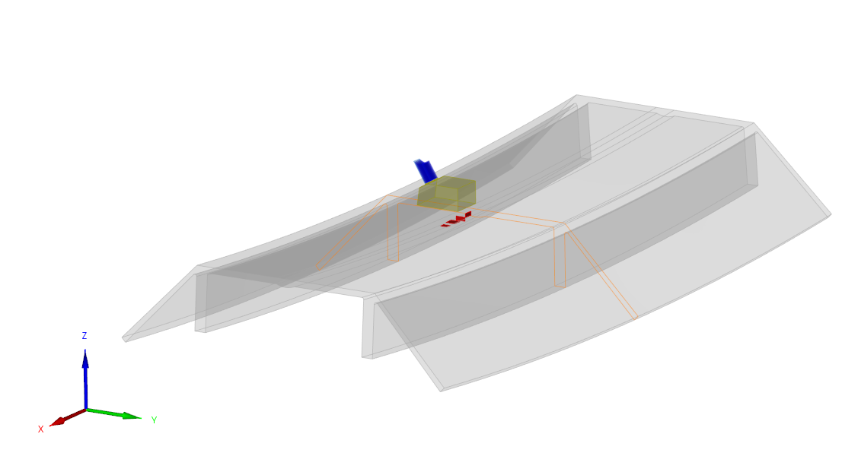
CIVA Model Live Demo
Models used in these demos are not the same as the real structure, just artificial representations. These were generated to demonstrate the concept.
NASA Langley Research Center - Nondestructive Evaluation Sciences Branch

Slide 22
Summary
Numerical simulation of inspection has been the subject of research for several decades. Only relatively recently has the technology matured to the point where we can start using these tools to integrate into and solve real world problems, we just need to figure out the best way how.
Simulations offer several new and expanded capabilities, including:
Reduce time by finding the optimal equipment configuration, instead of trial and error
Produce estimated results to help prepare procedures and show inspectors what they can expect in the field
Help plan for eventualities that would normally cause delays
Help process the data by matching inspection results to simulated defects (inverse problem)
Things that we need to work on to further mature the application NDE simulations
Optimize integration into existing workflows
Focus and filter strategy for result delivery, making cross-discipline communication more efficient
Rapid and efficient verification/validation (V&V) strategies, and identifying what we can do prior to V&V
NASA Langley Research Center - Nondestructive Evaluation Sciences Branch

