Slide 1
DATAWorks 2024: Meta-Analysis of the Effectiveness of the SALIANT Procedure for Assessing Team Situation Awareness
Sarah A. Shaffer
Miriam E. Armstrong
March 2024

Slide 2
Purpose and scope of the current study
Many Department of Defense (DoD) systems aim to increase or maintain Situation Awareness (SA)
SA frequently goes unmeasured or is measured sub-optimally
There are many methods for measuring SA!
Situational Awareness Linked Indicators Adapted to Novel Tasks (SALIANT)
Notes:
Many Department of Defense (DoD) systems aim to increase or maintain Situational Awareness (SA) at the individual or group level. In some cases, maintenance or enhancement of SA is listed as a primary function or requirement of the system. However, during test and evaluation SA frequently goes unmeasured or is measured sub-optimally. The aim of the current work is to conduct a meta-analysis of an existing scientific SA metric designed to measure team SA: the Situational Awareness Linked Indicators Adapted to Novel Tasks (SALIANT). The meta-analysis assesses when and how SALIANT can serve as a reliable indicator of performance at testing. Additional applications of SALIANT in non-traditional operational testing domains (e.g., software and big data platforms) will also be discussed.

Slide 3
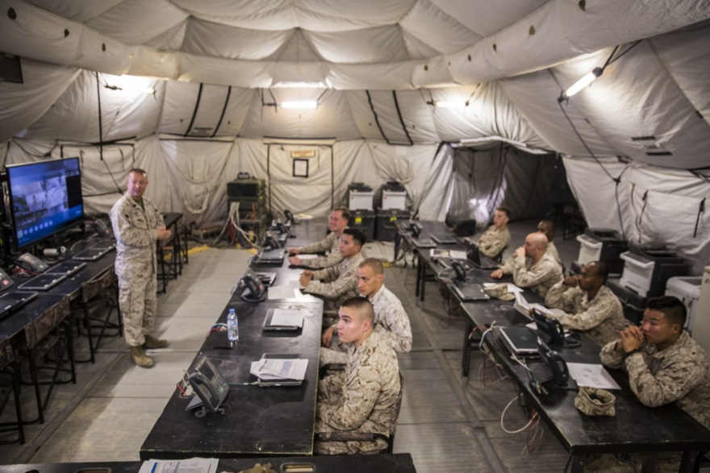
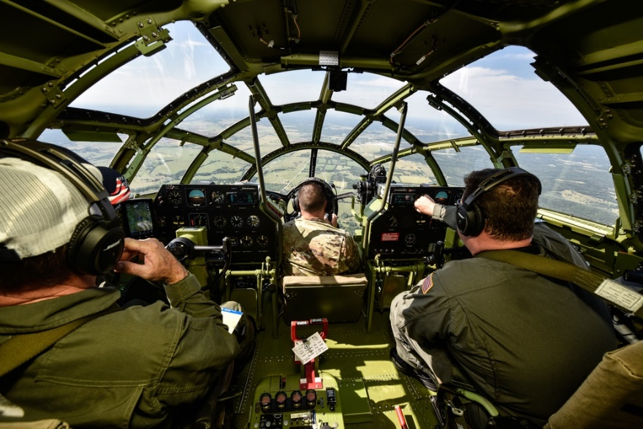
Team SA is critical for many DoD missions
Command and Control
Air Missions
Cyber Operations
All images sourced from Defense Visual Information Distribution Service (DVIDS). The appearance of U.S. Department of Defense (DoD) visual information does not imply or constitute DoD endorsement.
https://www.dvidshub.net/image/4807193/spotlight-djc2-expeditionary-c2-solution
https://www.dvidshub.net/image/5526682/cockpit-b-29
https://www.dvidshub.net/image/7758911/cyber-operations
Notes:
DVIDS links:
https://www.dvidshub.net/image/4807193/spotlight-djc2-expeditionary-c2-solution
https://www.dvidshub.net/image/5526682/cockpit-b-29
https://www.dvidshub.net/image/7758911/cyber-operations

Slide 4
What is Situation Awareness?
SITUATION AWARENESS
Perception Of data and elements of the environment
Level 1
Comprehension Of the meaning and significance of the situation
Level 2
Projection Of future states and events
Level 3

Slide 5
What does Situation Awareness involve?
Task & Environment Factors
Workload
Automation
System Design
Complexity
Feedback
SITUATION AWARENESS
Perception Of data and elements of the environment
Level 1
Comprehension Of the meaning and significance of the situation
Level 2
Projection Of future states and events
Level 3
Decision
Action
Environment State
Operator Factors
Goals
Preconceptions
Knowledge
Experience
Training
Ability

Slide 6
Team-level Situation Awareness
Team SA is a product of both:
Individual SA
Interactions between team members
SA – Situation/al Awareness
Notes:
In picture: ground truth of some situation and a three-person team.
The SA of the team depends upon both the SA of the individual team members and the interactions between the team members.
In this example, each individual has an incomplete understanding of ground truth and thus low SA. But by working together, the team as a whole has perfect SA.

Slide 7
Why should we try to measure team Situation Awareness?
It is important to measure team SA during testing because SA cannot be inferred from overall mission performance or individual SA
It is impossible to accurately assess the true performance of a system without distinguishing usability and system functionality from SA effects
Understanding impacts to SA can help improve system performance and mission outcomes
SA – Situation/al Awareness

Slide 8
How is Situation Awareness measured?
Survey | Behavioral | Query
C-SA (Cranfield Situation Awareness Scale) | Accuracy/Reaction Time | SAGAT (Situation Awareness Global Assessment Technique)
MARS (Mission Awareness Rating Scale) | Eye Movement | SPAM (Situation Present Assessment Method)
SABARS (Situation Awareness Behaviorally Anchored Rating Scale) | Imaging (e.g., Electroencephalography)
SART (Situation Awareness Rating Technique) | SALIANT (Situation Awareness Linked Indicators Adapted to Novel Tasks)

Slide 9
NAVAIR researchers developed the Situation Awareness Linked Indicators Adapted to Novel Tasks (SALIANT) technique to measure team SA
Identify specific, observable behaviors that indicate team SA
Develop a simulated event that requires team coordination
Observers record whether team demonstrated SA
NAVAIR – Naval Air System Command; SA – Situation/al Awareness

Slide 10
SALIANT indicator dimensions
Spatial Awareness
Trends
Changes
Abnormalities
Problem Recognition
Report
Locate source
Understand problem consequences
Understand action consequences
Anticipate Need for Action
Inform team of actions
Monitor actions (self & team)
Communicate important information
Knowledge of tasks
Effectively allocate time & attention
Monitor & share workload (self & team)
Answer questions quickly
Information awareness
Challenge dubious information
Re-check old information
SALIANT – Situation Awareness Linked Indicators Adapted to Novel Tasks

Slide 11
SALIANT: Problem recognition
Lost radio contact
Report
Need to re-establish contact
Understand problem consequences
Unexpected weather
Locate problem source
Suggest higher altitude
Inform of intent to move to higher altitude
Report
Move to higher altitude
Report updated position status
SALIANT – Situation Awareness Linked Indicators Adapted to Novel Tasks

Slide 12
Should testers use SALIANT?
SALIANT was developed over 25 years ago
Does the literature indicate that this is a good measure to use (in OT)?
OT – Operational Test; SALIANT – Situation Awareness Linked Indicators Adapted to Novel Tasks
Notes:
SAGAT, SPAM, SABARS are empirically validated/meta-analyzed

Slide 13
We conducted a meta-analysis to investigate the merits of the SALIANT procedure
Is SALIANT reliable?
Does SALIANT exhibit strong psychometric properties like internal consistency?
Is SALIANT sensitive?
Are SALIANT scores affected by factors hypothesized to affect SA (e.g., operator training)?
Is SALIANT consistent with other SA measures?
Are SALIANT scores correlated to SA measures derived from other procedures?
SA – Situation/al Awareness; SALIANT – Situation Awareness Linked Indicators Adapted to Novel Tasks
Notes:
Last is an exploratory measure b/c:
Other SA measures, esp. survey measures, likely measure confidence rather than true SA
We would not expect individual measures to be perfectly correlated with team measures

Slide 14
Methods

Slide 15
We conducted a meta-analysis to aggregate previous SALIANT findings
Synthesis and Interpretation
Study Selection
Data Extraction
Data Processing
SALIANT – Situation Awareness Linked Indicators Adapted to Novel Tasks

Slide 16
Our sample was studies that measured team SA using SALIANT
Searched:
Databases using terms “SALIANT,” “experiment,” and “measurement”
Papers citing originating SALIANT articles
Papers cited by an already included paper
Included:
Published journal articles, conference proceedings, technical reports, dissertations
Used SALIANT to measure team SA
Reported relevant statistics
SA – Situation/al Awareness; SALIANT – Situation Awareness Linked Indicators Adapted to Novel Tasks

Slide 17
We extracted study results relevant to SALIANT’s reliability, sensitivity, and consistency with other SA measures
Is SALIANT reliable?
Cronbach’s alpha (internal reliability measure)
Is SALIANT sensitive?
Effect sizes of operator or environmental factors
Is SALIANT consistent with other SA measures?
Correlation between SALIANT and other SA measures
SA – Situation/al Awareness; SALIANT – Situation Awareness Linked Indicators Adapted to Novel Tasks
Notes:
Mention:
- Not all included studies had results relevant to each question
- Some studies had multiple results relevant to each research question

Slide 18
We cleaned messy data
Some studies conducted multiple tests relevant to our research questions
E.g., investigated effect of multiple types of operator experience on SALIANT
Averaged related results to obtain up to one statistic per study
SALIANT – Situation Awareness Linked Indicators Adapted to Novel Tasks

Slide 19
We aggregated results of individual studies to find a meta-analytic average
Random effects model
Assumes variance both within and between individual studies
Appropriate when there is heterogeneity among included studies
Results and variance of individual studies
Meta-analytic average

Slide 20
Results

Slide 21
Fewer studies than expected met our inclusion criteria
Six studies measured SA using SALIANT and reported results
Due to low number of studies, we have low statistical confidence in our findings
Study | Internal reliability | Effects of factors | Correlation with other SA measures
Bowers et al. (1998) | - | - | r = .007
Cuevas et al. (2015) | - | r = .366 | -
Fink (2000) | α = .97 | - | r = -.004
Milham (2005) | - | r = .110 | -
Milham et al. (2000) | - | - | r = .720
Muniz, Bowers, et al. (1998) | - | - | r = .740
Number of studies in meta-analysis | NA | 2 | 4
SA – Situation/al Awareness; SALIANT – Situation Awareness Linked Indicators Adapted to Novel Tasks
Notes:
We found and coded six studies that met our inclusion criteria, namely published articles that measured team SA using SALIANT and reported the results.
(We found additional studies that used SALIANT to measure team SA but that did not include the results. Theses were not appropriate for use in the meta-analysis but may be otherwise useful. We’ll talk more about those studies when we discuss future directions.)
Each study provided information about one or two of the research questions we were interested in. For example, the 1998 article authored by Bowers and colleagues reported enough information for us to calculate the average correlation between SALIANT and other SA measures, but the study did not analyze SALIANT’s internal reliability or the effect that operator or external factors had on SA. Therefore, even though we coded six studies, none of the meta-analytic tests we ran contained more than 4 studies.
For one of our research questions, we did not have sufficient data to run a meta-analytic test at all. Only one study reported the internal reliability of the SALIANT technique. Fink’s 2000 dissertation reported a Cronbach's alpha of .97 which is very high. This one result provides only anecdotal evidence for SALIANT’s internal reliability as it is not clear that SALIANT maintains internal consistency outside of this one study.
We did have sufficient data to run a meta-analytic tests to investigate whether SALIANT was sensitive to factors that influence SA and whether SALIANT agrees with other SA measures. However, the number of studies in each of these tests are small (2 and 4, respectively). As a result, from a statistical standpoint we have low confidence in the results.

Slide 22
No evidence that SALIANT is sensitive to factors that affect SA
Two studies investigated effects of factors likely to affect SA
Cuevas et al. (2015): operator experience
Milham (2005): display design
Meta-analytic findings non-significant
r = .152, 95% CI [-0.063, 0.354]
Difficult to draw conclusions because of small number of studies, heterogeneity between studies
At present, no compelling evidence that SALIANT is sensitive to factors that impact SA
CI – Confidence Interval; SA – Situation/al Awareness; SALIANT – Situation Awareness Linked Indicators Adapted to Novel Tasks
Notes:
The first meta-analytic test investigated whether SALIANT was sensitive enough to pick up on factors that we expect will influence SA. Ultimately, we did not find compelling evidence that it does.

Slide 23
No evidence that SALIANT is consistent with other SA measures
Four studies compared results from SALIANT to other measures of SA
Bowers et al. (1998): query measure
Fink (2000): query and survey measures
Milham et al. (2000): survey measure
Muniz et al. (1998): behavioral measure
Meta-analytic findings non-significant
r = 0.399, 95% CI [-0.101, 0.738]
Difficult to draw conclusions because of small number of studies, heterogeneity between studies
No compelling evidence that SALIANT correlates with other SA measures
CI – Confidence Interval; SA – Situation/al Awareness; SALIANT – Situation Awareness Linked Indicators Adapted to Novel Tasks

Slide 24
Conclusions

Slide 25
At present, we have anecdotal, but no statistical, evidence for the use of SALIANT
Is SALIANT reliable?
Not tested (only one study reported relevant results)
Is SALIANT sensitive?
No evidence for this
Small number of studies (2) prevents definitive conclusion
Is SALIANT consistent with other SA measures?
No evidence for this
Small number of studies (4) prevents definitive conclusion
SA – Situation/al Awareness; SALIANT – Situation Awareness Linked Indicators Adapted to Novel Tasks

Slide 26
Do we recommend SALIANT?
Source: Khosrork Creatas Video+ / Getty Images Plus via Getty Images
SALIANT – Situation Awareness Linked Indicators Adapted to Novel Tasks
Notes:
Video: Khosrork Creatas Video+ / Getty Images Plus via Getty Images (Creative #:
1257532165, https://www.gettyimages.com/detail/video/dont-know-what-to-say-confused-unsure-girl-afro-stock-footage/1257532165?adppopup=true)

Slide 27
We may gain more insight using methods other than meta-analysis
Multiple studies used SALIANT but did not report results
Reasons why are a qualitative finding (e.g., low agreement between observers, difficult for observers to multitask)
Short-term future directions:
Systematic qualitative review
Alternative quantitative aggregation methods (e.g., vote counting)
Potential long-term direction:
Investigate additional measures of team SA
SA – Situation/al Awareness; SALIANT – Situation Awareness Linked Indicators Adapted to Novel Tasks

Slide 28
Bottom line: we’re continuing to investigate the best ways to measure team SA
Sarah Shaffer
sshaffer@ida.org
Miriam Armstrong
marmstro@ida.org
SA – Situation/al Awareness
Image sourced from Defense Visual Information Distribution Service (DVIDS). The appearance of U.S. Department of Defense (DoD) visual information does not imply or constitute DoD endorsement. https://www.dvidshub.net/image/7758911/cyber-operations

Slide 29
Works Cited
Bowers, C. A., Weaver, J., Barnett, J., & Stout, R. (1998). Empirical validation of the SALIANT methodology. Proceedings of the First Human Factors & Medicine Panel Symposium on Collaborative Crew Performance in Complex Operational Systems. 12-1–12-6.
Muniz, E., Bowers, C. A., Stout, R. J., & Salas, E. (1998). The validation of a team situational measure. Proceedings of the 3rd Annual Symposium and Exhibition on Situational Awareness in the Tactical Environment, 62, 183–190.
Muniz, E., Stout, R., Bowers, C., & Salas, E. (1998). A methodology for measuring team situational awareness: situational awareness linked indicators adapted to novel tasks (SALIANT). NATO human factors and medicine panel on collaborative crew performance in complex systems, Edinburgh, North Atlantic Treaties Organisation, Neuilly-sur-Seine, 20–24.
Rosenthal, R. (1995). Writing meta-analytic reviews. Psychological Bulletin, 118(2), 183–192.
Steinberg, Alan. (2008). Foundations of situation and threat Assessment. Handbook of multisensory data fusion, 457–522.

Slide 30
Flowchart for considerations when selecting SA measurement methods
Systems expected to impact SA?
Is the system designed to enhance SA?
YES
YES
NO
NO
SA measures most likely not needed.
Measure SA.
Portfolio of indirect measures are likely appropriate to ensure SA is not degraded.
Measure SA.
High-quality, direct measures (query-based) necessary to demonstrate improved SA.
e.g., body armor; munitions (with no user interface)
e.g., vehicle with minimal changes to systems that are not designed to affect SA
e.g., mission command systems, NVGs, system updates that are designed to enhance to SA
NVG – Night Vision Goggles; SA – Situation/al Awareness
Notes:
The type of SA measurement you choose should depend on whether the system under test is expected or designed to affect SA.
Indirect indicators like SALIANT are appropriate for measures that may impact SA but aren’t designed to promote SA. Indirect indicators alone are not enough to assess systems designed to promote SA.

Slide 31
We conducted a meta-analysis to investigate the merits of the SALIANT procedure
Question 1: Does SALIANT exhibit good psychometric properties?
Hypothesis 1.a: SALIANT demonstrates good internal reliability
Hypothesis 1.b: SALIANT demonstrates good inter- and intra- rater reliability.
Question 2: Is SALIANT sensitive to operator and environmental factors?
Hypothesis 2.a: SALIANT is sensitive to operator factors that influence SA (e.g., experience, operator ability, operator goals, training)
Hypothesis 2.b: SALIANT is sensitive to environmental factors that influence SA (e.g., automation, system design, task complexity, workload)
Question 3: Is SALIANT consistent with other SA measures?
Exploratory analysis; no hypotheses made
SA – Situation/al Awareness; SALIANT – Situation Awareness Linked Indicators Adapted to Novel Tasks

