Slide 1
Adaptive Sequential Experimental Design for Strategic Reentry Simulated Environment
DATAWorks 2024
Kelly Koser Sarah Brummond
Senior Statistician Mathematician
kelly.koser@jhuapl.edu sarah.brummond@jhuapl.edu
JHU/APL Proprietary

Slide 2
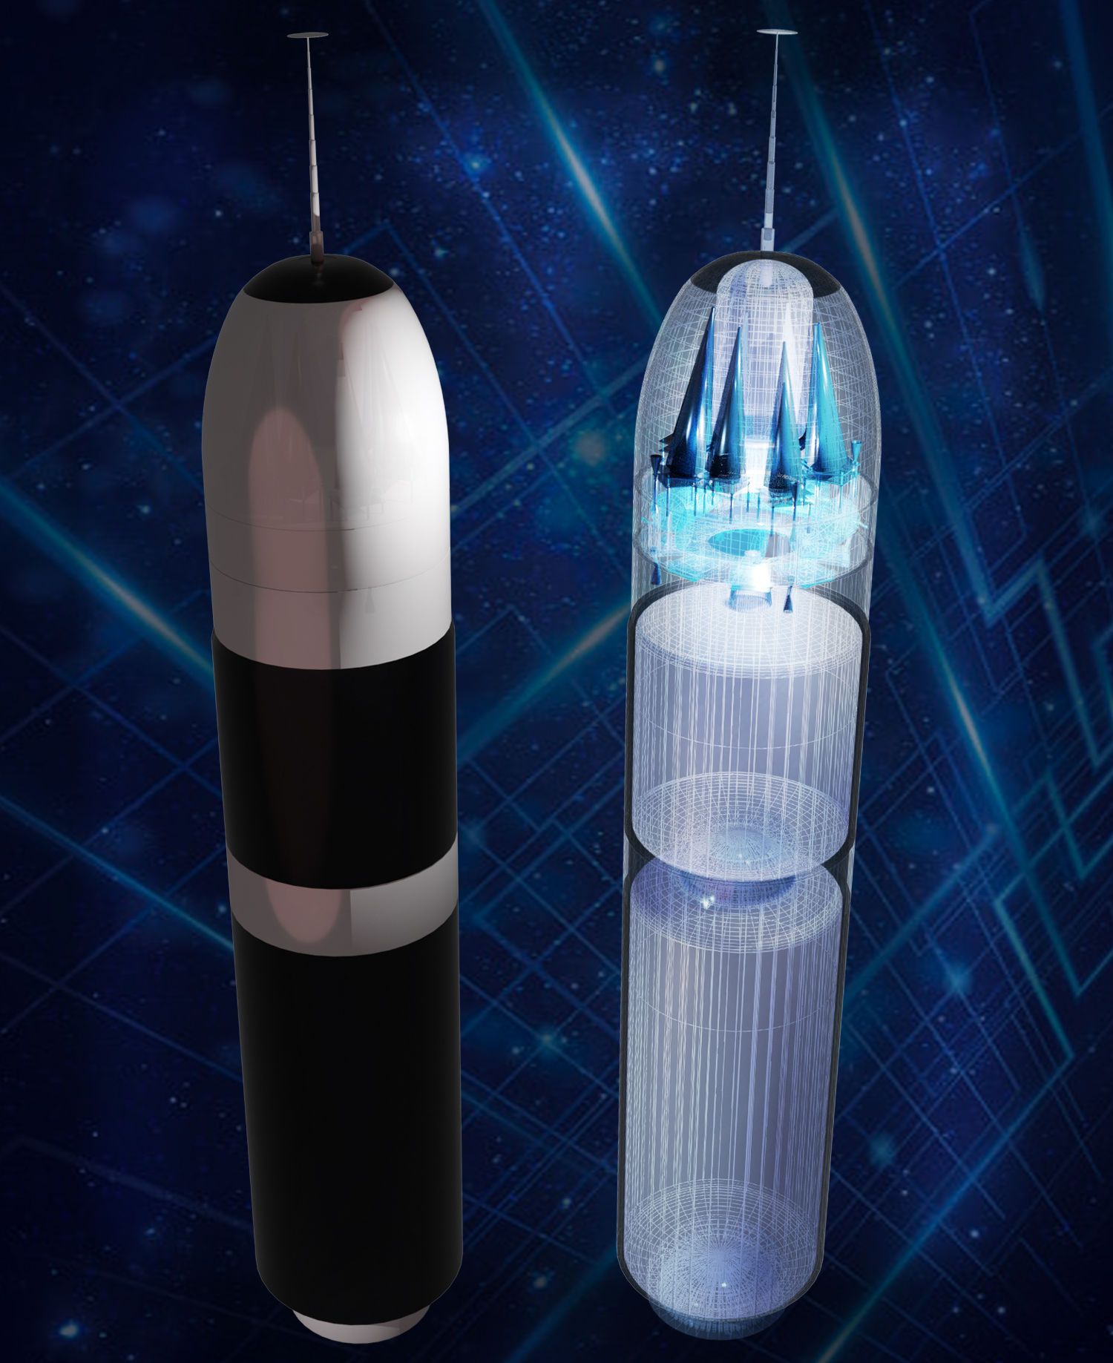
Background and Motivation
Background:
Johns Hopkins University Applied Physics Laboratory (JHU/APL) set mission to develop and demonstrate a digital simulation environment that enables the generation and evaluation of survivable nuclear reentry systems composed of current and emerging technologies in relevant threat environments
Identified need for experimental design techniques to efficiently select and simulate reentry system trajectories
Statistical model outputs necessary to assess impact of reentry and trajectory conditions on weapon system performance
Ideal scenario would integrate engineering, simulation, and analysis tools into one digital environment for rapid design and evaluation of reentry systems
Project Goal: Develop repeatable process for designing and assessing missile trajectory parameter trade space

Slide 3
Sampling and Metamodel Process
No
Meet stopping criteria?
Identify operational space
Develop experimental design
Run trajectory simulations
Construct and evaluate metamodel
Finalize metamodel
Yes
Project Goal: Develop repeatable process for designing and assessing missile trajectory parameter trade space

Slide 4
Initial Experimental Design Approach
CONSIDERATIONS
APPROACH
Weapon system engineers provided initial list of reentry system trajectory parameters to inform simulations related to:
Reentry conditions (4 - continuous variables)
Trajectory waypoints (4 – combination of continuous and discrete variables)
Maneuver Conditions (3 – combination of continuous and categorical variables)
Engineers requested constraints (i.e. disallowed regions) on the combination of some parameters
Example: Waypoint 2 altitude < Waypoint 1 altitude
Implement space-filling design ^{[1]} that spreads the design points out nearly evenly or uniformly throughout the region of experimentation
Specifically create and execute a fast flexible filling design that combines both a screening design and a fast flexible filing space-filling design
Experimental Design Method | PROS | CONS
Fast Flexible Filling (FFF) | Allows for categorical variables Can incorporate disallowed regions during design creation While not equally spaced, spacing of design points is based on cluster centroids which creates good spacing | Design points may not provide equally spaced design coverage Only available in JMP software with linear constraints

Slide 5
Gaussian Process Regression Modeling
Examples with Simulated Data
Constructed metamodel using Gaussian Process Regression (GPR) Modeling approach ^{[2]} based on design points selected from FFF design to evaluate Miss Distance
Gaussian Process Regression Modeling is frequently used for deterministic computer experiments
Model that can be solved analytically while still being able to model relatively complex systems
Provides a way of characterizing functions (e.g. $y=f\left(x\right)+ε$) that does not require committing to a specific function (non-parametric model)
Enables assessment of the impact of reentry trajectory parameters on the miss distance between the reentry vehicle and a defensive system
The strategic selection of additional data points and simulations allows for the continued refinement of the Gaussian Process Model

Slide 6
Adaptive Sequential Experimental Designs
Adaptive sequential experimental designs use the responses already observed to determine how best to augment an existing design in order to achieve some objective^{[3]}
New design points are selected in regions where the model gradient is expected to be large or where there is large uncertainty in the model results
Maximum value-weighted squared error (MaxVSE) criterion
Demonstration^{[4]}:

Slide 7
Adaptive Sequential Experimental Designs
Adaptive sequential experimental designs use the responses already observed to determine how best to augment an existing design in order to achieve some objective ^{[3]}
New design points are selected in regions where the model gradient is expected to be large or where there is large uncertainty in the model results
Maximum value-weighted squared error (MaxVSE) criterion
Demonstration^{[4]}:

Slide 8
Adaptive Sequential Experimental Designs
Adaptive sequential experimental designs use the responses already observed to determine how best to augment an existing design in order to achieve some objective ^{[3]}
New design points are selected in regions where the model gradient is expected to be large or where there is large uncertainty in the model results
Maximum value-weighted squared error (MaxVSE) criterion
Demonstration^{[4]}:

Slide 9
Adaptive Sequential Experimental Designs
Adaptive sequential experimental designs use the responses already observed to determine how best to augment an existing design in order to achieve some objective ^{[3]}
New design points are selected in regions where the model gradient is expected to be large or where there is large uncertainty in the model results
Maximum value-weighted squared error (MaxVSE) criterion
Demonstration^{[4]}:

Slide 10
Adaptive Sequential Experimental Designs
Adaptive sequential experimental designs use the responses already observed to determine how best to augment an existing design in order to achieve some objective ^{[3]}
New design points are selected in regions where the model gradient is expected to be large or where there is large uncertainty in the model results
Maximum value-weighted squared error (MaxVSE) criterion
Demonstration^{[4]}:
Implemented MaxVSE adaptive sequential experimental design to add design points and improve metamodel

Slide 11
Sampling and Metamodel Process Revisited
Weapon System Engineers identified reentry trajectory parameters
Adaptive Sequential Sampling Experimental Design
No
Meet stopping criteria?
Identify operational space
Develop experimental design
Run trajectory simulations
Construct and evaluate metamodel
Finalize metamodel
Yes
FFF Space-Filling Design
GP Model
Project Goal: Develop repeatable process for designing and assessing missile trajectory parameter trade space

Slide 12
Software and Analysis Integration
Generate Design Points
Generate initial sample
Run initial reentry trajectory simulations
Update sample with simulation results
Create initial Gaussian Process Model
Adaptive sampling to choose batch of points
Run reentry trajectory simulations on new batch
Add new data from batch to existing data
Update Gaussian Process Model
Compare Models
Software package implemented in R can be integrated into digital engineering environments

Slide 13
Conclusions and Path Forward
MAIN TAKEAWAY
FFF and adaptive sequential experiment design, GP models, and repeatable and integrable scripts provide promise for understanding and assessing weapon system trajectories
PATH FORWARD
Effort was internally funded to demonstrate digital engineering capability. Identifying opportunities to apply experimental design, statistical modeling, and software integration efforts to direct sponsor work.
Use cases will inform stopping criteria for continual sampling and metamodel process
Continue working with digital engineering team to identify software and analysis integration opportunities

Slide 14
References
[1] Wojton, H., Avery, K., Yi, H., & Miller, C. (2021). Space Filling Designs for Modeling & Simulation Validation. https://www.ida.org/-/media/feature/publications/s/sp/space-filling-designs-for-modeling-and-simulation-validation/d-21562.ashx
[2] Wang, J. (2022). An Intuitive Tutorial to Gaussian Processes Regression https://arxiv.org/pdf/2009.10862.pdf#:~:text=The%20Gaussian%20processes%20model%20is%20a%20distri%2D%20bution%20over%20functions
[3] Erickson, C. B., Ankenman, B. E., Plumlee, M., & Sanchez, S. M. (2021). Gradient‐based criteria for sequential experiment design. Quality and Reliability Engineering International, 37(7), 3084–3107. https://doi.org/10.1002/qre.2981
[4] Azzimonti, D. (2022). Gaussian processes and sequential design of experiments. https://ai-dd.eu/sites/default/files/school-2/Azzimonti_noAppendix.pdf

Slide 15
QUESTIONS?

