Slide 1
Effectively Leveraging Historical Data Using Design of Experiments
Tom Donnelly, PhD, CAP
Systems Engineer
JMP Statistical Discovery LLC
Tom.Donnelly@jmp.com
DATAWorks 2026
April 16
IDA

Slide 2
Outline
Start with a detailed example using a small historical data set to build and validate a model. No new data needed. This is just your time analyzing!
Compare properties of randomly split subset to DOE created subset.
Compare results of models for predicting the “test half” of the data.
Discuss some additional examples with more data.
Bureaucratic data.
Mixture data
Simulation data
Use DOE from candidate set to make hybrid Space-filling/I-optimal Design
Discuss validation subsets and alternative methods.
Train/Validate/Test
K-fold
Information Criteria
Self-Validating Ensemble Models (SVEM)

Slide 3
Quote
From title page of “Chapter 13: Validation” in Common Errors in Statistics (and How to Avoid Them) by Phillip I. Good and James W. Harden (2006)
“The simple idea of splitting a sample and then developing the hypothesis on the basis of one part and testing it on the remainder may perhaps be the said to be one of the most seriously neglected ideas in statistics.”
G.A. Barnard in discussion following
Stone, M. Cross-validatory choice and assessment of statistical predictions,
JRSS B. 1974 36:111-147

Slide 4
How to split?
Randomly?
Randomly stratified by response?
Grouped if replicates present (to prevent data leakage)
Hold out additional subset for fairer test whenever using validation portion to tune model for the training portion of the data? (to prevent data leakage)
What validation strategy? Often depends on how much data you have.
Train/Validate/Test
K-Fold
Information Criteria such as BIC, AICc, or ERIC (Use to penalize model complexity like Adjusted R²)
Self-Validating Ensemble Modeling (SVEM) (Use to evaluate models with more terms than data points!)
More discussion to follow on these points after the main topic below.
Pick the most informative subset for proposed model? Create a DOE?
Use COTS tools like JMP® or Design-Expert®, or
skpr R - an open‑source DOE suite in R that explicitly supports generating optimal designs from a candidate set. (developed by Tyler Morgan-Wall, IDA)

Slide 5
More Historical Data is Generally Better.
More varied data is better. Want lots of different settings.
Balanced data would be nice, often it is not. Sometimes there's a lot of similar runs and only a few “outliers.” They may be most informative.
Big data sets are generally easier to validate models because random splits on average contain nearly identical information.
As data sets get smaller, more variability can show up in the random draw skewing the behavior of training, validation, & test subsets. Problem is less data makes it harder to keep “behavior” of the subsets the same.
As data sets get very small one can run low on degrees of freedom and flexibility in models. May need to use Information Criteria or SVEM to do variable selection.
Historical data sets can often have multicollinearity issues. Creating DOE subsets can help. Penalized regression methods may also help. Look at the VIFs.
There’s often missing settings when pulling historical data together.
“Did you say hysterical data?”

Slide 6
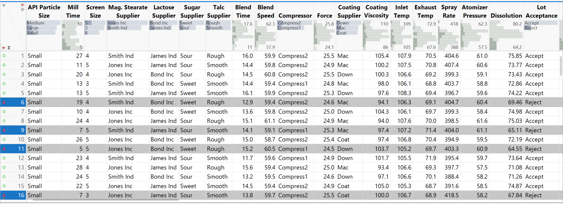
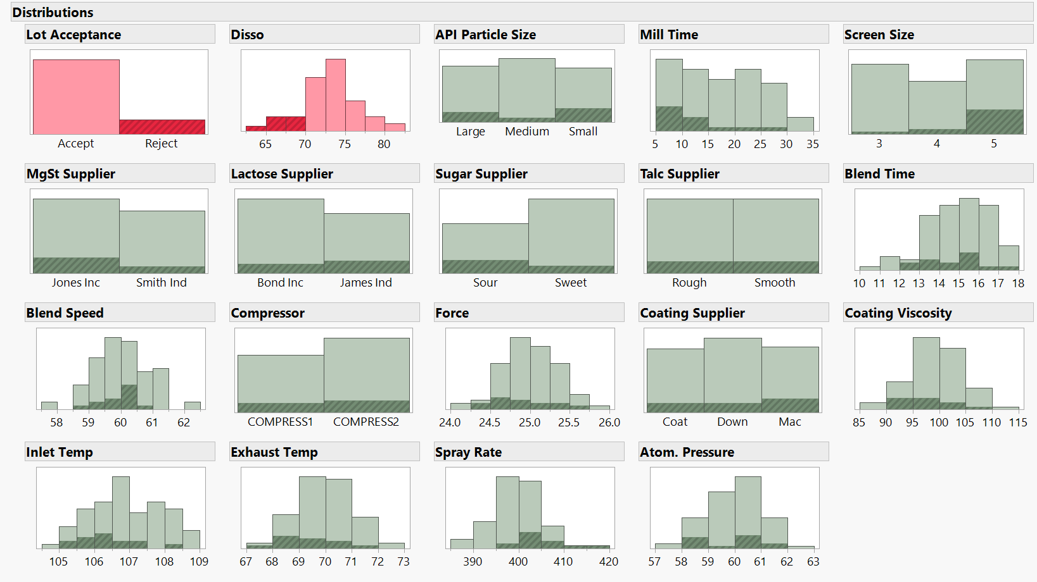
90 Historical Runs of Pharmaceutical Tablet Data – 17 Factors

Slide 7
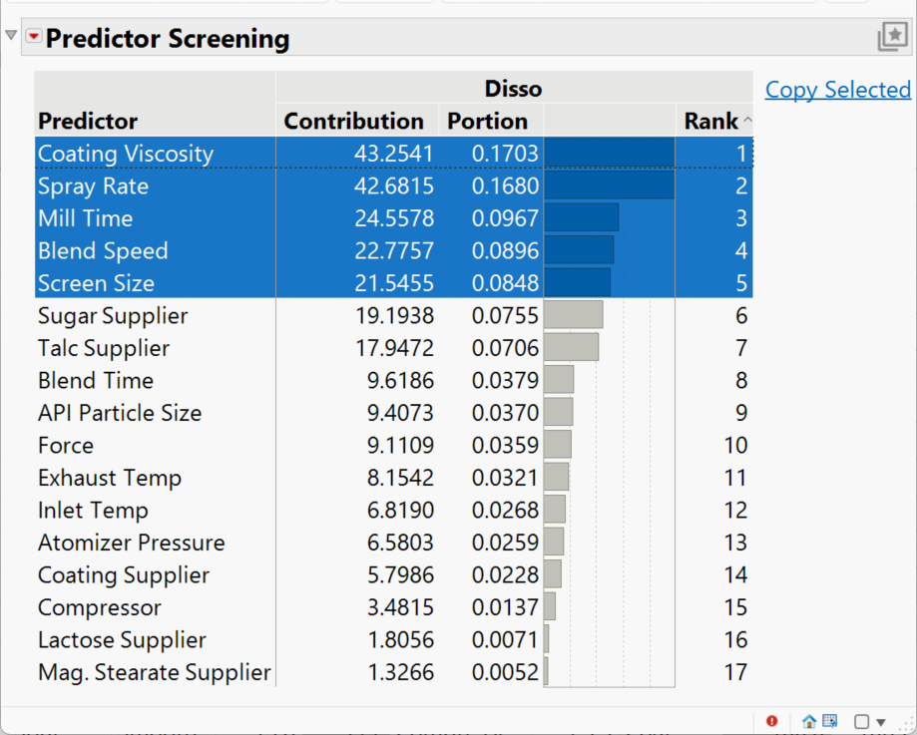
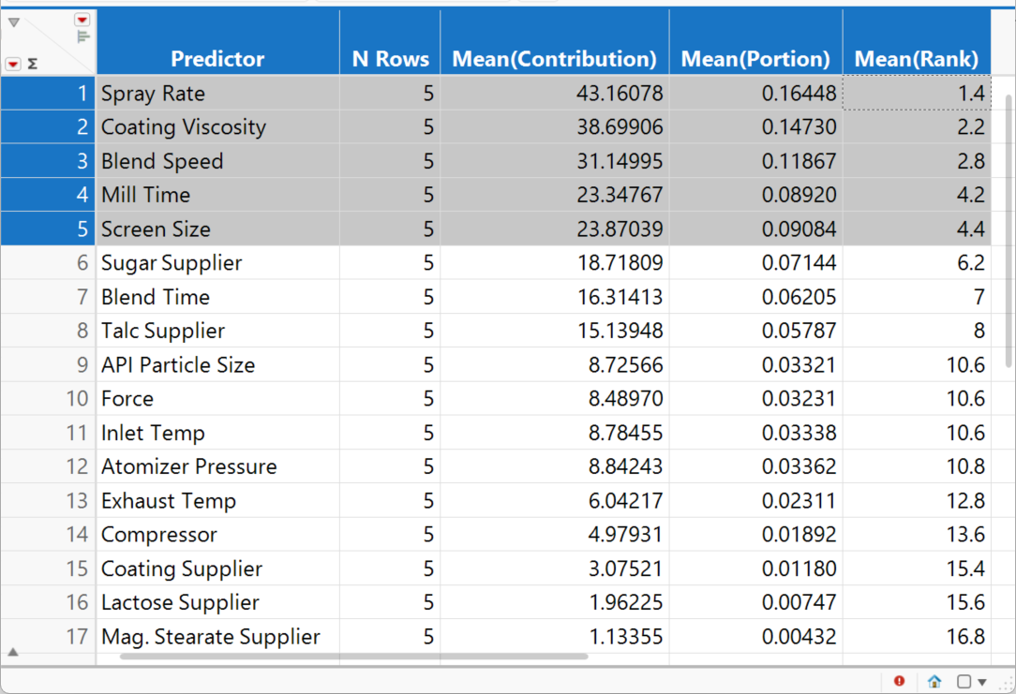
Average Multiple Bootstrap Forest Rankings to Select Factors

Slide 8
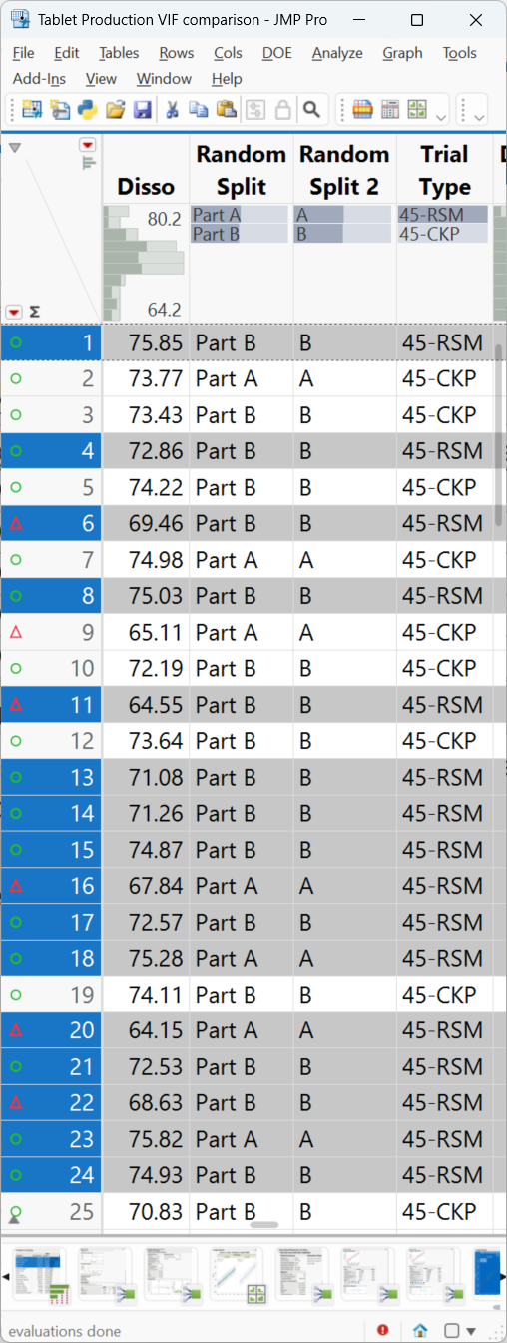
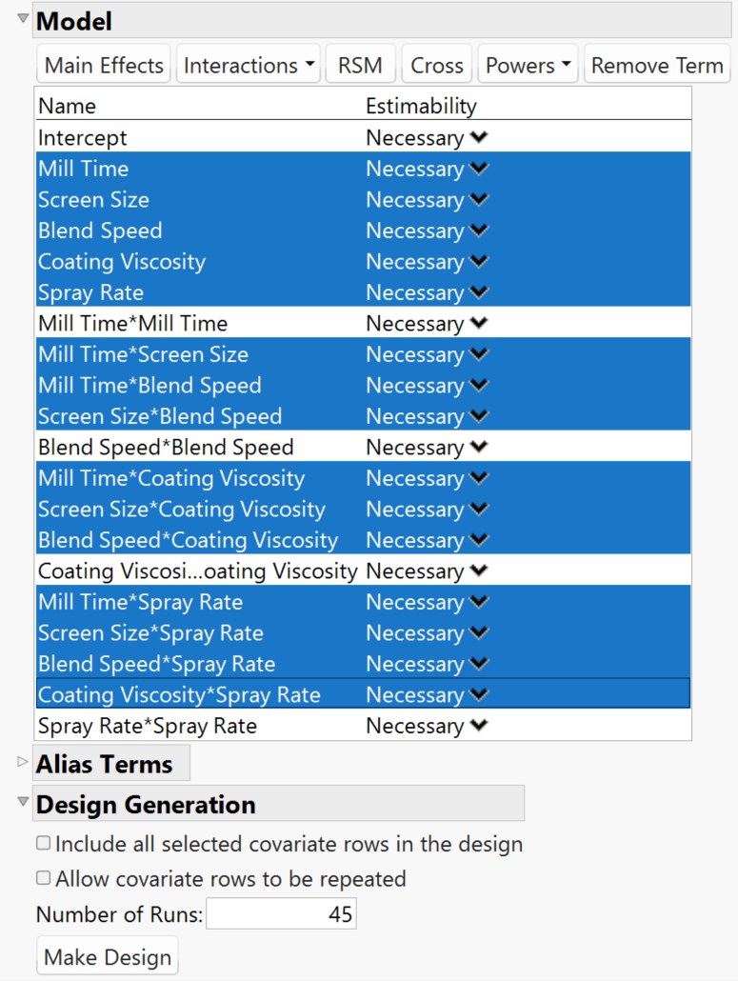
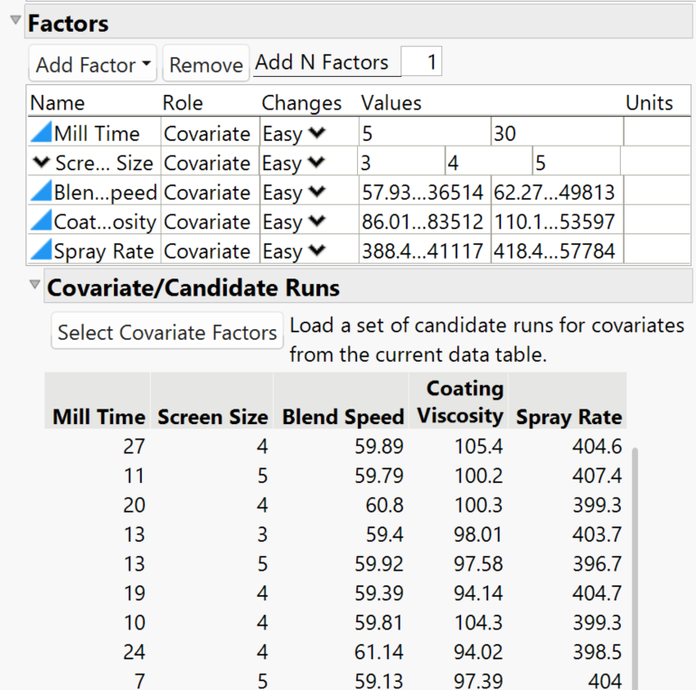
Choose 45-Run Design from 90 Candidate Rows to Support 5-factor Quadratic RSM

Slide 9
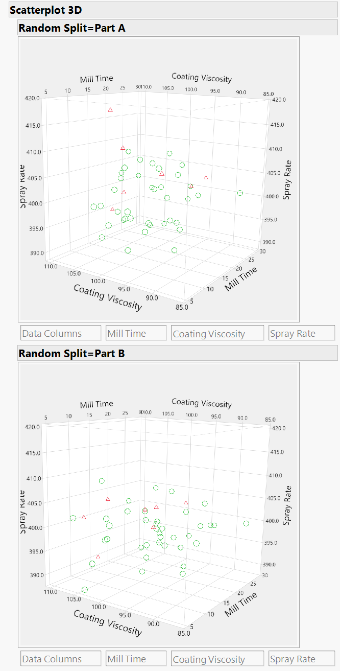
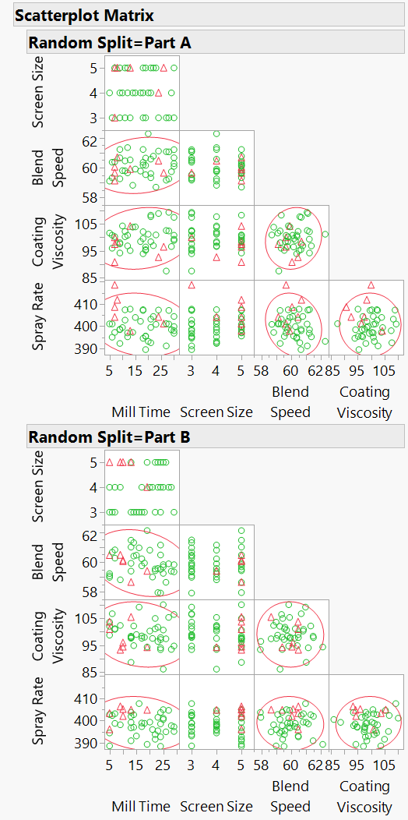
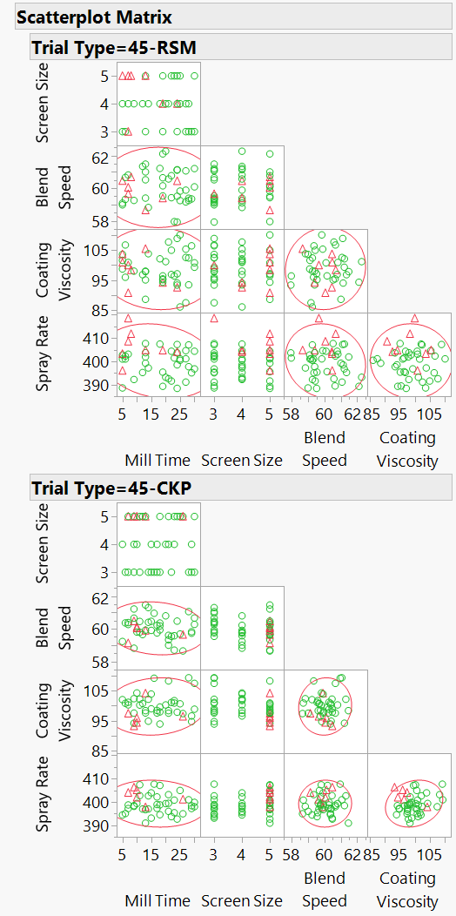
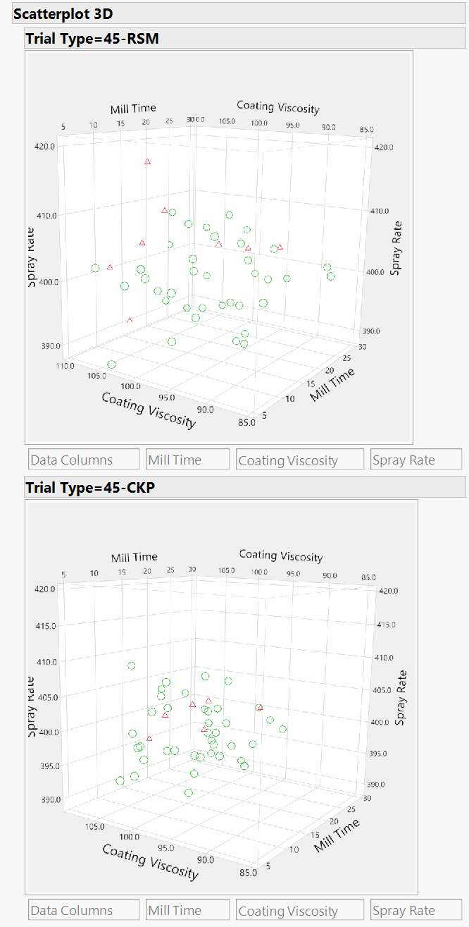
3D Scatterplot and Scatterplot Matrix Projections of Random Stratified Split and DOE/CKP Split Data Points

Slide 10
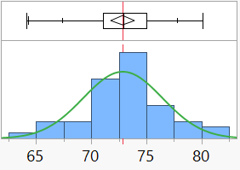
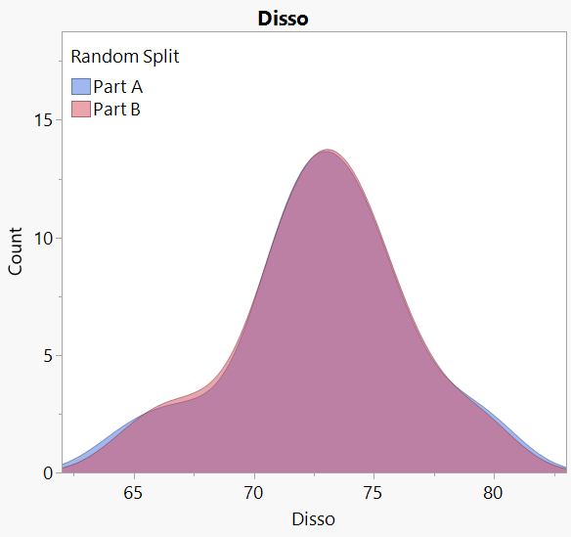
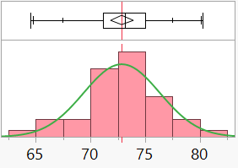
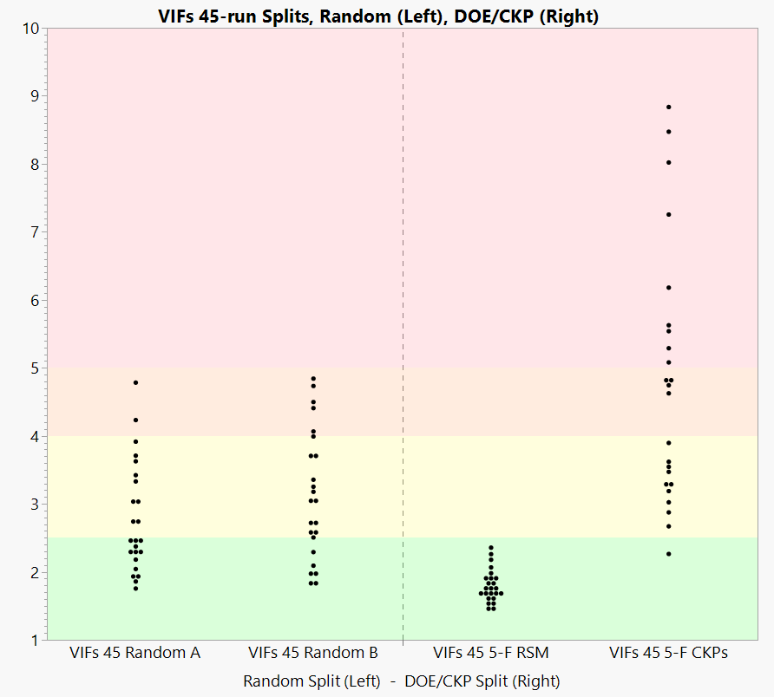
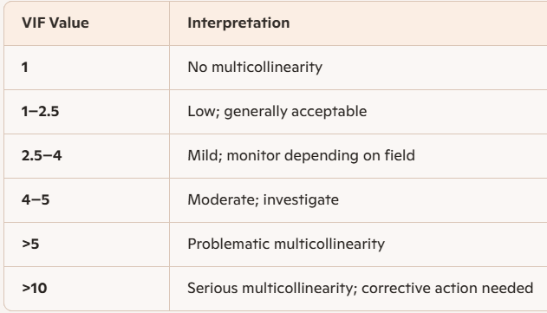
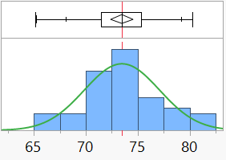
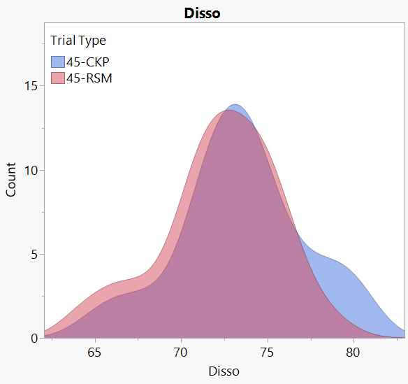
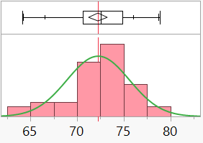
Comparing Random Stratified Split & DOE/CKP Split of Response Data
Variance Inflation Factors & Similarity of Subset Distributions of Response Values

Slide 11
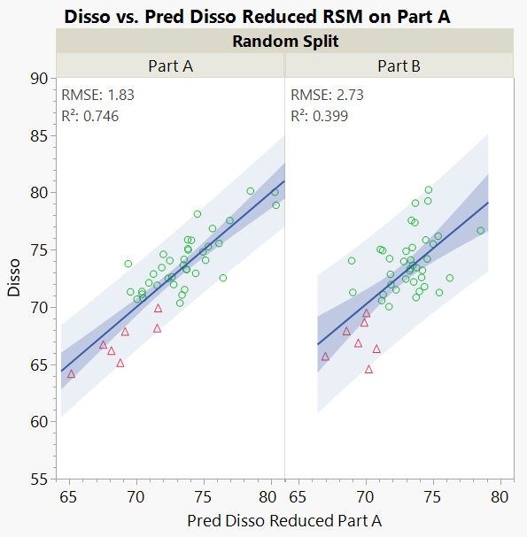
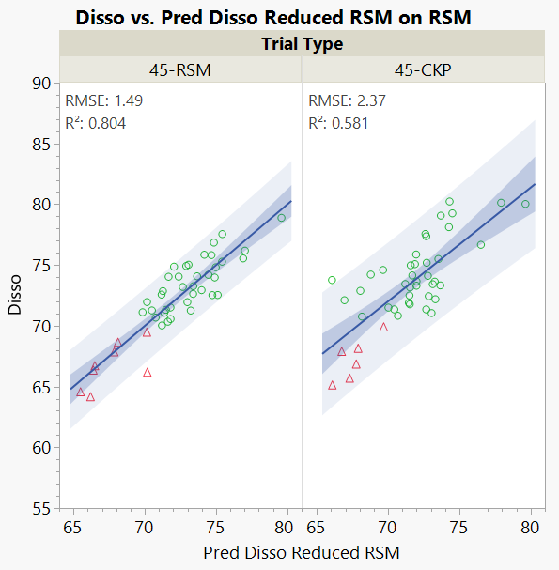
Actual vs. Predicted plots for reduced quadratic regression models for the Random Stratified split data and the DOE/CKP split data
RMSE values are lower & R² values are higher for the CKP data than the Part B data.
Model fit to 45 DOE trials predicts better than model fit to 45 randomly chosen Part A trials.

Slide 12
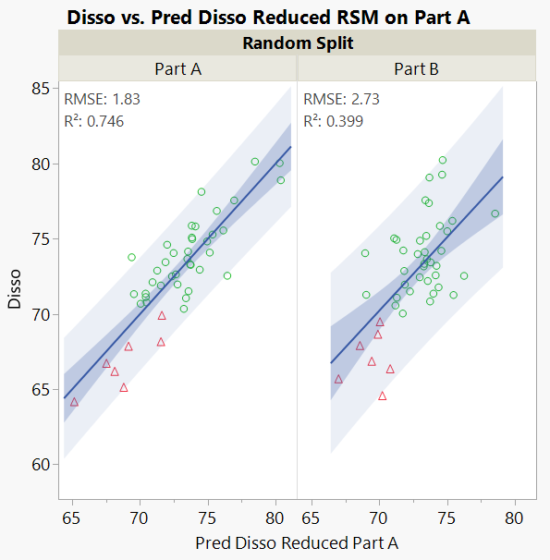
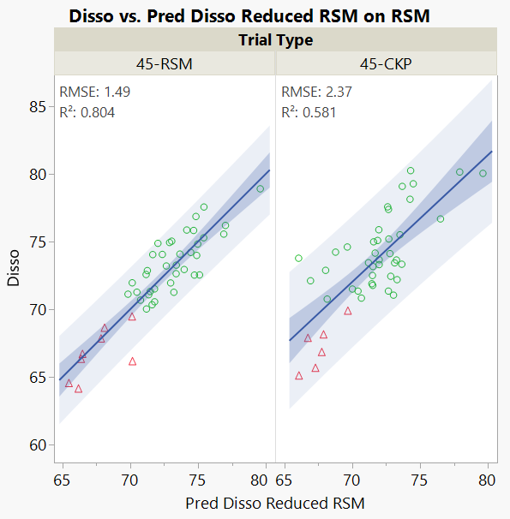
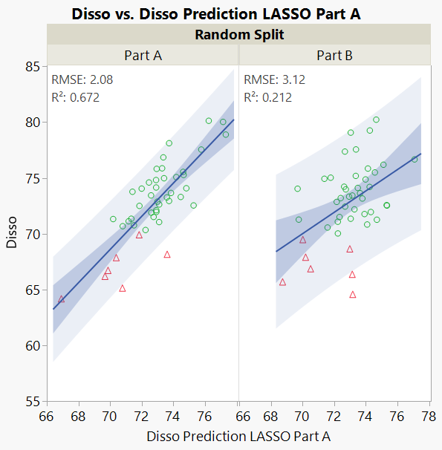
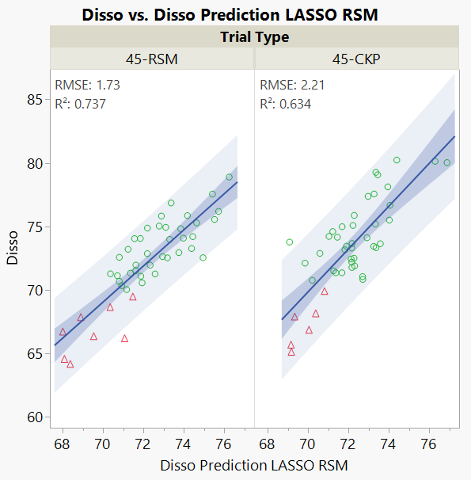
Actual vs. Predicted plots for reduced regression and LASSO models for the Randomly split data and the DOE/CKP split data
RMSE values are lower & R² values are higher for the CKP data than the Part B data.
Models fit to 45 DOE trials predicts better than models fit to 45 randomly chosen Part A trials.

Slide 13
Examples of Using Historical Data as a Candidate Set for a DOE from which to Build Well Predicting Models
150K+ rows from 20-years of FAA data for daily numbers of flights in airspace of each Air Route Traffic Control Center (ARTCC).
Able to well predict number of flights for any given ARTCC and day the following year. Models falter when either unusual short-term events like hurricanes or long-term events like pandemics or recessions occur.
648 all possible factor combinations of USAF deterministic simulation of biological agent attack of air base.
Small DOE subsets of size 36 (1/18th) and 108 (1/6th) runs well predict 324-run test half of data.
65-unique-run Latin hypercube for 6 factors with each trial replicated 100X for stochastic simulation of helicopter flying surveillance at IDFW. (6500 obs.)
Smaller DOEs work well because there’s lots of data covering nearly all the design space.
Hundreds of blends of 3-component mixtures of Alcohols and Minerals
Able to very accurately predict NMR or Raman spectra for blends NOT used in analysis from models built on very small DOE subsets of the data. Also able to predict concentrations of components from the spectra of an unknown sample.

Slide 14
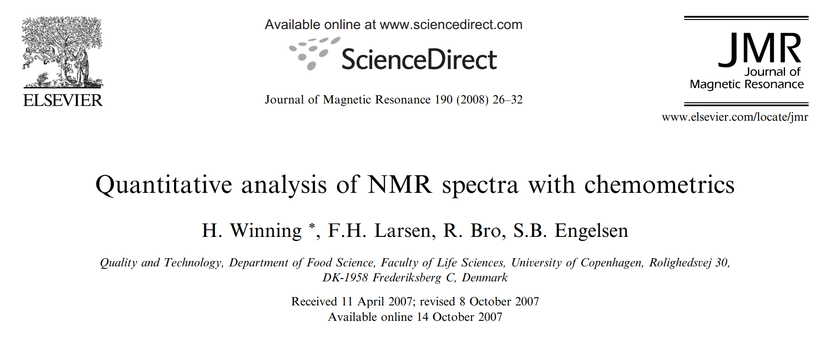
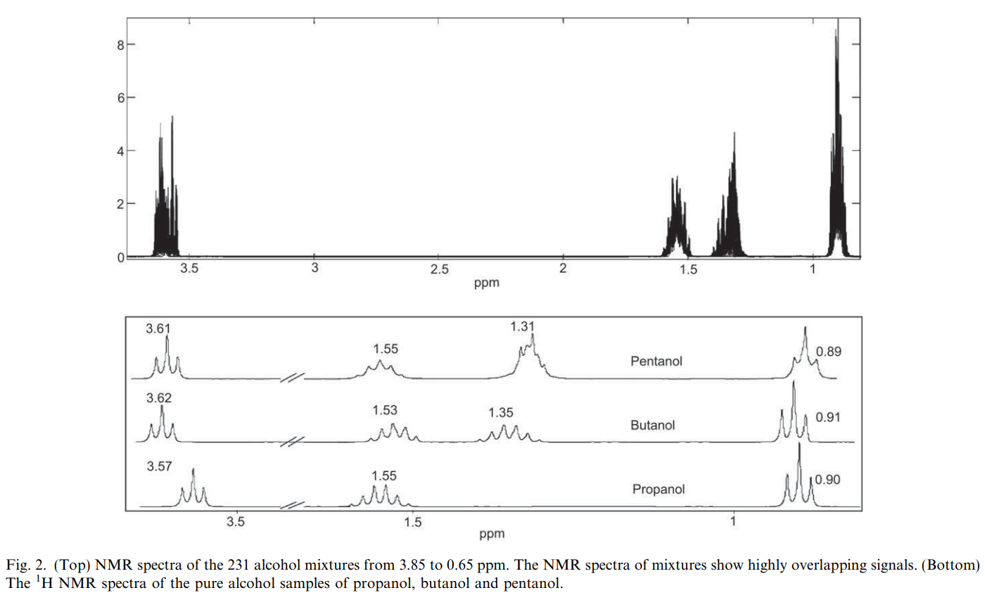
Overlay of 231 alcohol- blend
spectra
Spectra for 3 pure alcohols

Slide 15
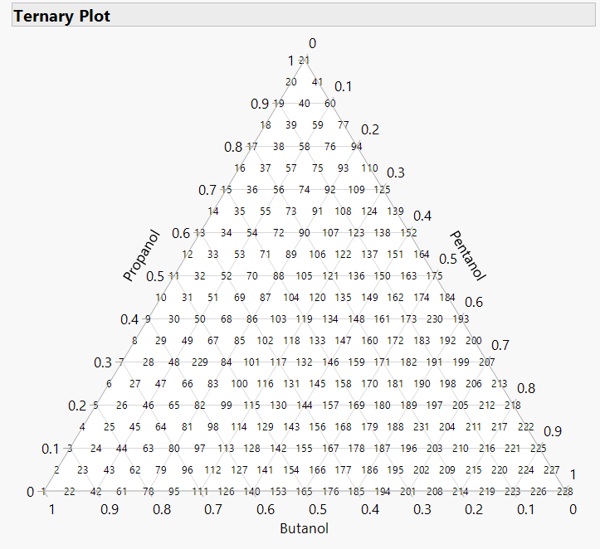
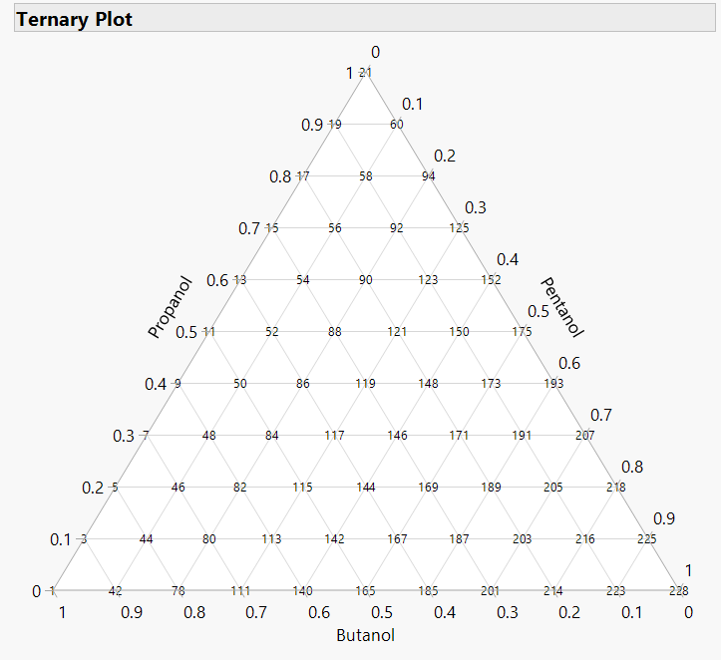

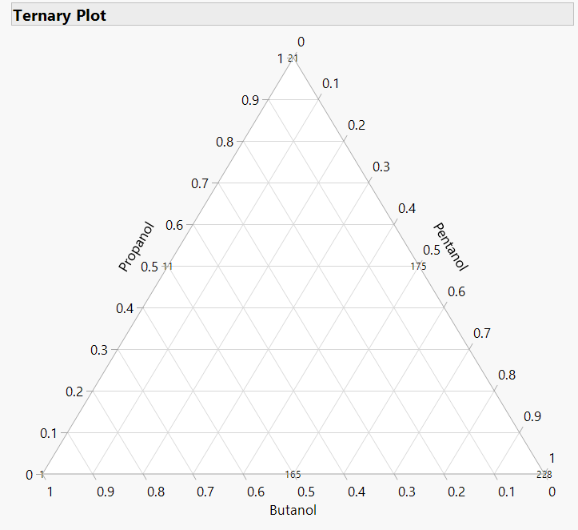
Alcohol Blends
231-blend “5% lattice”
66-blend “10% lattice”
21-blend “20% lattice”
6-blend “50% lattice”
Various size “lattice” DOE subset
mixture designs

Slide 16
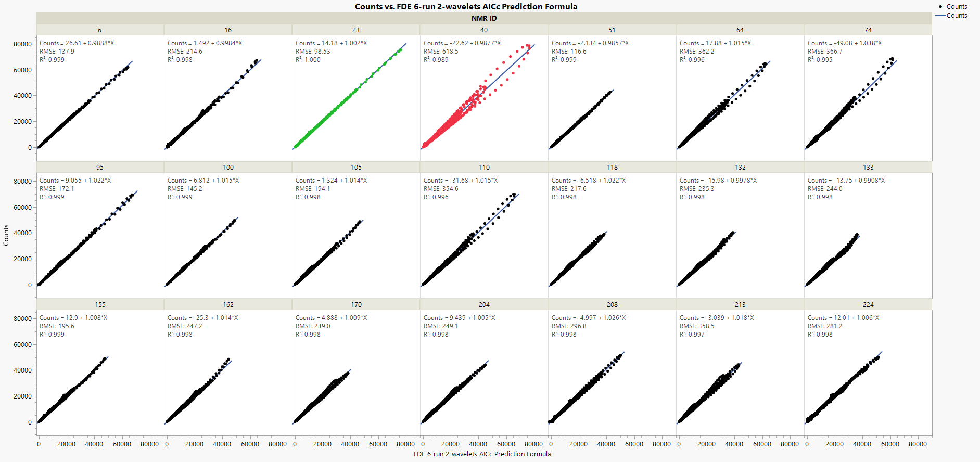
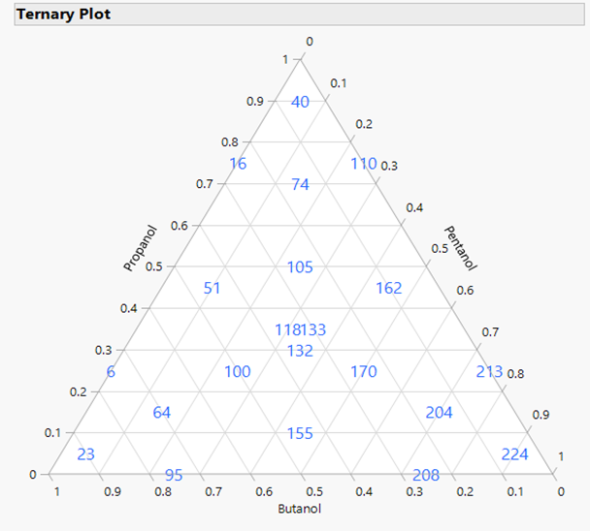
Actual vs. Predicted Plots for 21 Test Blends
1.000
0.989
“check points”

Slide 17
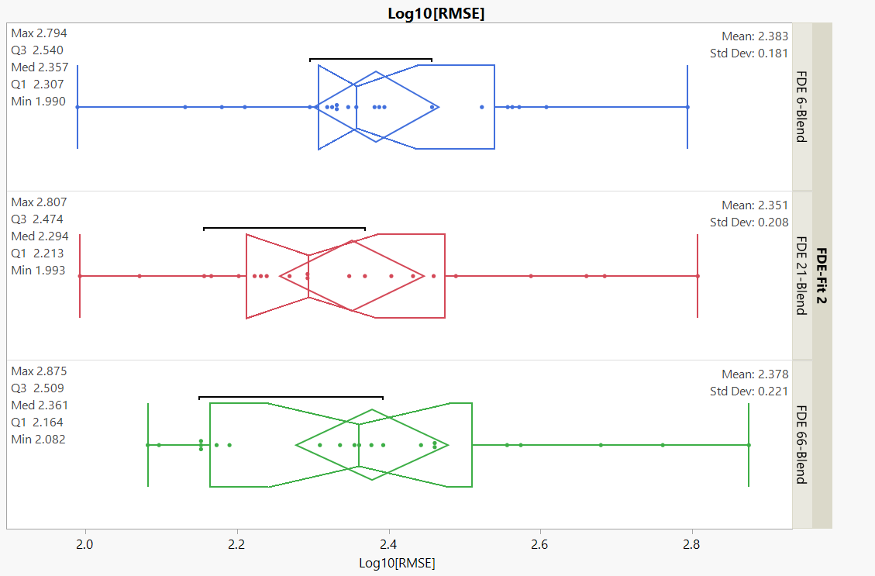
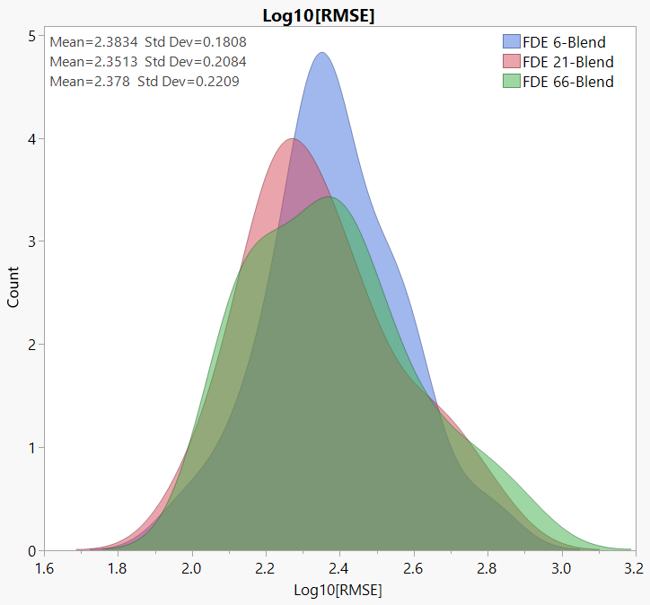
No Statistical or Practical Improvement Observed when Increasing from 6 to 21 or 66 Blends to Train FDA Model
Outlier Box Plots for 21 checkpoints NOT used to build models

Slide 18
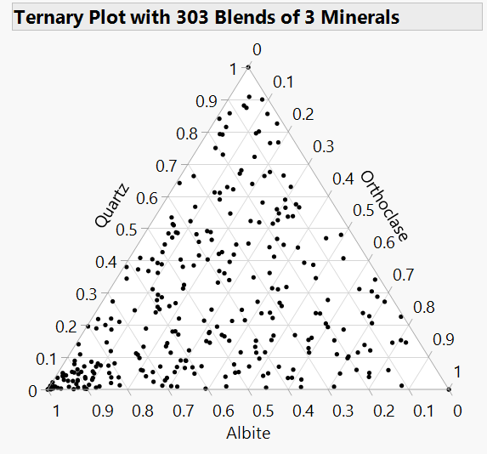
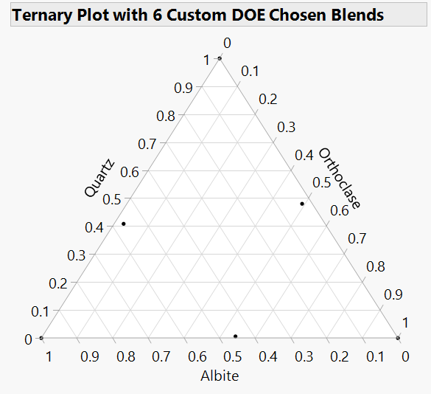
Mineral Blends
Use Custom DOE to choose the most informative subset of trials (blends) from existing trials used as a candidate set.

Slide 19
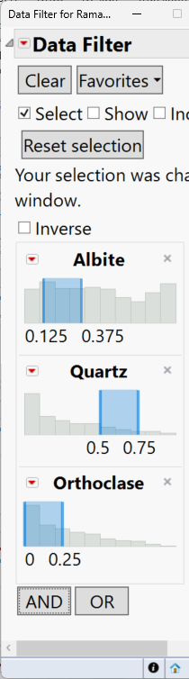
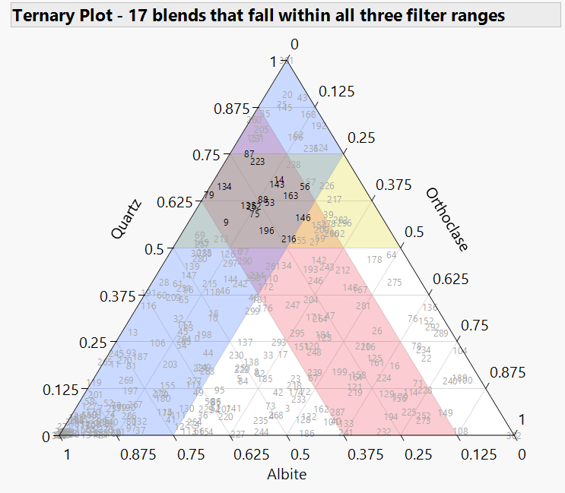
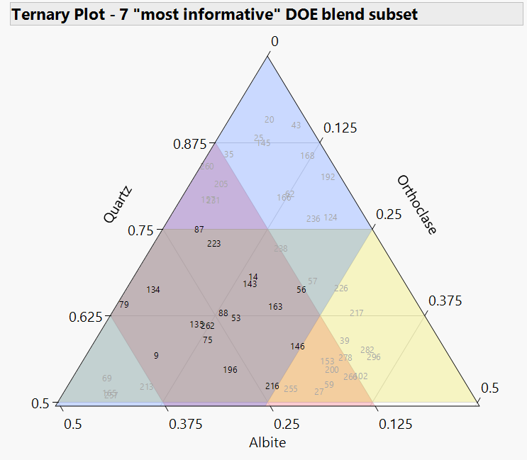
Mineral Blend Study (continued)
Use Custom DOE on a constrained region of design space
17 filtered blends used as candidate trials
7 circled trials are DOE subset

Slide 20
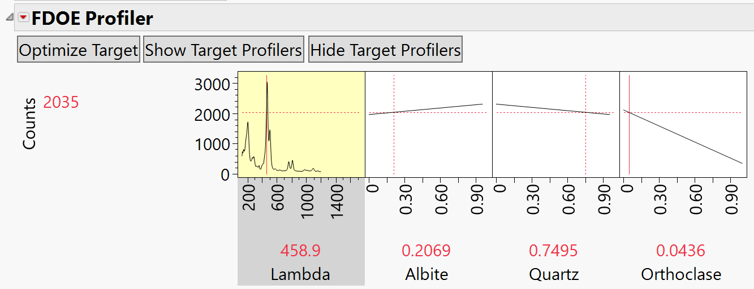
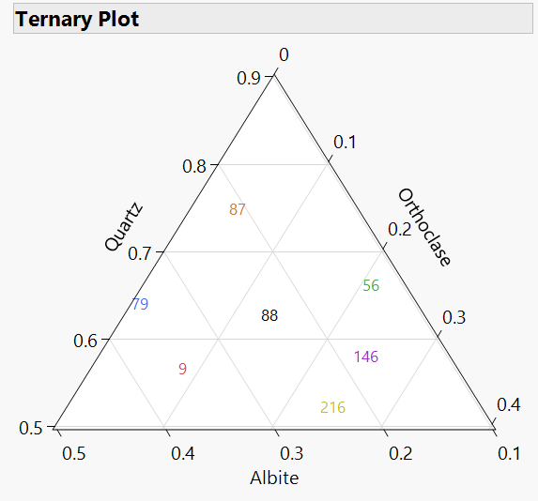
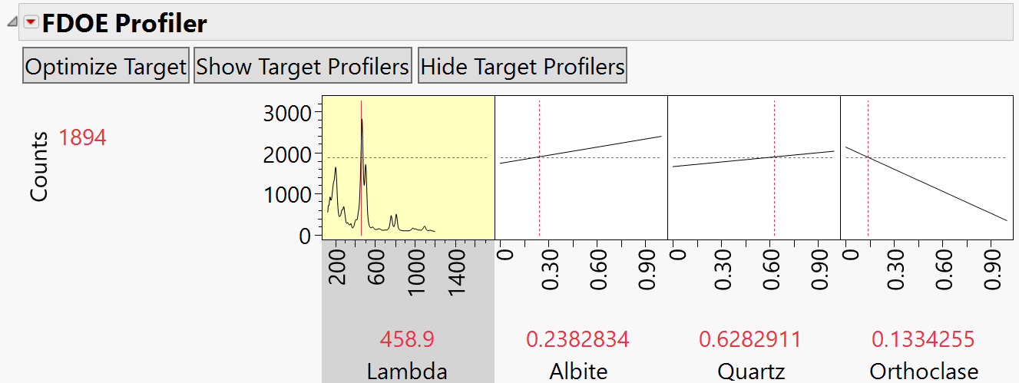
Settings for Raman ID# 87 (20.69%, 74.95%, 4.36%) – before Optimize Target
NOTE: Outer 6 points used to Train Model
Raman ID# 88 used
as Target spectra
Predicted settings for Raman ID #88 – after Optimize Target
23.83% 62.83% 13.34%
Notes:
Result of clicking Optimize Target button
NMR_ID #155 is the Target Curve (45% 10% 45%)

Slide 21
Settings for Raman ID# 87 (20.69%, 74.95%, 4.36%) – before Optimize Target
Predicted settings for Raman ID #88 – after Optimize Target
Actual blend
23.83% 62.82% 13.35%
23.83% 62.83% 13.34%
Notes:
Result of clicking Optimize Target button
NMR_ID #155 is the Target Curve (45% 10% 45%)

Slide 22
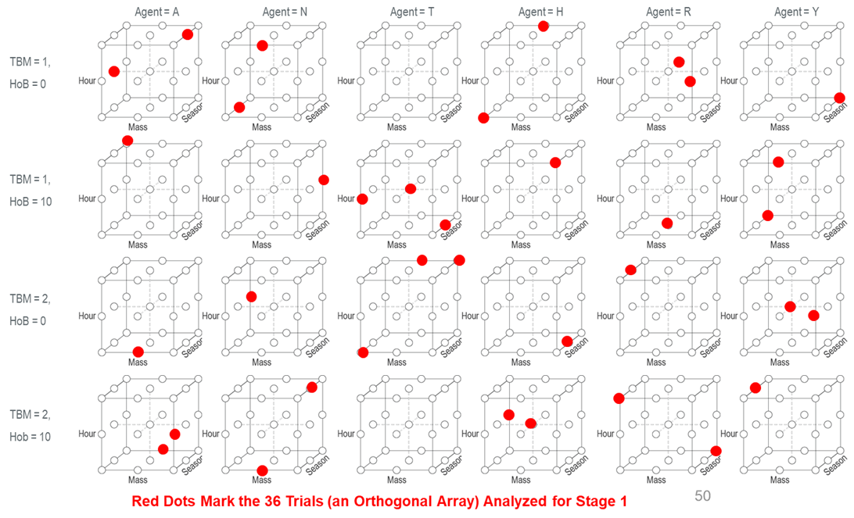
OA and NOA Designs
Six categorical factors
X1 has 6-levels
X2, X3, & X4 have 3-levels
X5 & X6 have 2-levels
18, 36, 108, 324, 648 trials
Compare Distributions
Compare Scatterplot Matrices
Compare Color Maps of Correlations
36 (5.6%) of All 648 Possible Combinations of Settings for 6 Variables (6 X 3 X 3 X 3 X 2 X 2 )

Slide 23
Four Stage Design Sequence
Stage 1
Stage 2
Stage 3
Stage 4
36 Total
Simulations
108 Total
Simulations
324 Total
Simulations
ALL 648
Simulations
Design 1, 36 trials
Design 1, 36 trials
Design 1, 36 trials
Design 1, 36 trials
Design 2, 72 trials
Design 2, 72 trials
Design 2, 72 trials
Design 3, 216 trials
Design 3, 216 trials
Main effects only for ALL variables
+ some 2-way interactions
Stage 1 effects plus all 2-way interactions
+ some 3-way interactions
Stage 2 effects plus all 3-way interactions
Stage 3 effects plus ALL remaining 4-way, 5-way and 6-way interactions
5.6% of 648
16.7% of 648
50% of 648
Design 4, 324 trials
NOTE: Length of this green box should be longer than shown
324 trials in Design 4 used as checkpoints for Designs 1, 2 & 3

Slide 24
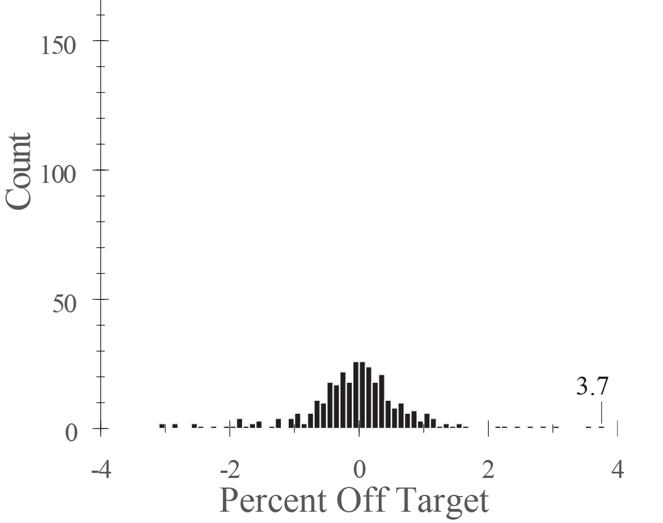
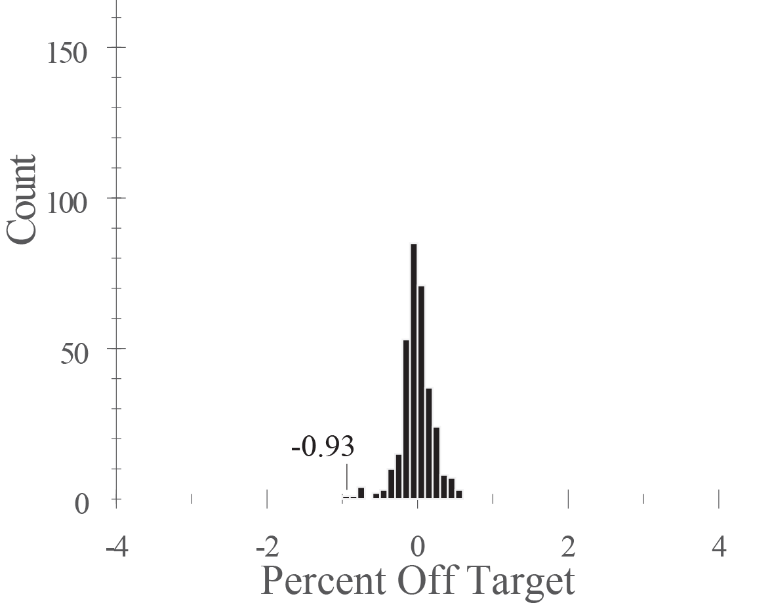
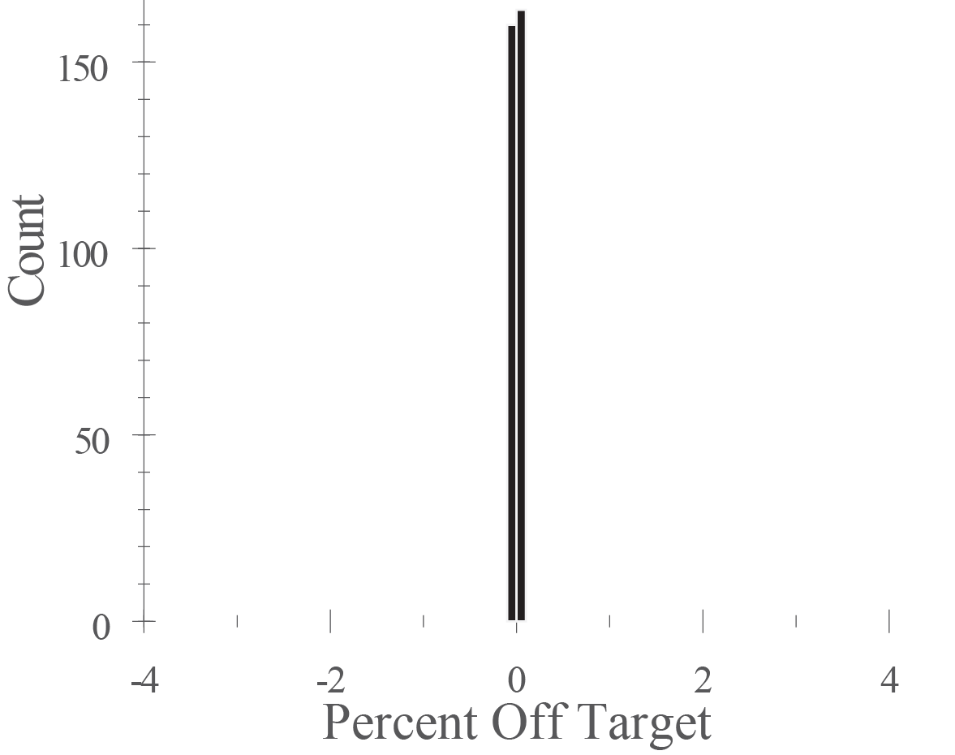
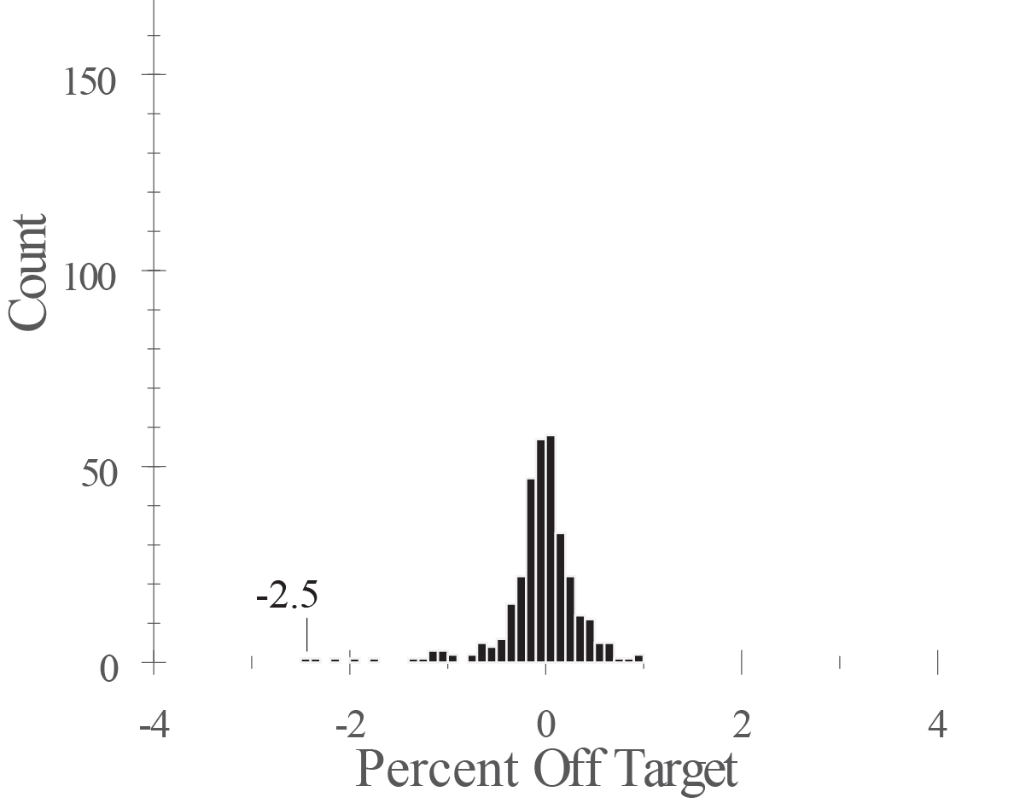
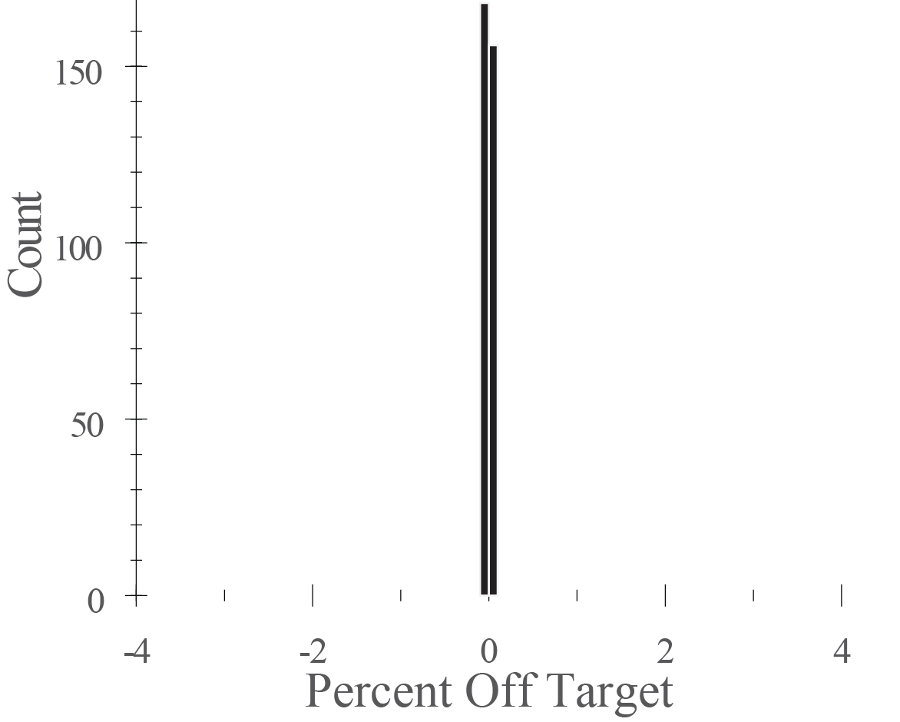
“Factor Sparsity” and “Effect Heredity” Used to Enhance Model Complexity
36 trials (5.6%)
108 trials (16.7%)
324 trials (50%)
1-way w/nesting model
Reduced 2-way model
Reduced 3-way model
Histograms showing % off target for predicting 324 checkpoint trials.
Worst Case = 3.7%
Half of Cases < 0.37%
Worst Case = -0.93%
Half of Cases < 0.11%
Worst Case = -0.0081%
Half of Cases < 0.0007%
1-way + some 2-way
terms model
2-way + some 3-way
terms model
Factor Sparsity states only a few variables will be active in a factorial DOE
Effect Heredity states significant interactions will only occur if at least one parent is active
( See Wu & Hamada, p. 112)
Worst Case = -2.5%
Half of Cases < 0.16%
Worst Case = -0.0251%
Half of Cases < 0.0010%
Oct. 1, 2007 visit by Profs. Wu & Joseph of GA Tech ISyE

Slide 25
How are Space-Filling Designs Different from Traditional Designs?
Rather than emphasizing high leverage trials (“corners”) for a simple polynomial model, space-filling designs “spread” their trials more uniformly through the space to better capture the local complexities of the simulation model.

Slide 26
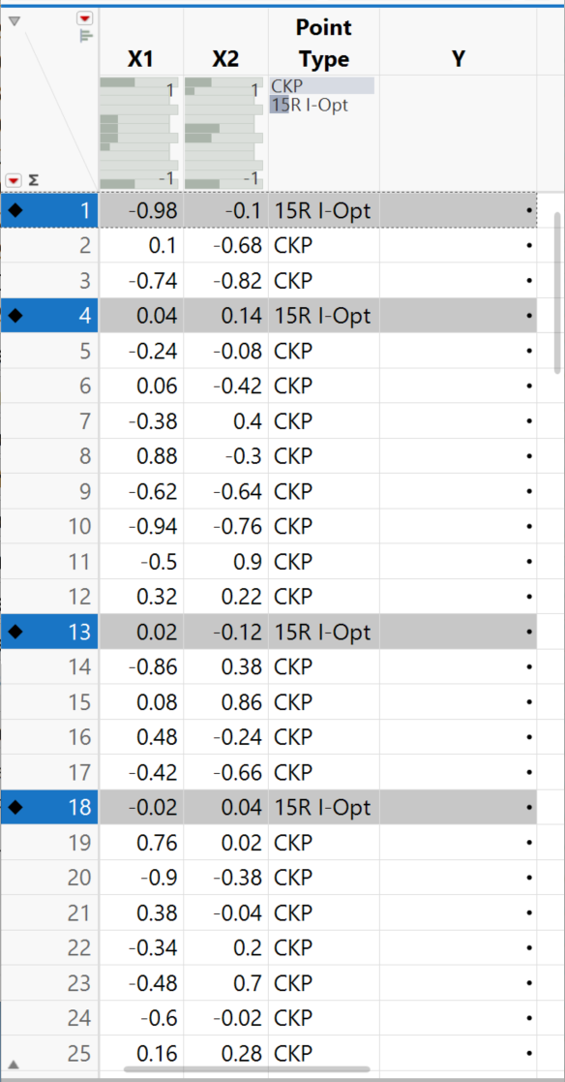
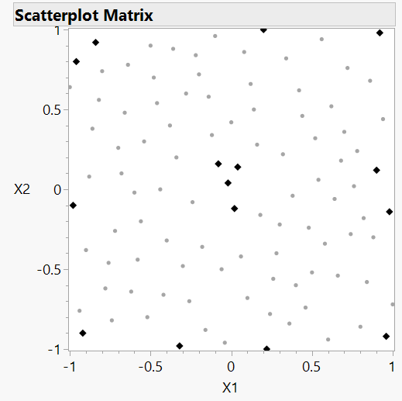
Use Space-Filling Design as Candidate for Response-Surface Design like I-Optimal
Black diamonds are the 15 trials chosen for a 2-factor I-optimal design supporting a quadratic model.
Gray circles are the Latin Hypercube candidate points not chosen for the design.

Slide 27




Slide 28
Underfit
Overfit
The bias is an error from erroneous assumptions in the learning algorithm. High bias can cause an algorithm to miss the relevant relations between features and target outputs.
Model too simple – it underfits.
The variance is an error from sensitivity to small fluctuations in the training set. High variance can cause an algorithm to model the random noise in the training data, rather than the intended outputs. Model too complex – it overfits.
Too Simple
Too Complex
“One can fit the data from a process but not necessarily fit the process from which the data come.”
– Bob Wheeler

Slide 29



It is fair to use Validation data to help determine “best fit” of Training data.
Underfit
Overfit
Too Simple
Too Complex

Slide 30

Data Leakage and Reproducibility in ML is a Problem
[Submitted on 14 Jul 2022]
[2207.07048v1] Leakage and the Reproducibility Crisis in ML-based Science (arxiv.org)

Slide 31

R-Square vs. Number of Splits in Decision Tree For Random Subset with 60% Train, 20% Validation(Tune), 20% Test
Underfit
Overfit
Might be influenced seeing poorer Test R-Square
Too Simple
Too Complex

Slide 32

R-Square vs. Number of Splits in Decision Tree For Random Subset with 60% Train, 20% Validation(Tune), 20% Test
Underfit
Overfit
Too Simple
Too Complex

Slide 33
Don’t Let Test Data Influence your Modeling
Highly recommended that after creating Train, Validation(Tune), and Test subsets, that you remove the Test subset from your analyses.
Or if you like K-fold cross-validation, instead of using 5 folds, make 6 and hide one.
Hide the Test data away.
Do NOT look at these data again until you have reached a decision on your final model.
There’s a reason why data mining competitions don’t provide you with the Test data that determines the winning model.
Once you are satisfied with your final model fit to your Training data, then use the Test data to evaluate how well your final model performs.

Slide 34



Honest Assessment
Create Stratified & Grouped Model Validation Column,
Breaking Data into Training, Validation (Tune), & Test Subsets
Underfit
Overfit
Automate model fitting while preventing data leakage
Too Simple
Too Complex

Slide 35




Model Validation methods Choose best one depending on the amount of data
Train – Validate – Test
Subsets
(Stratified & Grouped)
K-Fold Subsets
(Modern “DOE Chosen”)
Information Criteria
(AICc, BIC, & ERIC)
Self-Validating
Ensemble Models
(SVEM)
More Data
Less Data

Slide 36
Self-Validating Ensemble Modeling (SVEM)
SVEM is inspired by random forests/bagging, but uses the fractionally weighted bootstrap rather than resampling
Make a second copy of original data to be fit.
Split fractional weights between two sets with each trial.
The best way to use autovalidation we found was to reinitialize the weights and refit nBoot times and use the average of these models as the predictor. We called this Self-Validating Ensemble Models (SVEM)
Individual Forward Selection models have p<n, but the SVEM ensemble can have p>n, supersaturated not just in potential effects, but supersaturated in active effects.

Slide 37


Self-Validating Ensemble Modeling (SVEM)

Slide 38


Actual vs. Predicted plots for reduced quadratic regression models for the DOE/CKP split data fit with Self-Validating Ensemble Model (SVEM) and Ordinary Least Squares (OLS).
Model fit to 45-DOE trials with SVEM validation (1000 bootstrap fits) predicts 45-CKP trials better than model fit to same 45-DOE trials with OLS.
RMSE value is lower & R² value is higher for the actual vs. predicted plot with SVEM model than with the OLS model.

Slide 39
Outline
Start with a detailed example using a small historical data set to build and validate a model. No new data needed. This is just your time analyzing!
Compare properties of randomly split subset to DOE created subset.
Compare results of models for predicting the “test half” of the data.
Discuss some additional examples with more data.
Bureaucratic data.
Mixture data
Simulation data
Use DOE from candidate set to make hybrid Space-filling/I-optimal Design
Discuss validation subsets and alternative methods.
Train/Validate/Test
K-fold
Information Criteria
Self-Validating Ensemble Models (SVEM)

