Slide 1

ENTROPY-DRIVEN DESIGN OF SENSITIVITY EXPERIMENTS
David M. Steinberg
Tel Aviv University

Slide 2
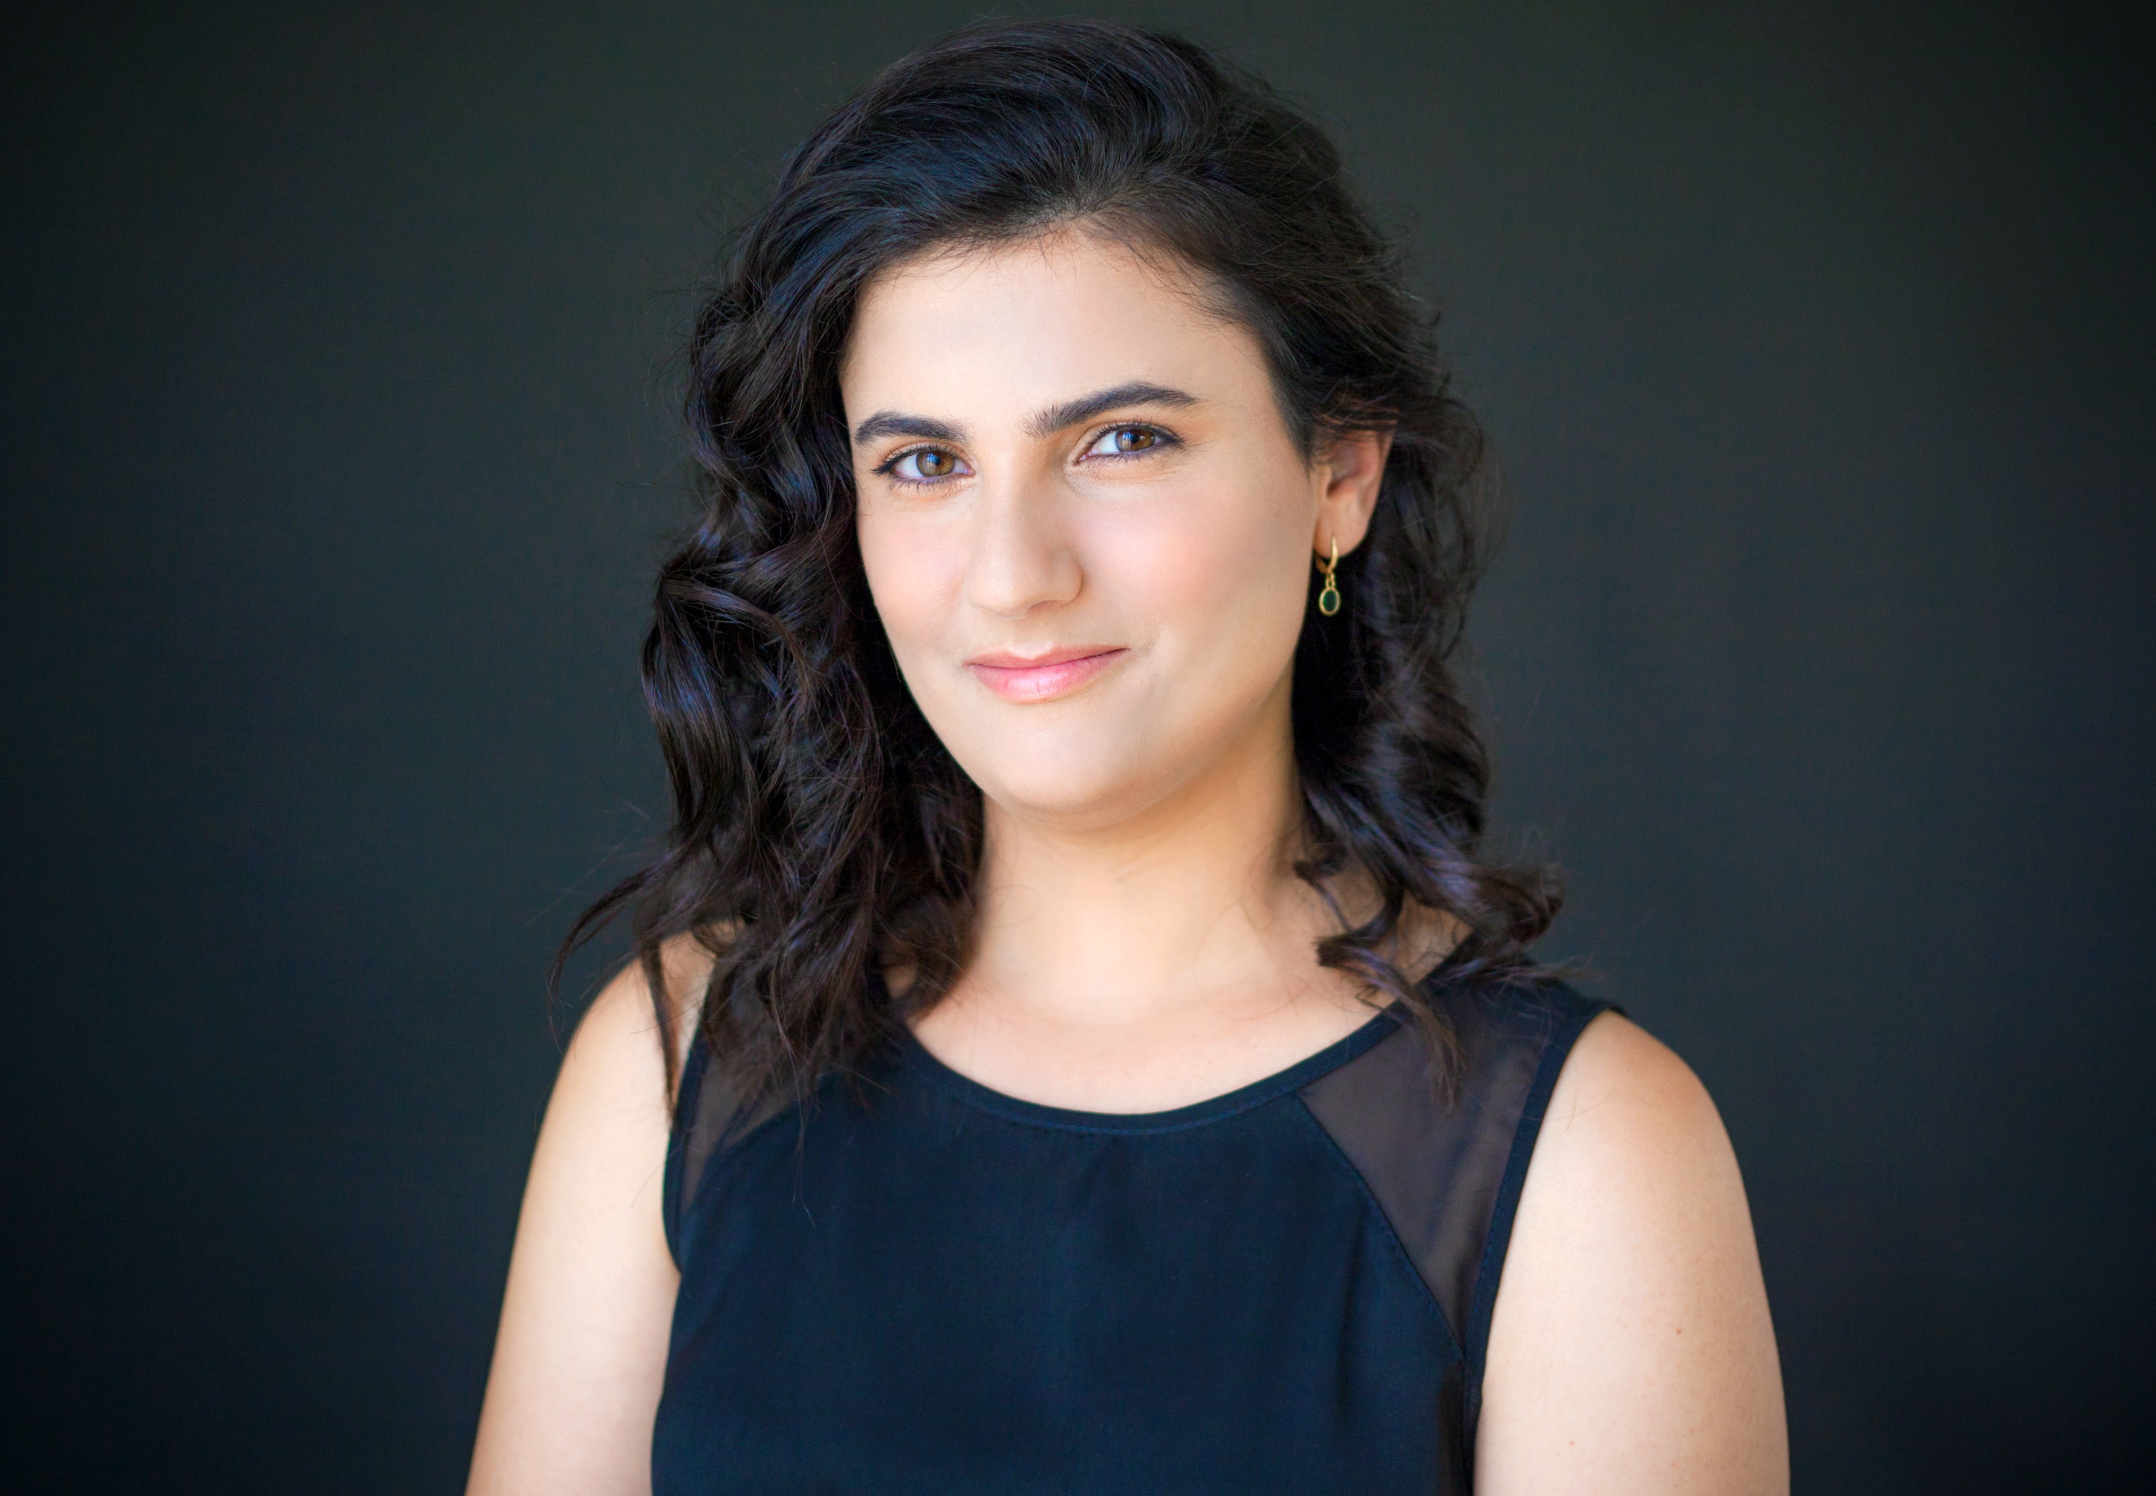


PARTNERS
Rotem Rozenblum
Tel Aviv University
Amit Teller
Rafael LTD

Slide 3
Funding
This work was supported by a grant from the Rafael Science Fund. This fund was established to enhance scientific research collaboration between industry and academic institutions.

Slide 4
Outline
Background
Existing Methods
Entropy Reduction Designs
Shiny App
Simulation Results
Summary

Slide 5
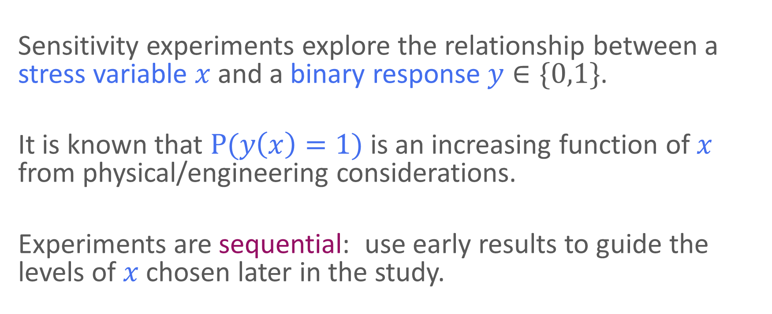
Background
Sensitivity experiments explore the relationship between a stress variable $x$ and a binary response $y∈\{0,1\}$.
It is known that $P(y\left(x\right)=1)$ is an increasing function of $x$ from physical/engineering considerations.
Experiments are sequential: use early results to guide the levels of $x$ chosen later in the study.

Slide 6
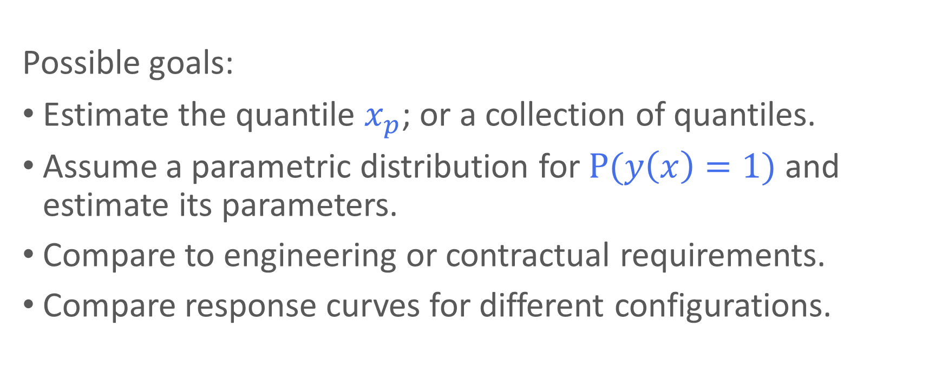
Background
Possible goals:
Estimate the quantile $x_{p}$; or a collection of quantiles.
Assume a parametric distribution for $P(y\left(x\right)=1)$ and estimate its parameters.
Compare to engineering or contractual requirements.
Compare response curves for different configurations.

Slide 7
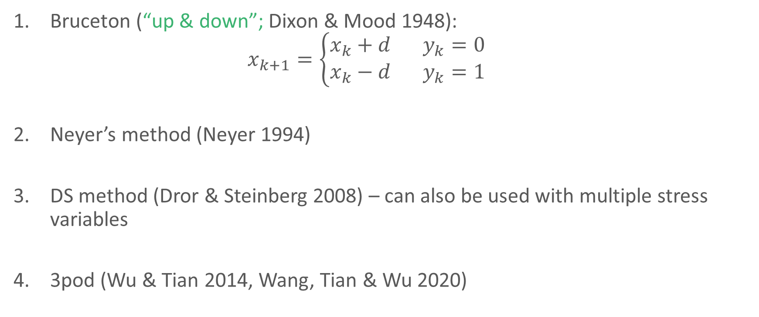
Existing Methods
Bruceton (“up & down”; Dixon & Mood 1948):
$$x_{k+1}=\left\{\begin{matrix}x_{k}+d & y_{k}=0 \\ x_{k}−d & y_{k}=1\end{matrix}\right.$$
Neyer’s method (Neyer 1994)
DS method (Dror & Steinberg 2008) – can also be used with multiple stress variables
3pod (Wu & Tian 2014, Wang, Tian & Wu 2020)
Notes:
D-optimality – maximizing the determinant of the information matrix -> minimizing the variance of the estimated parameters in the GLM

Slide 8
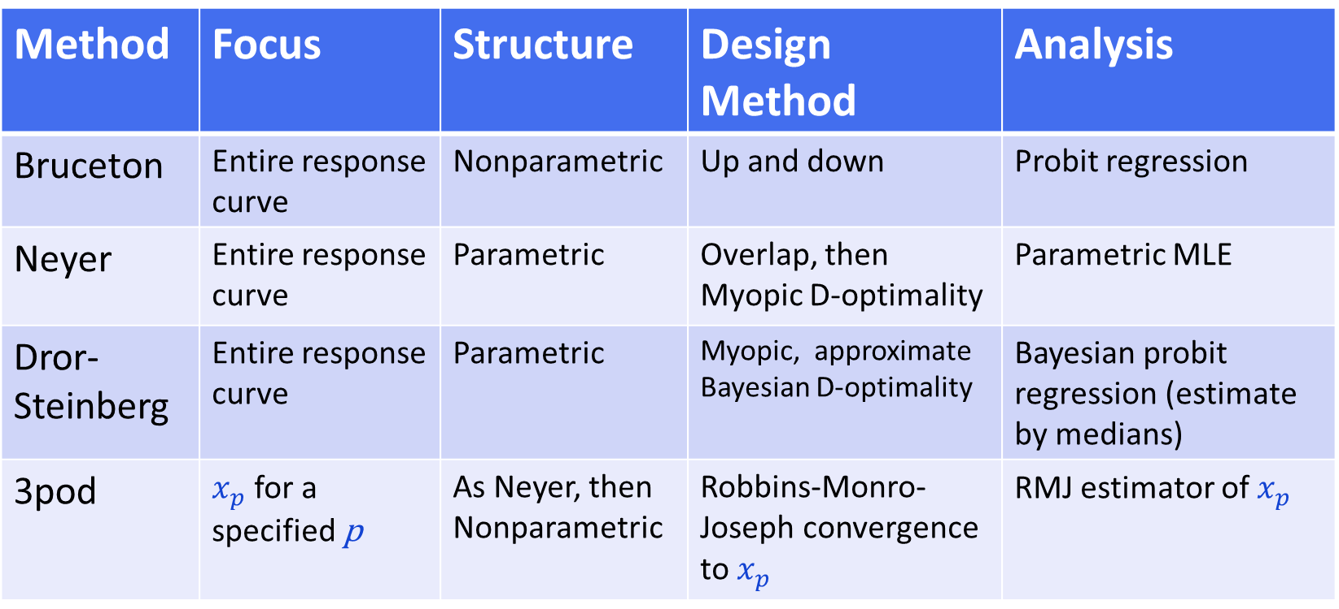
Existing Methods
Method | Focus | Structure | Design Method | Analysis
Bruceton | Entire response curve | Nonparametric | Up and down | Probit regression
Neyer | Entire response curve | Parametric | Overlap, then Myopic D-optimality | Parametric MLE
Dror-Steinberg | Entire response curve | Parametric | Myopic, approximate Bayesian D-optimality | Bayesian probit regression (estimate by medians)
3pod | $x_{p}$ for a specified p | As Neyer, then Nonparametric | Robbins-Monro-Joseph convergence to $x_{p}$ | RMJ estimator of $x_{p}$
Notes:
D-optimality – maximizing the determinant of the information matrix -> minimizing the variance of the estimated parameters in the GLM

Slide 9
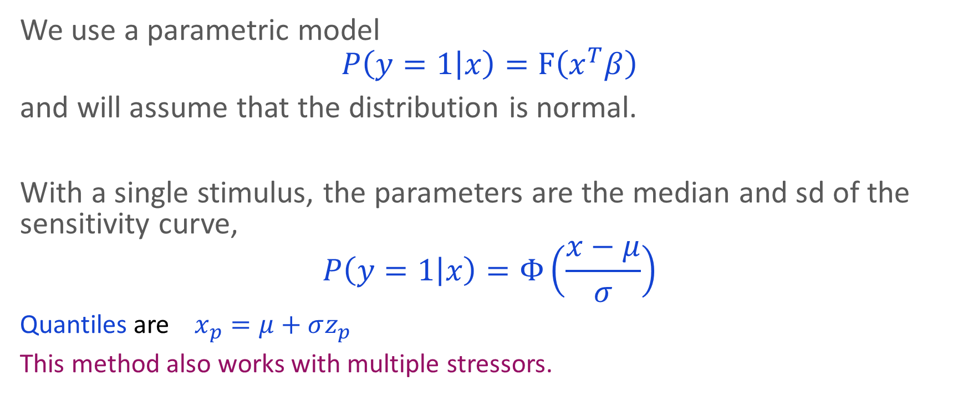
Entropy Reduction Designs
We use a parametric model
$$P\left(y=1 | x\right)=F\left(x^{T}β\right)$$
and will assume that the distribution is normal.
With a single stimulus, the parameters are the median and sd of the sensitivity curve,
$$P\left(y=1 | x\right)=Φ\left(\frac{x−μ}{σ}\right)$$
Quantiles are $x_{p}=μ+σz_{p}$
This method also works with multiple stressors.
Notes:
Why Probit –
engineers think of these experiments as giving indirect measures of the "sensitivity distribution";
i.e. the critical point at which each unit in a population would respond.
Since each unit is applied only with a single stress, asking if it is above, or below, the critical value.
The question of what link function to use is then equivalent to "what is the distribution of the critical values (the so-called "sensitivity distribution") across the population?“
The answer is normal distribution which lead to Probit link

Slide 10
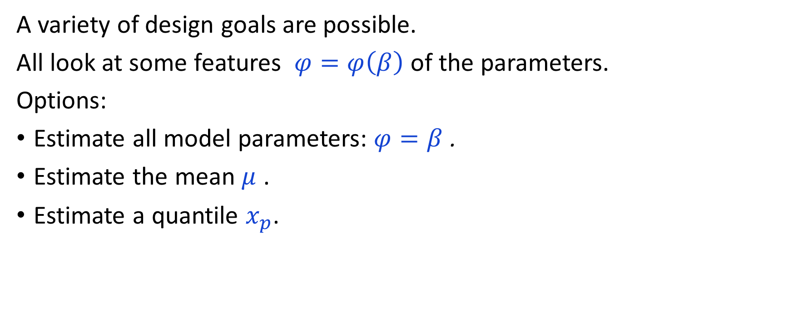
Entropy Reduction Designs
A variety of design goals are possible.
All look at some features $φ=φ\left(β\right)$ of the parameters.
Options:
Estimate all model parameters: $φ=β$ .
Estimate the mean $μ$ .
Estimate a quantile $x_{p}$.
Notes:
Why Probit –
engineers think of these experiments as giving indirect measures of the "sensitivity distribution";
i.e. the critical point at which each unit in a population would respond.
Since each unit is applied only with a single stress, asking if it is above, or below, the critical value.
The question of what link function to use is then equivalent to "what is the distribution of the critical values (the so-called "sensitivity distribution") across the population?“
The answer is normal distribution which lead to Probit link

Slide 11
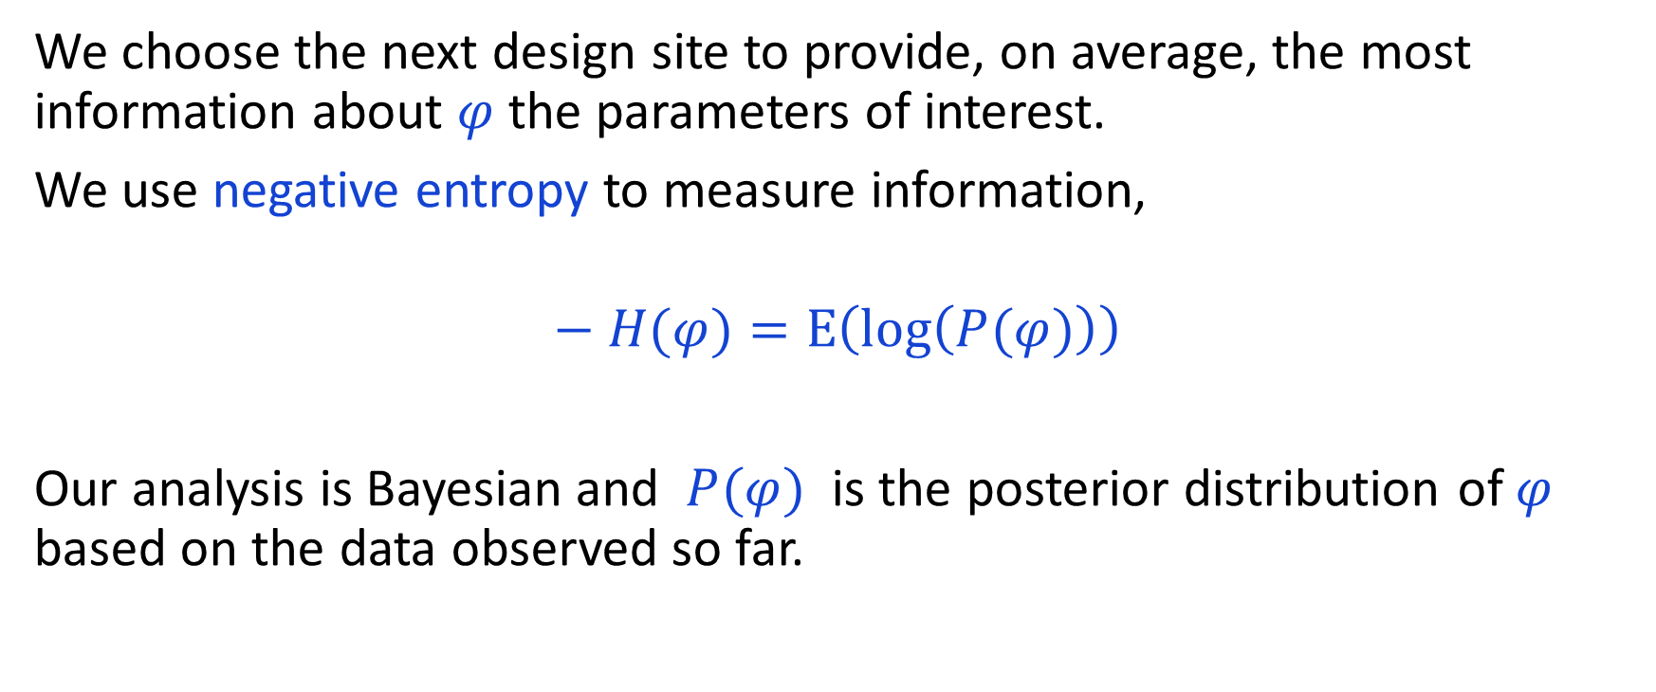
Entropy Reduction Designs
We choose the next design site to provide, on average, the most information about $φ$ the parameters of interest.
We use negative entropy to measure information,
$$− H(φ)=E\left(\log\left(P(φ)\right)\right)$$
Our analysis is Bayesian and $P(φ)$ is the posterior distribution of $φ$ based on the data observed so far.

Slide 12
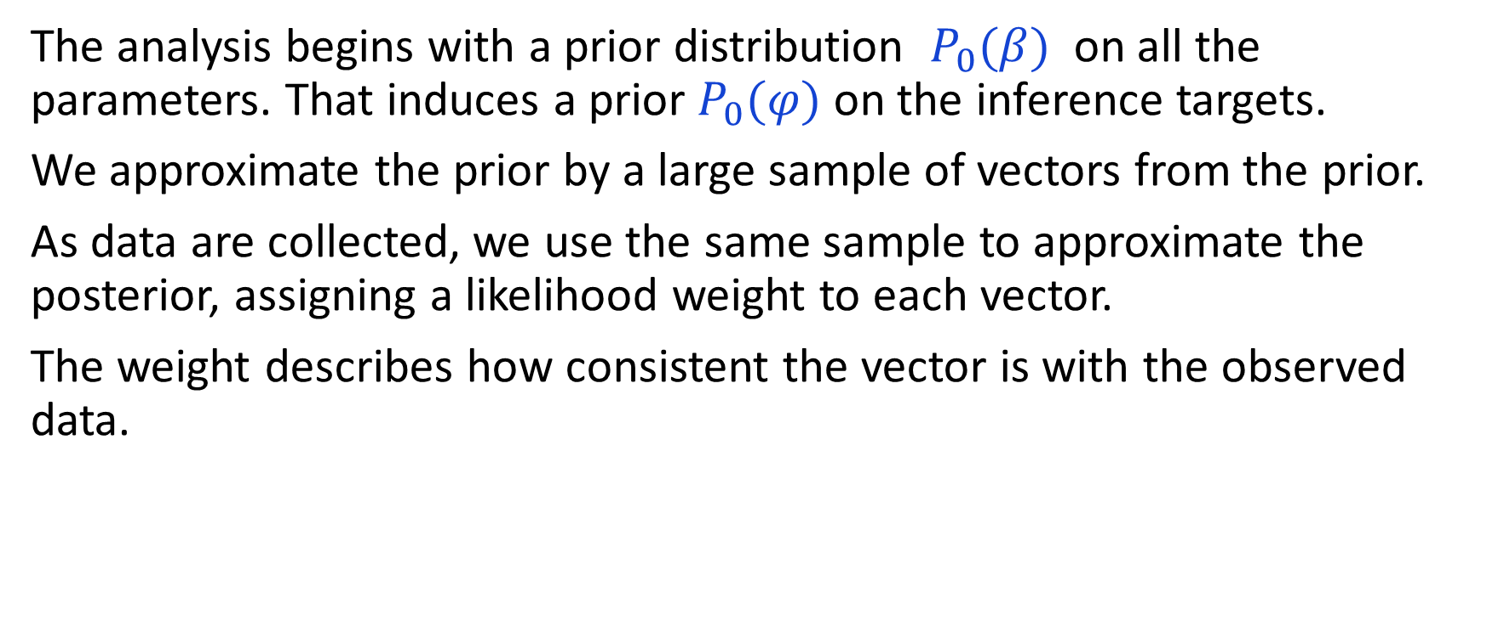
Entropy Reduction Designs
The analysis begins with a prior distribution $P_{0}(β)$ on all the parameters. That induces a prior $P_{0}(φ)$ on the inference targets.
We approximate the prior by a large sample of vectors from the prior.
As data are collected, we use the same sample to approximate the posterior, assigning a likelihood weight to each vector.
The weight describes how consistent the vector is with the observed data.

Slide 13
Entropy Reduction Designs
ALL methods for sensitivity experiments exploit prior information.
Informative sensitivity experiments need stimuli that are away from the “no fire” and “all fire” regions.
Prior information always serves as the initial guide for where that region is located.
Our method requires informative priors, not flat ones.
Unless there is strong advance knowledge from past testing, we advise setting priors with high variance.
That way the experimental data will quickly take over from the prior as the main source of information.

Slide 14
Shiny App
Our Shiny app makes it easy to implement the ideas for single stress problems.
It guides you through an experiment, recommending design settings and analyzing the data .

Slide 15
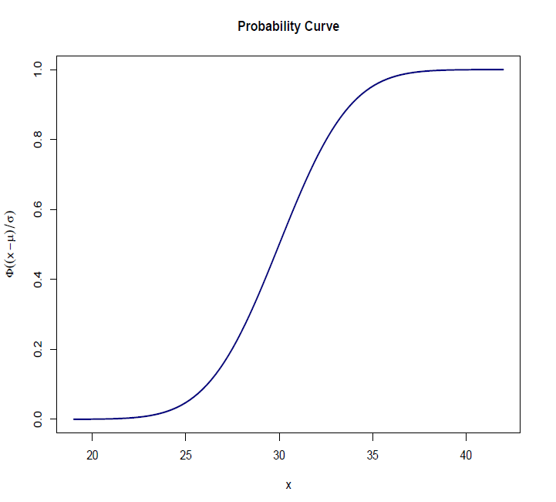
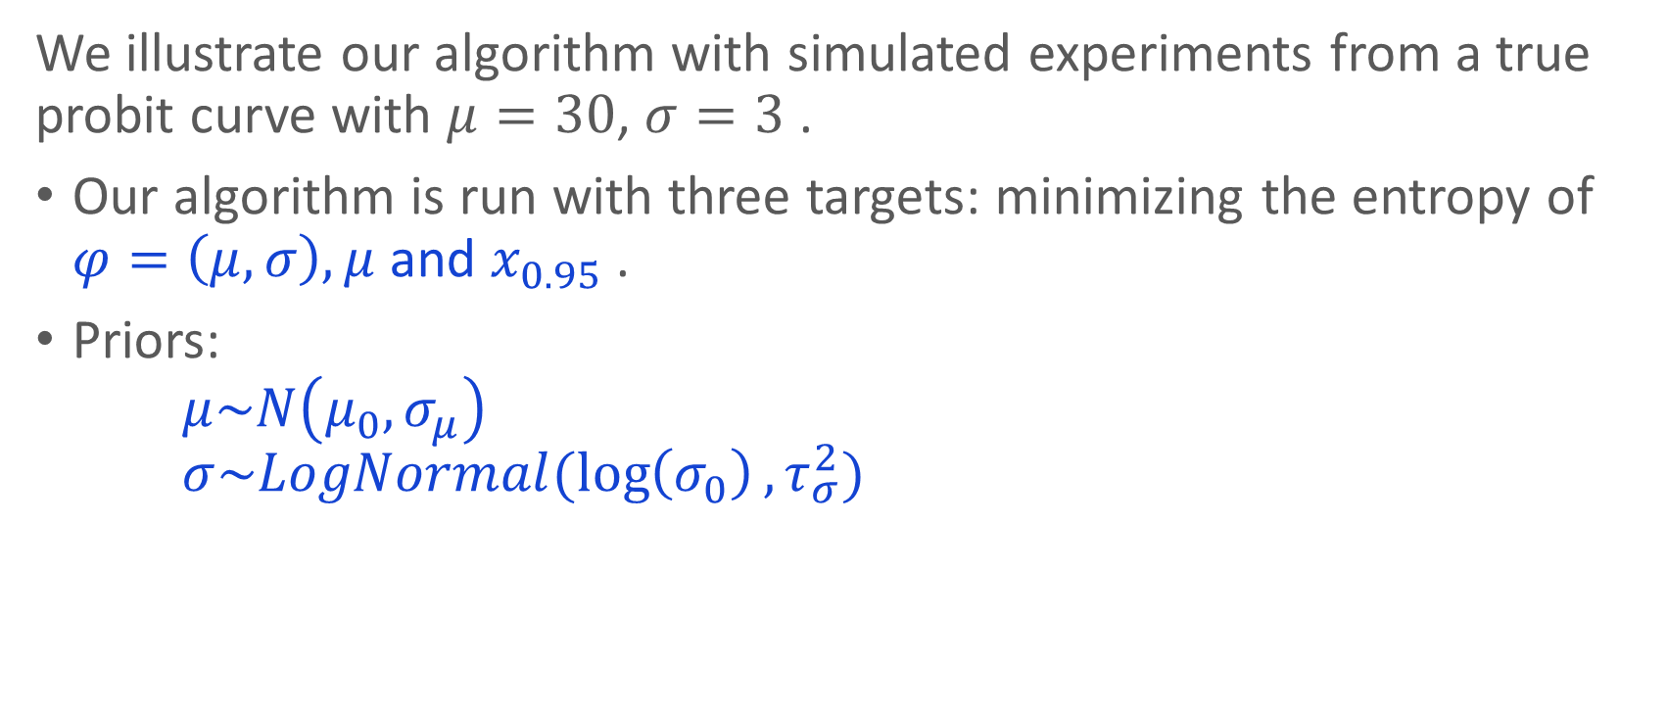
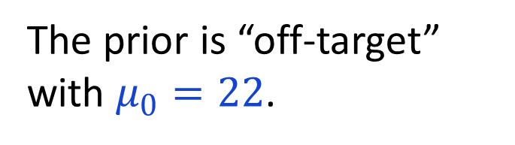
Examples
We illustrate our algorithm with simulated experiments from a true probit curve with $μ=30$, $σ=3$ .
Our algorithm is run with three targets: minimizing the entropy of $φ=\left(μ,σ\right), μ$ and $x_{0.95}$ .
Priors: $μ\sim N\left(μ_{0},σ_{μ}\right)$ $σ\sim LogNormal(\log\left(σ_{0}\right),τ_{σ}^{2})$
The prior is “off-target” with $μ_{0}=22$.

Slide 16
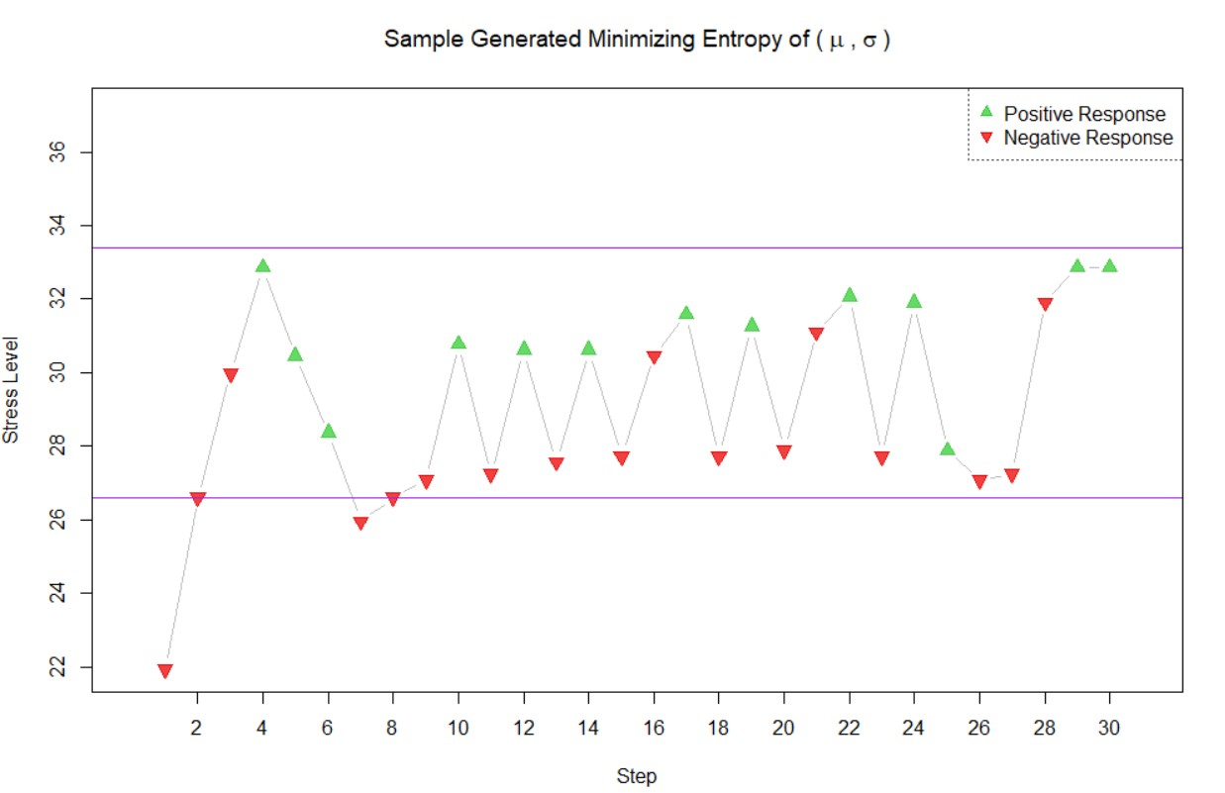

Typical Entropy Sample: $φ=(μ,σ)$
Notes:
Off target, independent priors
I purple – the D-optimal design is concentrating the observations on $μ±1.136σ$

Slide 17
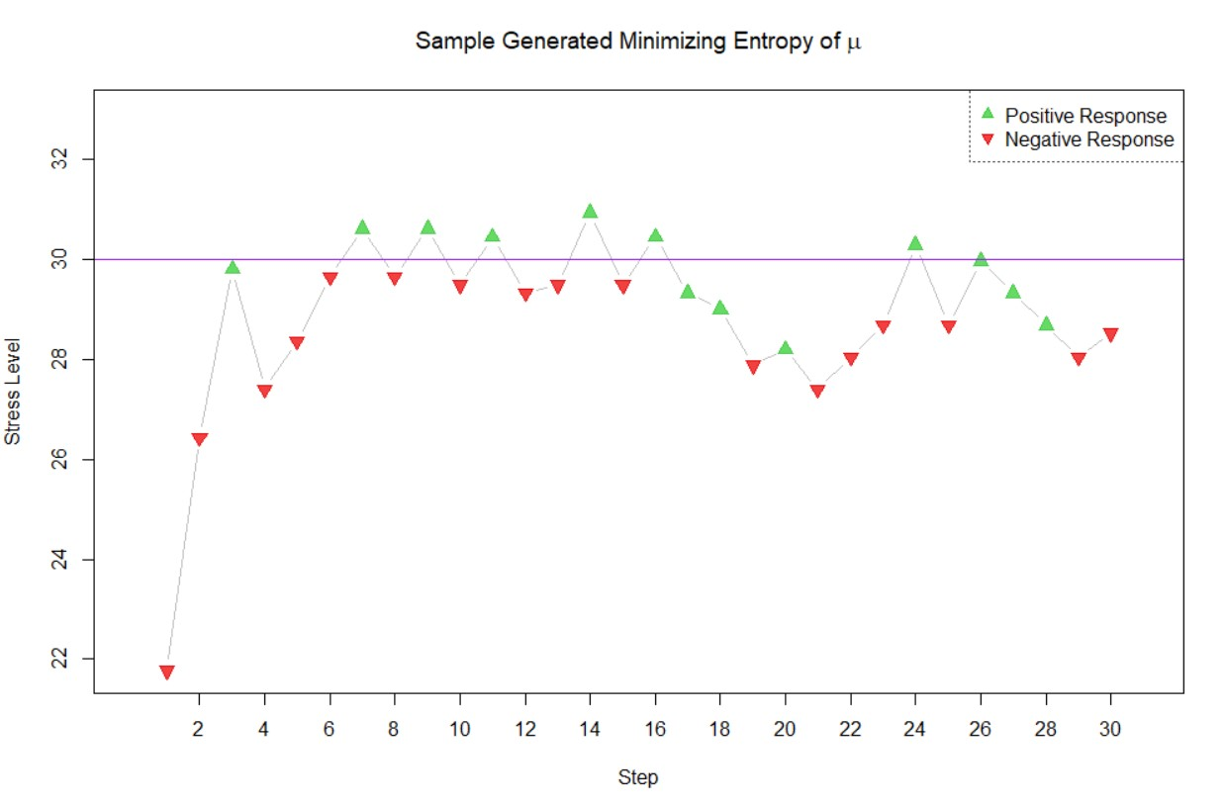

Typical Entropy Sample: $φ=μ$

Slide 18
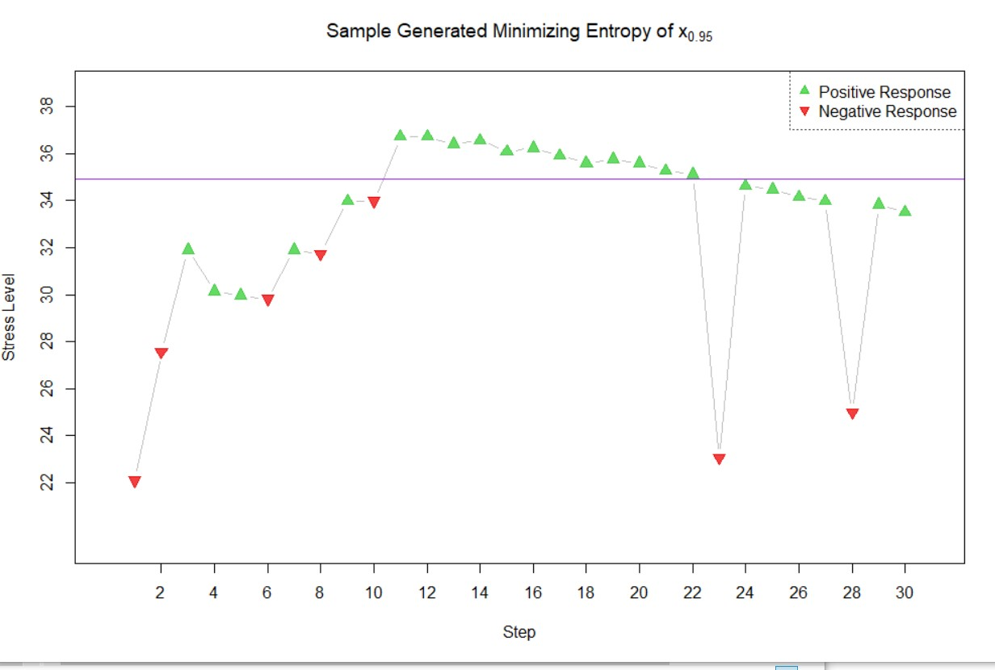

Typical Entropy Sample: $φ=x_{0.95}$

Slide 19
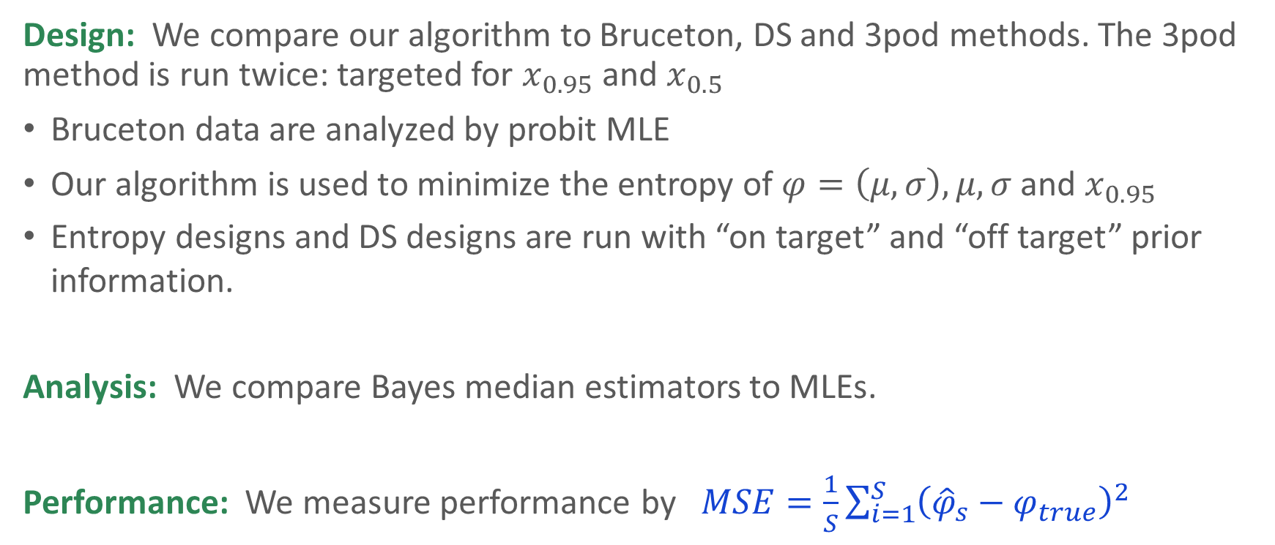
Simulation Results
Design: We compare our algorithm to Bruceton, DS and 3pod methods. The 3pod method is run twice: targeted for $x_{0.95}$ and $x_{0.5}$
Bruceton data are analyzed by probit MLE
Our algorithm is used to minimize the entropy of $φ=\left(μ,σ\right), μ, σ$ and $x_{0.95}$
Entropy designs and DS designs are run with “on target” and “off target” prior information.
Analysis: We compare Bayes median estimators to MLEs.
Performance: We measure performance by $MSE=\frac{1}{S}\sum_{i=1}^{S}{{\left({\hat{φ}}_{s}−φ_{true}\right)}^{2}}$

Slide 20
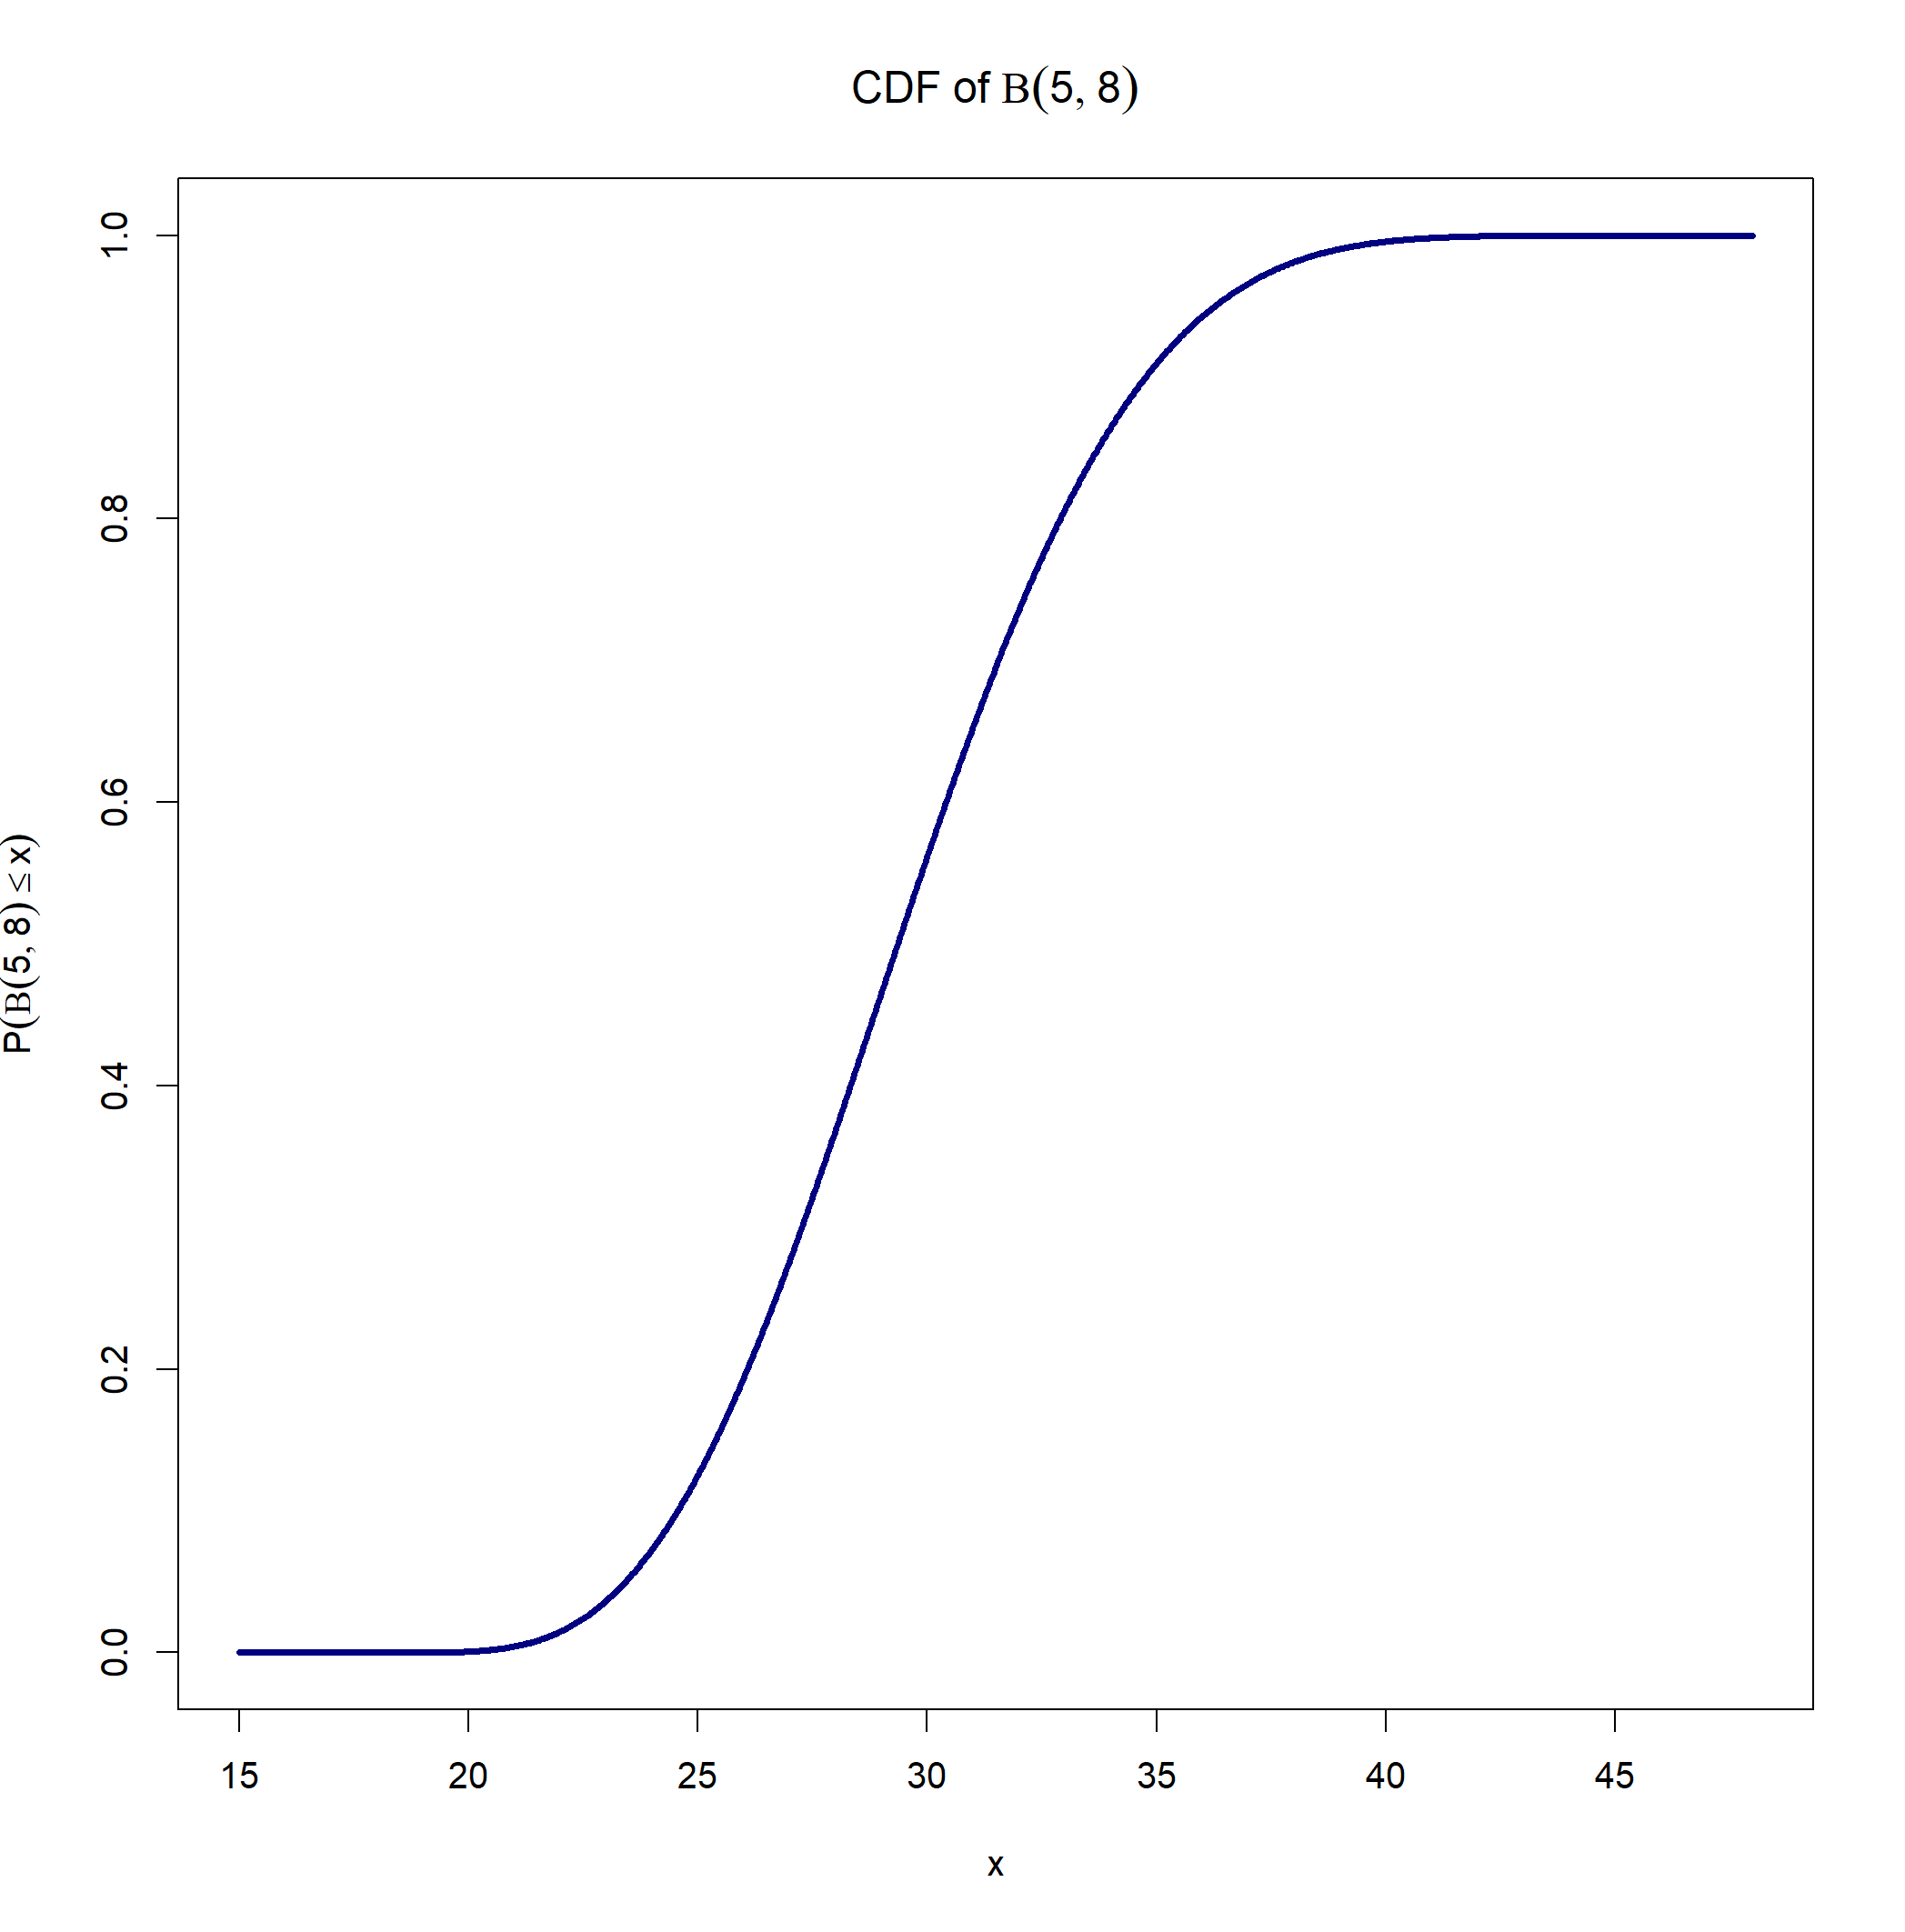

Simulation Results
We consider data from a normal sensitivity distribution and from an asymmetric Beta distribution. For both distributions, $μ=30$, $σ=3$

Slide 21
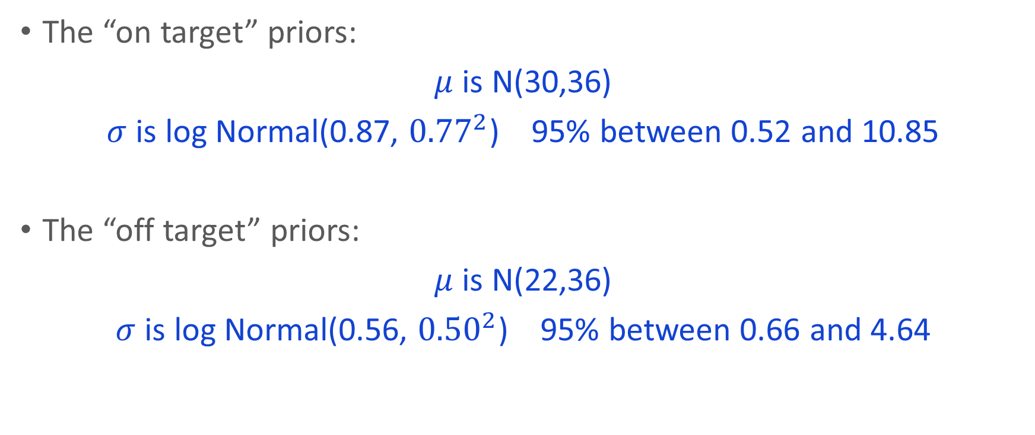
Simulation Results
The “on target” priors:
$μ$ is N(30,36)
$σ$ is log Normal(0.87, ${0.77}^{2}$) 95% between 0.52 and 10.85
The “off target” priors:
$μ$ is N(22,36)
$σ$ is log Normal(0.56, ${0.50}^{2}$) 95% between 0.66 and 4.64

Slide 22
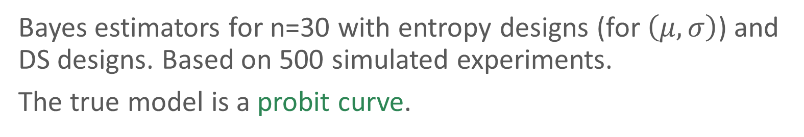
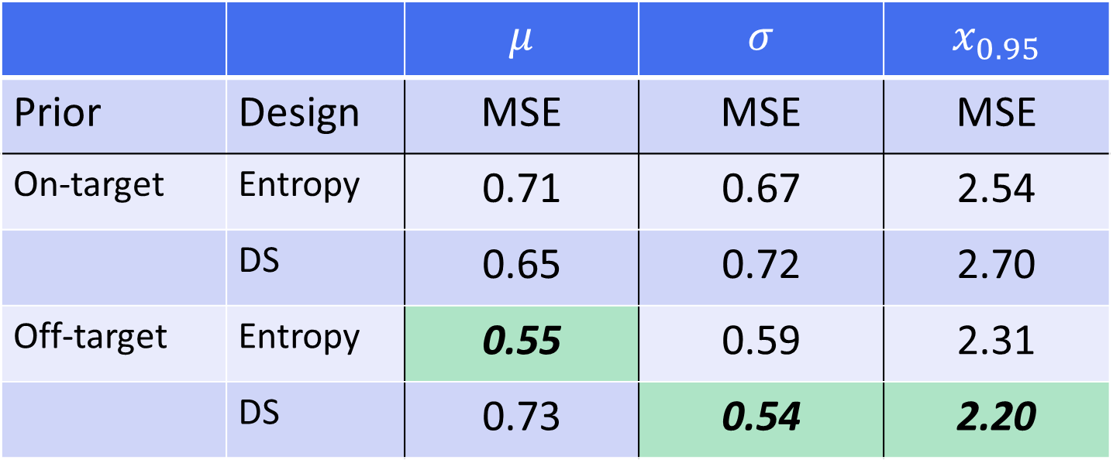
Simulation Results
Bayes estimators for n=30 with entropy designs (for $\left(μ,σ\right)$) and DS designs. Based on 500 simulated experiments.
The true model is a probit curve.
 |  | $$μ$$ | $$σ$$ | $$x_{0.95}$$
Prior | Design | MSE | MSE | MSE
On-target | Entropy | 0.71 | 0.67 | 2.54
 | DS | 0.65 | 0.72 | 2.70
Off-target | Entropy | 0.55 | 0.59 | 2.31
 | DS | 0.73 | 0.54 | 2.20

Slide 23
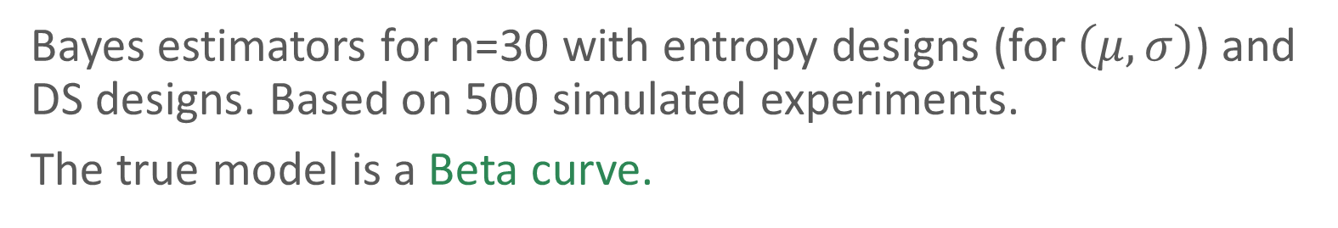
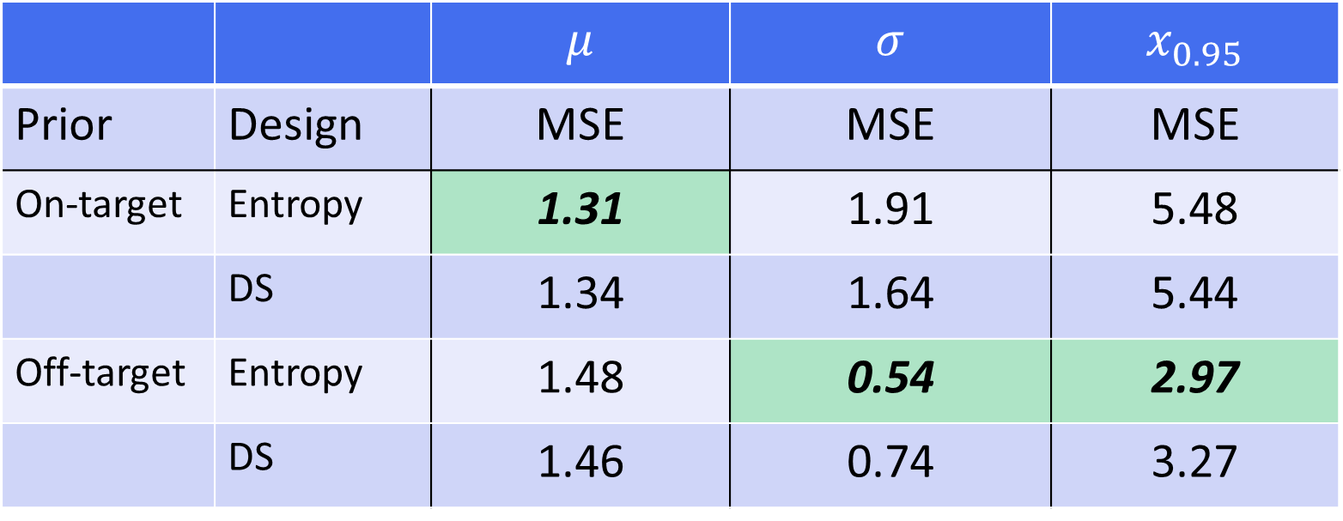
Simulation Results
Bayes estimators for n=30 with entropy designs (for $\left(μ,σ\right)$) and DS designs. Based on 500 simulated experiments.
The true model is a Beta curve.
 |  | $$μ$$ | $$σ$$ | $$x_{0.95}$$
Prior | Design | MSE | MSE | MSE
On-target | Entropy | 1.31 | 1.91 | 5.48
 | DS | 1.34 | 1.64 | 5.44
Off-target | Entropy | 1.48 | 0.54 | 2.97
 | DS | 1.46 | 0.74 | 3.27

Slide 24
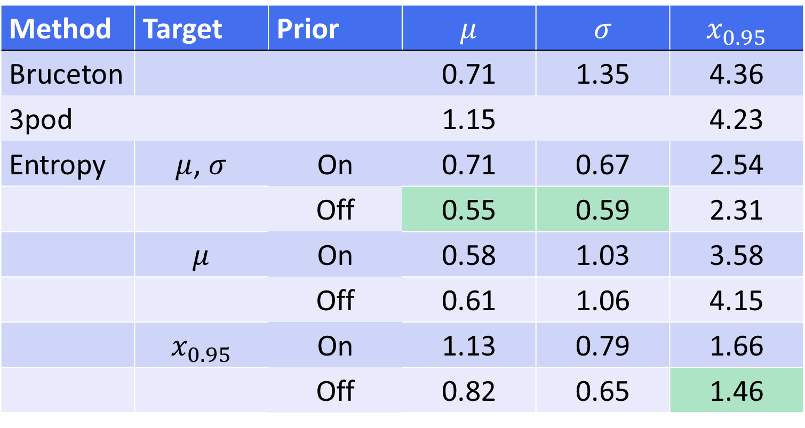
Simulation Results
Method comparison for n=30. Based on 500 simulated experiments. The true model is a probit curve.
Method | Target | Prior | $$μ$$ | $$σ$$ | $$x_{0.95}$$
Bruceton |  |  | 0.71 | 1.35 | 4.36
3pod |  |  | 1.15 |  | 4.23
Entropy | $μ$, $σ$ | On | 0.71 | 0.67 | 2.54
 |  | Off | 0.55 | 0.59 | 2.31
 | $$μ$$ | On | 0.58 | 1.03 | 3.58
 |  | Off | 0.61 | 1.06 | 4.15
 | $$x_{0.95}$$ | On | 1.13 | 0.79 | 1.66
 |  | Off | 0.82 | 0.65 | 1.46

Slide 25
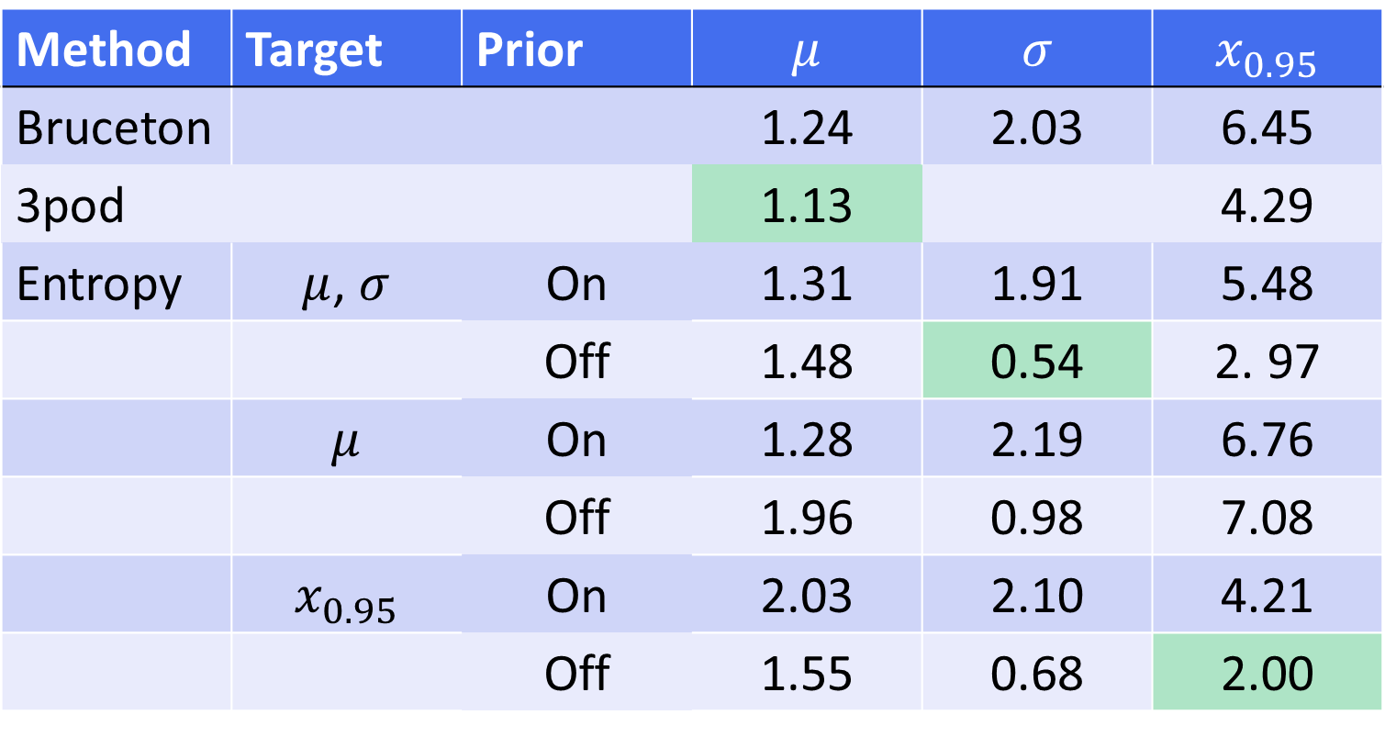
Simulation Results
Method comparison for n=30. Based on 500 simulated experiments. The true model is a Beta curve.
Method | Target | Prior | $$μ$$ | $$σ$$ | $$x_{0.95}$$
Bruceton |  |  | 1.24 | 2.03 | 6.45
3pod |  |  | 1.13 |  | 4.29
Entropy | $μ$, $σ$ | On | 1.31 | 1.91 | 5.48
 |  | Off | 1.48 | 0.54 | 2. 97
 | $$μ$$ | On | 1.28 | 2.19 | 6.76
 |  | Off | 1.96 | 0.98 | 7.08
 | $$x_{0.95}$$ | On | 2.03 | 2.10 | 4.21
 |  | Off | 1.55 | 0.68 | 2.00

Slide 26
Summary
Maximum change in entropy is an efficient criterion for sensitivity experiments.
The method can be applied with multiple stressor variables.
It requires a Bayesian analysis with an explicit description of prior information.
Simulation results show that the method yields good estimates of key features.
Using entropy allows the team to focus on the goal(s) that are really important.
Our shiny app makes it easy to implement entropy design and to analyze the results.

