Slide 1
Compositional Assurance
Integrating Formal Verification with Statistical T&E for Mission-Critical AI Systems
The IRON COMPASS Framework
Tiffany A. Ceasor
Founder & Principal Researcher
Technological Society of Applied Research (TSAR)
Ph.D. candidate, Florida Atlantic University
VP Technical Mission Strategy & Growth, RiVidium.Inc
DATAWorks 2026 · Alexandria, VA
IRON COMPASS was funded and produced entirely by the Technological Society of Applied Research (TSAR), a 501(c)(3) research organization, and is its intellectual property. © 2026. All rights reserved.

Slide 2
The T&E Problem
how do we provide rigorous assurance for systems whose input spaces are effectively infinite?
Three paradigms are available — and none alone suffices:
∞
Statistical T&E
characterizes behavior on samples; cannot guarantee undesirable outcomes never occur
infinite operational input space
Formal Verification
proves properties universally; scalability limits on complex architectures
LLMs in defense decision-support
Classifier + policy-compliance stacks
Autonomous and semi-autonomous systems
LLM Self-Check
the check and the generated output draw from the same learned distribution — evidence is correlated, not independent
IRON COMPASS · DATAWorks 2026 · Ceasor (TSAR)
2
© 2026 Technological Society of Applied Research (TSAR). Funded and produced entirely by TSAR. All rights reserved.

Slide 3
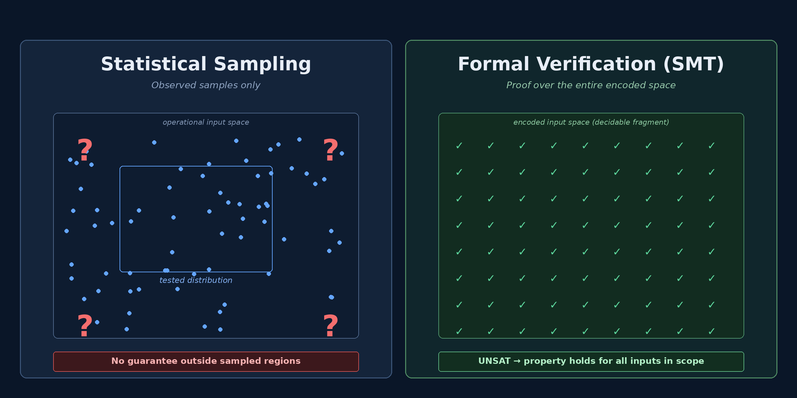
Statistical Sampling vs. Formal Verification
different epistemics — neither alone answers “no undesirable output, ever”
→ The IRON COMPASS claim: apply the strongest feasible method to each partition of the requirements.
IRON COMPASS · DATAWorks 2026 · Ceasor (TSAR)
3
© 2026 Technological Society of Applied Research (TSAR). Funded and produced entirely by TSAR. All rights reserved.

Slide 4
The Key Insight
different system properties admit different verification strategies
Safety-critical properties
e.g., “the system never outputs an unauthorized command”
→ formally verifiable with SMT — mathematical certainty, not statistical confidence
Performance properties
e.g., “classification accuracy exceeds 95% on operationally representative inputs”
→ characterized by statistical T&E with quantified confidence intervals
Partition the requirements · apply the strongest feasible method · compose the evidence
IRON COMPASS · DATAWorks 2026 · Ceasor (TSAR)
4
© 2026 Technological Society of Applied Research (TSAR). Funded and produced entirely by TSAR. All rights reserved.

Slide 5
The IRON COMPASS Four-Tier Assurance Hierarchy
the tiers organize evidence; the method-binding discipline is the contribution
Formally Verified
TIER 1
Evidence: Proof certificate per checked output
Universal proof via SMT solving
Statistically Bounded
TIER 2
Evidence: CIs with seeds; drift time-series
Confidence intervals + drift monitoring
Empirically Tested
TIER 3
Evidence: Pre-registered rubric + reviewer trail
Structured SME judgment
Assumed (Context & Monitoring)
TIER 4
Evidence: Assumption register with monitoring plan
Audited assumption + monitoring plan
Each property is assigned to exactly one tier via an ordered classification procedure (next slide).
IRON COMPASS · DATAWorks 2026 · Ceasor (TSAR)
5
© 2026 Technological Society of Applied Research (TSAR). Funded and produced entirely by TSAR. All rights reserved.

Slide 6
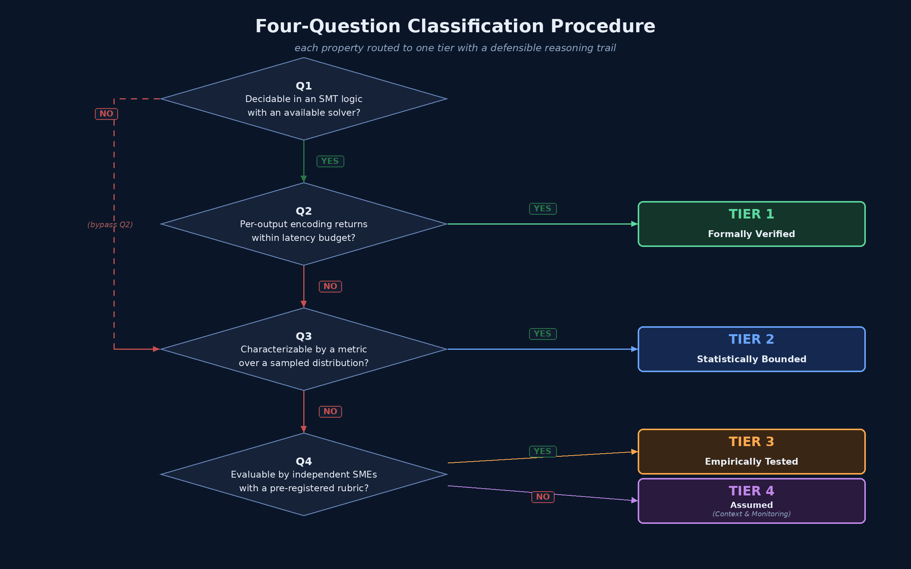
IRON COMPASS Classification Procedure
four ordered questions — each property routes to exactly one tier
Decision trail itself becomes auditable evidence in the T&E record.
IRON COMPASS · DATAWorks 2026 · Ceasor (TSAR)
6
© 2026 Technological Society of Applied Research (TSAR). Funded and produced entirely by TSAR. All rights reserved.

Slide 7
Tier 1 — Formally Verified
universal proof with respect to an encoded specification
What Tier 1 guarantees
Example: “no unauthorized command in output”
Every released output was checked against the encoded constraint
UNSAT → property holds for all inputs in scope
The runtime checker — not the model — is the source of the guarantee
Proof certificate is independently checkable
(set-logic QF_SLIA)
(declare-const output String)
(assert (not (str.contains output
"shutdown")))
(assert (not (str.contains output
"launch_authorize")))
(check-sat)
Pre-deployment requirements
At runtime: bind the generated output to the constant, query the solver. UNSAT → release. SAT → block and log.
Encoding validation (domain expert review)
Known-pass / known-fail test corpus
Rule-set consistency proof (standalone solver query)
Input canonicalization + fail-closed timeout policy
Z3 / cvc5 · millisecond-scale latency on per-output checks — within interactive T&E budgets
IRON COMPASS · DATAWorks 2026 · Ceasor (TSAR)
7
© 2026 Technological Society of Applied Research (TSAR). Funded and produced entirely by TSAR. All rights reserved.

Slide 8
Tier 2 — Statistically Bounded
confidence-interval characterization + drift monitoring against the pre-deployment bound
Pre-deployment
Illustrative: accuracy CI with drift trigger
W1–W8 = weekly drift-monitoring windows post-deployment
Designed experiment on stratified sample
Sample size chosen for target CI width (e.g., ±3 pp at p≈0.80)
Wilson-score CIs for binomial proportions; Clopper–Pearson where conservatism is preferred
Test dataset withheld by the OTA (DoDM 5000.101)
Runtime
Drift monitoring against pre-deployment baseline
PSI / KS / χ² — or JS, Wasserstein, MMD for subtler shifts
Multiple-testing discipline (Bonferroni or hierarchical)
CUSUM / change-point where automated triggers required
Drift detected at W6 → investigation + possible re-accreditation
IRON COMPASS · DATAWorks 2026 · Ceasor (TSAR)
8
© 2026 Technological Society of Applied Research (TSAR). Funded and produced entirely by TSAR. All rights reserved.

Slide 9
Tier 3 & Tier 4 — Judgment and Context
structured human judgment, and honest accounting of what is assumed
TIER 3 — Empirically Tested
TIER 4 — Assumed (Context & Monitoring)
structured human judgment on representative scenarios
disciplined record of what is assumed — and how it is policed
Operational vignettes representative of mission context
Pre-registered rubric (Likert scale) — tone, format, operational fit
Multiple independent SMEs
Krippendorff’s α ≥ 0.80 for mission-critical T&E
Evidence ships with the system — does not run on live decisions
Honest about scope: covers what was tested
Environmental assumptions (network, vendor, data provenance)
Rationale documented (SLA, heritage, upstream behavior)
Monitoring plan — triggers on assumption violation
Not an assurance claim about the system
Discipline: surface the assumption, don’t hide it
Auditable by oversight (DOT&E, MDA)
IRON COMPASS · DATAWorks 2026 · Ceasor (TSAR)
9
© 2026 Technological Society of Applied Research (TSAR). Funded and produced entirely by TSAR. All rights reserved.

Slide 10
IRON COMPASS Property-Class to SMT-Theory Mapping
encoding sketches are standard SMT-LIB — the taxonomy as a T&E methodology is the contribution
Class | Property form | Theory | Example
A1 | Output-pattern exclusion | QF_SLIA | no restricted command in output
A2 | Output-pattern required form | QF_SLIA | required header prefix
B1 | Scored quantity vs. threshold | QF_LRA | toxicity < 0.15
B2 | Composite score constraint | QF_LRA | weighted-risk composite
C1 | Structured lookup — exclusion | QF_UFLIA | entity not restricted
C2 | Structured lookup — authorization | QF_UFLIA | role authorized for action
D1 | Integrity vs. committed reference | QF_SLIA | hash matches commitment
E1 | Bounded length | QF_SLIA | length ≤ 4,096 tokens
E2 | Fixed-width identifier format | QF_BV | type tag in high 16 bits
Individual encodings are standard SMT-LIB. The classification as a T&E methodology is the contribution.
IRON COMPASS · DATAWorks 2026 · Ceasor (TSAR)
10
© 2026 Technological Society of Applied Research (TSAR). Funded and produced entirely by TSAR. All rights reserved.

Slide 11
Case Study — LLM Logistics Decision-Support
apply the IRON COMPASS framework end-to-end to a representative AI system
System
The question
LLM deployed as a logistics planning decision-support tool
Accepts natural-language queries from a human planner
Returns recommendations — the planner retains decision authority
Consistent with DoDI 5000.98 (human judgment over lethal effects)
Which of these requirements can we prove, which must we characterize, which must we test, and which must we assume?
IRON COMPASS provides an answer and a reasoning trail — next slide.
Requirements to evaluate
No unauthorized-command output
Output length ≤ 4,096 tokens
No PII pattern in output
Accuracy and latency on operational queries
Response tone and operational fit
Infrastructure availability
IRON COMPASS · DATAWorks 2026 · Ceasor (TSAR)
11
© 2026 Technological Society of Applied Research (TSAR). Funded and produced entirely by TSAR. All rights reserved.

Slide 12
Case Study — Tier Assignments
running the IRON COMPASS classification procedure on each requirement
Property | Tier | Class / method | Rationale
No unauthorized-command output | 1 | A1 / SMT UNSAT | decidable; within latency budget; safety-critical
Output length ≤ 4,096 tokens | 1 | E1 / SMT UNSAT | trivially decidable and cheap
No PII pattern in output | 1 | A1 / SMT UNSAT | pattern-based; policy-critical
Response accuracy on stratified sample | 2 | Designed experiment + PSI drift | measurable; not universally verifiable
p95 response latency ≤ 2.0 s | 2 | Designed experiment + KS drift | empirically measurable; subject to drift
Response tone and operational fit | 3 | SME panel + rubric | holistic judgment; no single metric
Infrastructure availability ≥ 99.9% | 4 | Vendor SLA + assumption register | out of scope for system verification
The tier mix reflects the system: safety-critical content → Tier 1; behavior → Tier 2; usability → Tier 3; environment → Tier 4.
IRON COMPASS · DATAWorks 2026 · Ceasor (TSAR)
12
© 2026 Technological Society of Applied Research (TSAR). Funded and produced entirely by TSAR. All rights reserved.

Slide 13
Why SMT — not an LLM — Carries Tier 1
evidence independence is the operative requirement
LLM self-check — cannot carry Tier 1
SMT solver — independent evidence source
Hallucinated outputs are often high-likelihood in the model’s own distribution
A model's judging probabilities and its generating probabilities draw from the same learned distribution — the check and the output are statistically correlated, not independent
Learning-theoretic results (Xu et al. 2024; Banerjee et al. 2024): LLMs cannot learn all computable functions
A separate LLM-as-checker inherits training-data overlap and architectural priors — correlated failure modes
Does not share the generator’s training distribution or architectural biases
Independently checkable proof objects
Neurosymbolic tools (VeriCoT, AWS ARC) use the LLM as a translator — the symbolic checker is the arbiter
LLM-as-judge without a symbolic backstop → Tier 3 (not excluded, but not Tier 1)
IRON COMPASS · DATAWorks 2026 · Ceasor (TSAR)
13
© 2026 Technological Society of Applied Research (TSAR). Funded and produced entirely by TSAR. All rights reserved.

Slide 14
IRON COMPASS Unified Assurance Case → TEMP / IDSK / MBRA
the four tiers assemble into the evidence a DoD acquisition decision actually needs
Tier-specific evidence preserved for the life of the system
Policy alignment
Tier 1
DoDM 5000.100 — TEMP / T&E Strategy structure
SMT-LIB specs · encoding-validation evidence · proof certificate per output · timeout policy
DoDM 5000.101 — OT&E / LFT&E for AI-enabled systems; test dataset withholding
Tier 2
test design · CIs with seeds · multiple-testing policy · drift time-series
DoDI 5000.98 · IDSK — Tier 1 proofs + Tier 2 bounds populate the Integrated Decision Support Key
Tier 3
DoDI 5000.98 · MBRA — Tier 1 adversarial-robustness + Tier 2 drift update Mission-Based Risk Assessment
vignettes · pre-registered rubric · reviewer ratings + agreement stats · reviewer identities
DoDD 3000.09 — Autonomy; human judgment over lethal effects preserved
Tier 4
assumption register · rationale · monitoring plan · violation log
NIST AI RMF 1.0 — outcome-level functions — IRON COMPASS prescribes the method binding
IRON COMPASS · DATAWorks 2026 · Ceasor (TSAR)
14
© 2026 Technological Society of Applied Research (TSAR). Funded and produced entirely by TSAR. All rights reserved.

Slide 15
Takeaways — IRON COMPASS for T&E Practitioners
what to do Monday morning
1
Partition before you test
List each requirement. Route through the four-question procedure. The routing itself is auditable evidence.
2
Use SMT for the decidable, safety-critical content
Not for everything — only where properties live in decidable fragments and latency fits. Z3 and cvc5 are mature.
3
Let statistical T&E do what it does best
Designed experiments, CIs, drift monitoring — with multiple-testing discipline and DoDM 5000.101-compliant withholding.
4
Make assumptions first-class
Tier 4 is not weakness — it is disciplined accounting. What is assumed, and how will we know when it fails?
5
The compositional structure carries the argument
No single tier carries it alone. Independence between tiers is the property that makes the stack defensible.
Replacing binary “passed/failed” determinations with nuanced statements about what has been proven, what has been bounded, and what remains assumed.
IRON COMPASS · DATAWorks 2026 · Ceasor (TSAR)
15
© 2026 Technological Society of Applied Research (TSAR). Funded and produced entirely by TSAR. All rights reserved.

Slide 16
Thank you
Questions?
Tiffany A. Ceasor
tiffany@thetsar.org · ORCID 0009-0008-5799-6052
Full paper: ITEA Journal of Test and Evaluation (forthcoming)
The IRON COMPASS framework was funded and produced entirely by the Technological Society of Applied Research (TSAR), a 501(c)(3) research organization, and is its intellectual property. © 2026. All rights reserved.

