Slide 1



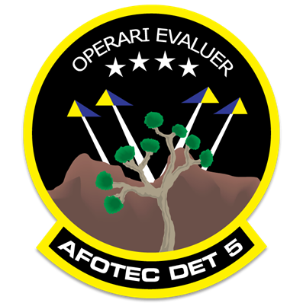
Resource Implications and Benefits of Model-Based Acquisition Planning
Jose L. Alvarado Jr., PhD
AFOTEC Detachment 5
Jose.alvarado.2@su.af.mil
April 22, 2026

Slide 2
Introduction: DoD Digital Engineering Strategy
Digital Engineering Strategy Vision: To modernize how the department designs, develops, delivers, operates, and sustains systems by securely and safely connecting people, processes, data, and capabilities across an end-to-end digital enterprise.
Help AFOTEC implement the DOD’s digital engineering strategy vision [1]
Processes and procedures that use system engineering concepts, such as MBSE, need to be developed.
Educate personnel in conducting testing using MBSE.
Motivation
Acquisition programs benefit from integrating developmental and operational T&E, including testers, both earlier in the acquisition process and through the end of the acquisition life cycle.
In response to the DoD’s digital modernization strategy, the Air Force Operational Test and Evaluation Center (AFOTEC) is helping to evolve the Air Force’s digital-engineering technology ecosystem.
Introduction & Background
Case Studies
Evaluation Process
Results
Conclusion

Slide 3
The Flight Test Application
Design Abstraction Level
Model-based testing (MBT) is the design of software tests using an abstract model that represents one or more aspects” [2].
The Model-Driven Test Design (MDTD) process divides testing into tasks that simplify test generation [2].
Helps test designers isolate tasks at a higher abstraction level.
Design test values independently of the details of the software or design artifacts and test execution.
Reuse of defined requirements/test specifications
Model/ Structure
Test Requirements
Redefined requirements/test specifications
Test Design
Implementation Abstraction Level
Test artifact
Test Planning
Input Values
Pass/Fail
Test Results
Test Scripts
Reuse Test Cases
Test Cases
Test Evaluation
Test Execution
Introduction & Background
Case Studies
Evaluation Process
Results
Conclusion

Slide 4
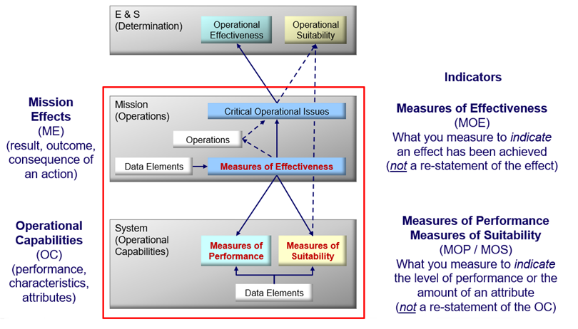
Current flight-testing approach in flight testing
Served as the baseline on which we will develop a model-based process
Measure Hierarchies and the overall AFOTEC OT&E construct.
AFOTEC A-2/9, "Air Force Operational Test and Evaluation Center Test Design Guide,". Albuquerque: AFOTEC, 2018.
Introduction & Background
Case Studies
Evaluation Process
Results
Conclusion

Slide 5
Case Studies
Two case studies were developed and produced using SysML implemented in MBSE with the Dassault Systems’ Cameo Systemes Modeler™ software package to execute and assess the proposed process.
The Combat Search and Rescue Locator (CSARL)
AFOTEC’s CSARL system is a fictional system developed as a training tool for flight test personnel to learn test planning.
The E-X airborne multi-sensor platform (E-X Platform)
The E-X system is an example of a moderately complex system that is readily accessible in the Effective Model-Based Systems Engineering textbook [4] and easily replicated in Cameo.
Additionally, it offers another platform for comparing outcomes between document-centric and model-centric processes.
Introduction & Background
Case Studies
Evaluation Process
Results
Conclusion

Slide 6
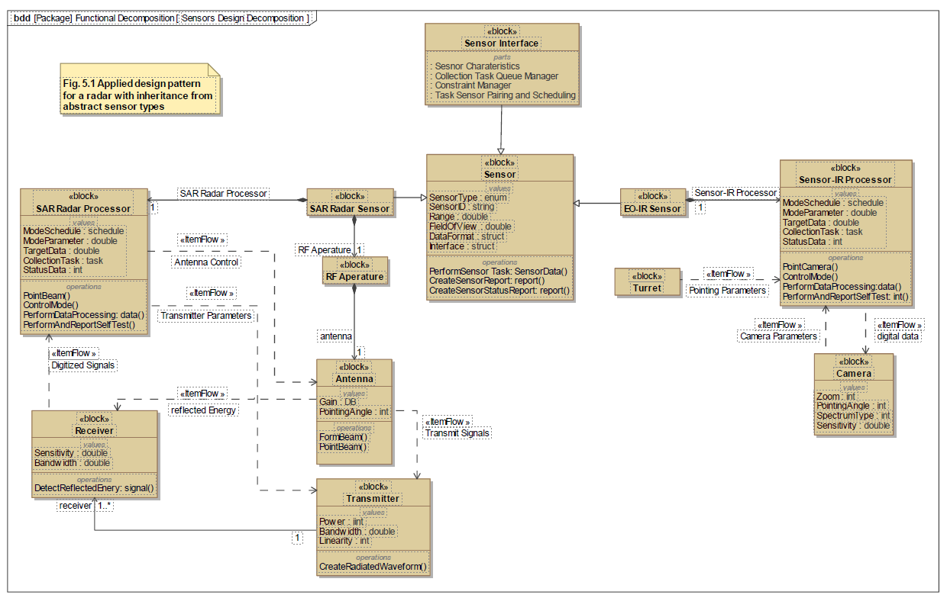
Case Studies
E-X Airborne Sensor Platform used in the Effective Model-Based Systems Engineering textbook [4].
The E-X airborne multi-sensor platform gathers intelligence, surveillance, and reconnaissance (ISR) data.
Operates in collaboration with ground stations and affiliated organizations, facilitating the collection and dissemination of ISR products.
E-X executes ISR missions and performs aerial imaging and sensing functions [4].
Introduction & Background
Case Studies
Evaluation Process
Results
Conclusion

Slide 7
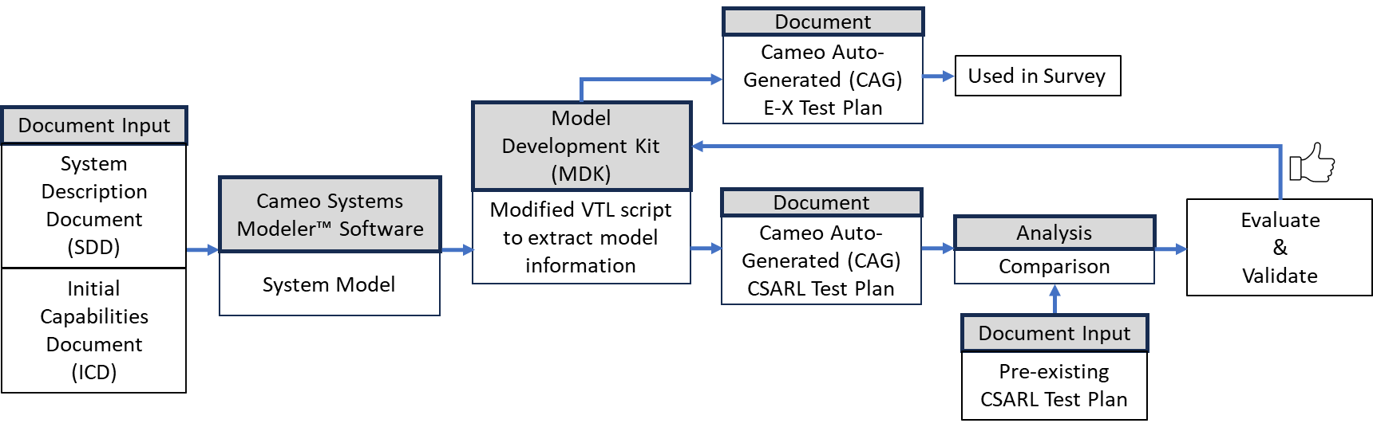
Auto-Generated E-X Airborne Sensor Platform Test Plan
The process used to generate the Cameo Auto-Generated (CAG) draft test plan leveraging readily available information in SysML diagrams in Cameo using the “AFOTEC Methodology” test structure.
Introduction & Background
Case Studies
Evaluation Process
Results
Conclusion

Slide 8
System Usability Survey
To assess the Cameo auto-generated (CAG) draft test plan, will use the System Usability Survey (SUS)
Developed in 1986 as a questionnaire designed to assess users' perceptions of a system's usability quickly [5].
“The international standard ISO 9241 breaks the measurement of usability down into three separate components that must be defined relative to the context of use” [5]:
Effectiveness: Whether people can complete their tasks and achieve their goals.
Efficiency: The extent to which they expend resources to achieve their goals.
Satisfaction: The level of comfort the experience provides in achieving their goals.
The objective of the SUS is to provide a measure of a subject’s perceptions of the usability of a system or product in a short period during the evaluation [5].
Introduction & Background
Case Studies
Evaluation Process
Results
Conclusion

Slide 9
Interpretation of the System Usability Survey Score
The SUS score, developed by Bangor, Kortum, and Miller in 2009, ranges from 0 to 100 [6].
They created a scale that correlates users' SUS scores with specific adjectives and ratings to provide a grading score.
Research has shown that SUS can effectively measure a system's perceived usability with a small sample size (around 8-12 users), providing a reliable assessment of how people view your system or product [5].
AFOTEC uses the acceptability ranges and adjective ratings to evaluate a SUT's usability, effectiveness, and suitability.
Introduction & Background
Case Studies
Evaluation Process
Results
Conclusion

Slide 10
Structure of the Survey
The Survey consisted of the ten SUS questions along with demographic data to assess the participants’ experience level.
The survey asked follow-up questions to assess the effectiveness and suitability of the CAG draft test plans.
The suitability assessment was divided into questions that addressed value and quality.
The survey also asked two questions focused on assessing the time savings the auto-generated test plan offers.
Based on the participants’ opinions, estimate a percentage of time savings the auto-generated test plan could provide.
The last question asked the participants’ opinions on recommending the CAG draft test plan as a tool for developing test plans for SUTs.
The survey was conducted using Microsoft Forms.
Participants were invited to participate through an email invitation containing the Microsoft forms link.
Was conducted from 24 Jun through 12 July 2024.
Introduction & Background
Case Studies
Evaluation Process
Results
Conclusion

Slide 11
Experience Level Based on Participant’s Self-Evaluation
The survey focused on evaluating the usability, effectiveness, and suitability.
Involved 21 participants
Current AFOTEC members from Detachment 5.
T&E professionals with diverse operational experience and maintenance backgrounds
Including civilians, officers, and enlisted personnel.
Each participant was assigned an overall experience level used in the survey analysis.
Determination of Experience Level Based on Participant’s Self-Evaluation
Introduction & Background
Case Studies
Evaluation Process
Results
Conclusion

Slide 12
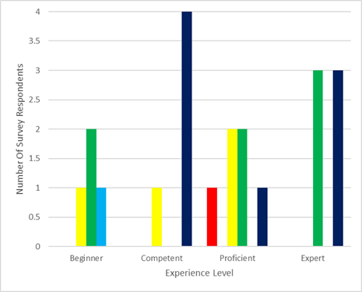
Results of System Usability Survey – Using Adjective Rating
CAG test plan’s overall adjective rating:
“Good” or better.
Classification of SUS Scores Based on Adjective Rating.
Distribution of Participant SUS Scores Based on Adjective Rating and Experience Level.
Stratification of SUS Scores Based on Adjective Rating.
Introduction & Background
Case Studies
Evaluation Process
Results
Conclusion

Slide 13
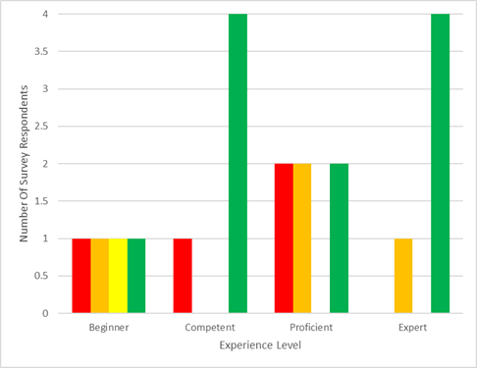
Results of System Usability Survey - Acceptability Rating
CAG test plan’s overall acceptability rating: “?”
Stratification of SUS Scores Based on Acceptability Rating.
Stratification of SUS Scores Based on Acceptability Rating.
Distribution of Participant SUS Scores Based on Acceptability Rating and Experience Level.
Introduction & Background
Case Studies
Evaluation Process
Results
Conclusion

Slide 14
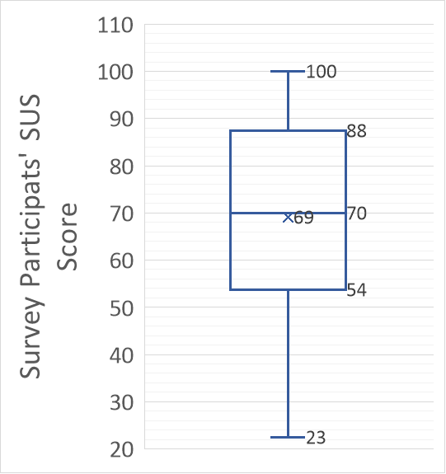
User System Usability Survey Score
SUS score of 68 corresponds to the 50th percentile [22].
Scores above 70 are typically considered good [22].
85 indicating excellent usability [22]
Scores below 50 suggest poor user experience [22].
The average SUS score is 69, suggesting that the auto-generated test plan has “slightly above-average” usability.
Box plot showing the Distribution of the Average SUS Scores Based on Experience Level.
Introduction & Background
Case Studies
Evaluation Process
Results
Conclusion

Slide 15
Effectiveness Data Collected During the Survey
Effectiveness data collected During the Survey and ordered based on responses.
Introduction & Background
Case Studies
Evaluation Process
Results
Conclusion

Slide 16
Value Data Collected During the Survey
Value data collected During the Survey and ordered based on responses.
Introduction & Background
Case Studies
Evaluation Process
Results
Conclusion

Slide 17
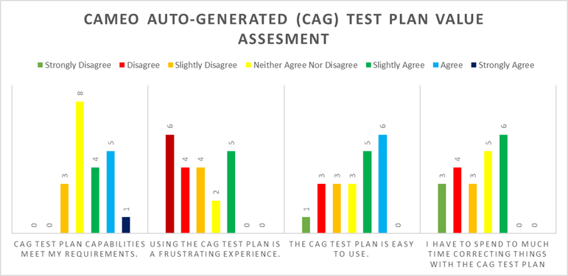
Value Data Collected During the Survey
Bar graph Illustrating the Results of the Value of the CAG Draft Test Plan.
Introduction & Background
Case Studies
Evaluation Process
Results
Conclusion

Slide 18
Quality Data Collected During the Survey
The quality of the CAG draft test plan was evaluated through feedback on five specific sections outlined in the AFOTEC Test Planning Guide.
Focused on participants' views of the plan’s section headings, the presentation of charts, figures, and diagrams, and the contents of the test plan's main body and measures section.
Quality data collected During the Survey and ordered based on responses.
Introduction & Background
Case Studies
Evaluation Process
Results
Conclusion

Slide 19
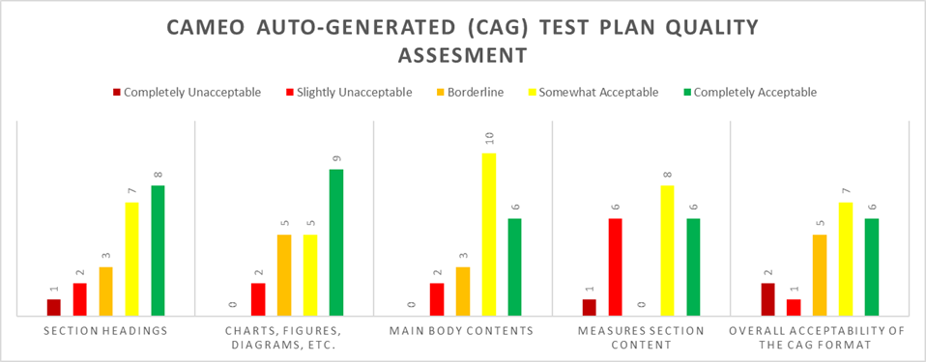
Quality Data Collected During the Survey
Bar graph Illustrating the results of the of the CAG Draft Test Plan Quality.
Introduction & Background
Case Studies
Evaluation Process
Results
Conclusion

Slide 20
Results of Time Reduction of the CAG Draft Test Plan
Reduction of Time Achieved by using the CAG draft test plan.
Reduction of Time | Number of Respondents Based on the Following Question
 | Utilizing the CAG example test plan, do you foresee a reduction of time in writing a final test plan?
YES | 20
NO | 1
Reduction Time Achieved by using the CAG draft test plan Decomposed by Experience Level.
Introduction & Background
Case Studies
Evaluation Process
Results
Conclusion

Slide 21
Results of Recommendation of the CAG Draft Test Plan
Opinion on Recommending a Test Team for Use in Writing a Final Test Plan.
Introduction & Background
Case Studies
Evaluation Process
Results
Conclusion

Slide 22
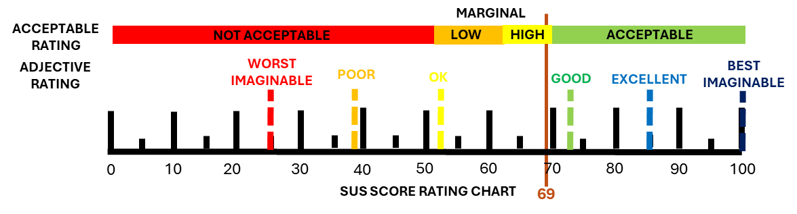
Summary of Survey –
Cameo Auto-Generated Draft Test Plan
The CAG draft test plan has proven to be a viable tool for creating and developing test plans.
The SUS results indicate that the CAG draft test plan benefits test teams.
Its suitability, effectiveness, and suitability make it a valuable resource.
AFOTEC members can use the CAG draft test plan to prepare test plans suitable for executing tests on a given SUT.
The CAG draft test plan is a welcome addition to the test planning process.
Introduction & Background
Case Studies
Evaluation Process
Results
Conclusion

Slide 23
Conclusion
This research explored software testing techniques and their processes for use in flight test T&E.
Demonstrated that an MBT approach facilitates the early establishment of test processes and test plan development.
The research delved into the software testing domain and identified techniques that could facilitate MBT constructs and methods used for flight testing planning.
These methods enabled abstract-level test planning early in the developmental process using SysML-defined activity, sequence, and use case diagrams.
Developed an AFOTEC methodology for collecting and organizing data for use in a standard AFOTEC test plan.
The structure allowed for the semi-automated generation of test plans for editing.
The test cases were used to define and create a template for the semi-automated test plan generation.
Introduction & Background
Case Studies
Evaluation Process
Results
Conclusion

Slide 24
Conclusion
This review has shown that semi-auto-generated test plans can be created from model artifacts using templates written in VTL script within the Dassault Systems’ Cameo Modeler™ software package.
The survey data shows that the AFOTEC methodology, which integrates MBT and MBSE in test plan development, is a viable process for creating and developing test plans and is beneficial in preparing suitable test plans for execution.
Moreover, the survey data indicated that using the draft test planning method can reduce the time a test team takes to develop a complete test plan, highlighting the method's effectiveness in streamlining the development process.
Introduction & Background
Case Studies
Evaluation Process
Results
Conclusion

Slide 25
Benefits: Cameo Auto-Generated Draft Test Plan
This CAG draft test plan offers substantial reduction and potential gains in efficiency.
The data indicated that using the CAG draft test plan can reduce the time a test team takes to develop a complete test plan.
Although this estimate is based on the opinions of various AFOTEC members, these professionals believe the tool can provide significant time savings.
Given that test plans typically take three to nine months to create and develop, an average time frame of 6 months translates to 75 days saved.
These findings underscore the tool's effectiveness in streamlining the test plan development process.
Introduction & Background
Case Studies
Evaluation Process
Results
Conclusion

Slide 26



Questions?

Slide 27
References
[1] Office of the Deputy Assistant Secretary of Defense for Systems Engineering. Digital Engineering Strategy. Department of Defense, Washington D.C., 2018.
[2] P. Ammann and J. Offutt, Introduction to software testing. Cambridge University Press, 2016.
[3] W. Roper, "There is no spoon: The new digital acquisition reality," Defense AR Journal, vol. 28, no. 4, pp. 488-488, 2021.
[4] J. M. Borky and T. H. Bradley, Effective Model-Based Systems Engineering. Springer International Publishing, 2018.
[5] J. Brooke, "SUS: a retrospective," Journal of Usability Studies, vol. 8, no. 2, 2013.
[6] A. Bangor, P. Kortum, and J. Miller, "Determining what individual SUS scores mean: Adding an adjective rating scale," Journal of Usability Studies, vol. 4, no. 3, pp. 114-123, 2009.

