Slide 1
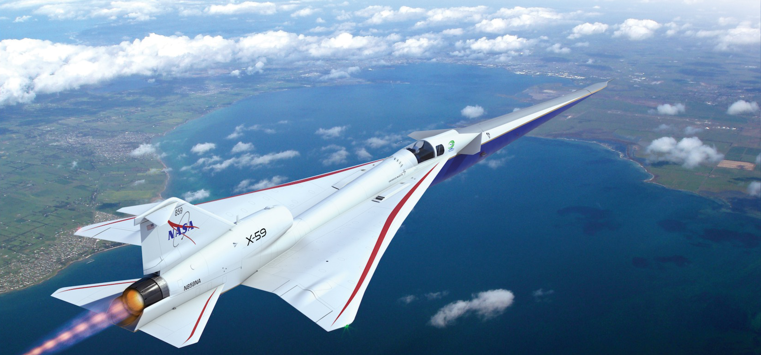
Redo Title Slide
An Overview of the NASA Quesst Community Test Campaign with the X-59 Aircraft
DATAWorks 2023
Alexandria, VA
April 26, 2023
Jonathan Rathsam, NASA Langley Research Center
Notes:
Good afternoon, my name is Jonathan Rathsam, and I’m from NASA Langley Research Center in Hampton, Virginia.
I’m the Technical Lead for Community Survey Design and Analysis in NASA’s Quesst Mission.
I’m excited to share this presentation with you today. Thank you so much to the organizing committee for this opportunity.
https://dataworks.testscience.org/full-agenda/

Slide 2
Outline
The NASA Quesst Mission
Phase 3 – Community Response Testing
Challenges and Strategies
Notes:
This morning Peter Coen gave a keynote presentation on NASA’s Quesst Mission. The current talk is an overview of the mission’s Phase 3, or community response testing with he X-59 aircraft. This talk sets the stage for the following two talks, which will focus on data considerations and statistical thinking for the community test campaign.

Slide 3


NASA Quesst Mission
Engage international research and regulatory communities
Prove NASA shaping technology quiets sonic booms
Develop standards for low noise supersonic flight over land
Gather representative data on public perceptions
Community Test Campaign
Notes:
My family and I live in Virginia, and my parents live 3000 miles away in Oregon. Flying from coast to coast means a long day of travel. The goal of supersonic flight over land is less time traveling so grandparents and grandkids can have more time together.
In NASA’s mission to expand knowledge and improve aviation for the general public, it conducts research to address sonic boom noise, which is the prime barrier to supersonic flight over land. It’s not the only barrier because future supersonic aircraft will also need to be efficient, affordable, and environmentally sustainable.
The Mission engages internationally with researchers and regulators toward the goal of new supersonic aircraft certification standards, not based on speed, but based on low noise levels.

Slide 4

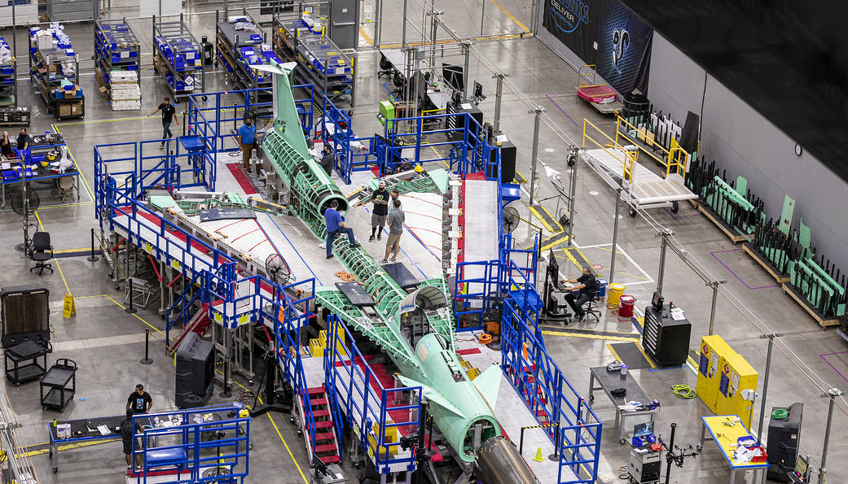
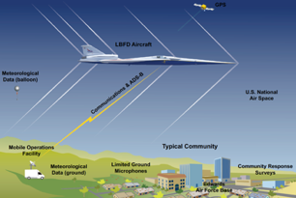
Phases of the NASA Quesst Mission
Phase 1 – Aircraft Development
In progress (2018-2024)
  Detailed design
  Fabrication, integration, ground test
  Subsonic and supersonic envelope expansion
Systematic Approach Leading to Community Testing
Phase 2 – Acoustic Validation
Preparation in progress, execution begins 2024
  Detailed in-flight and ground measurements
  Validation of X-59 acoustic signature and prediction tools
  Development of acoustic prediction tools for Phase 3
Phase 3 – Community Response Testing
Preparation in progress, execution begins 2025
  Community site selection
  Community response surveys
  Noise exposure design and estimation (measurement and predictions)
  Dose-response relationship development and data delivery
Notes:
The NASA Quesst Mission represents a systematic approach leading to community testing.
Phase 1 is aircraft development, and it’s currently going on with Lockeed Martin in Palmdale, California with the design, fabrication, and ground test of the X-59. When ready we’ll conduct a series of envelope expansion flights proving that the airplane is ready and safe to fly outside of the test ranges in the national airspace system.
After that we’ll stay in the test ranges to conduct the acoustic validation, which is Phase 2. Here we’ll be proving that the acoustic signature of the airplane matches what we set out to design. We’ll conduct detailed inflight and ground measurements of the signature of the airplane in preparation for community testing.
Phase 3, which is the payoff of the mission. That phase will be executed over 2-3 years staring in 2025 and will consist of several tests over different communities in the US and possibly abroad.

Slide 5
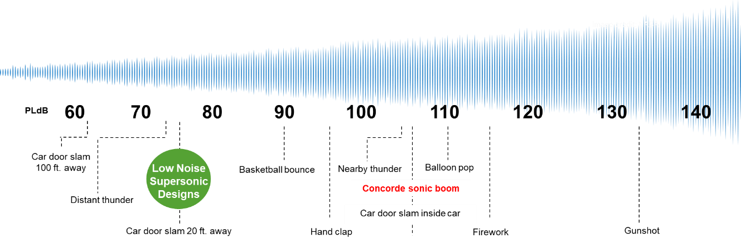
Quesst Phase 3 - Community Response Testing
Some aspects of community tests
4-6 tests in different communities across the US
Location selection will consider:
  Variation in climate zones
  Population demographics
  Urbanization level
Each test approximately 1 month long
Daytime/waking hours
Range of sound levels: 70 to 87 dB
Acquire community response representative of the general population
Response Metric
(annoyance level)
Dose Metric (noise level)
Notes:
The scale on the upper left shows the range of Perceived Level for various noises. Perceived Level is an acoustic metric for impulsive sounds. X-59 is expected to be approximately 75 dB, similar to distant thunder or a car door slamming across the street. By contrast, Concorde is about 105 dB on the same scale.
The dose-response relationship is shown on the lower left, which is the key result of the community response tests. The vertical axis is the response metric from the surveys and the horizontal axis is noise dose from X-59. The relationship will be delivered to regulators for the development of a noise standard.
Some details of the community tests are shown on the right: (summarize each)

Slide 6
Key Technical Elements of Community Response Testing
Test site selection
  Ensure representativeness
  Deployment coordination/logistics
  Public engagement
Survey Design and Analysis
  Participant recruitment
  Data analysis/statistical methods
  Tests of survey implementation, automated data processing methods
Exposure Design and Estimation
  Ground Recording System (acoustic monitor) placement strategies
  Recording and extraction of signature
  Characterization of carpet over test area (combining prediction and measurements)
Developing Dose-Response Relationship and Delivery to ICAO
  Matching exposure levels with participant location
  Aggregating of multiple community test results
  Ensuring validity/acceptance of technical approach
Exposure Estimation
Community Surveys
Dose-Response Relationship
Data to regulators
Notes:
The technical elements are organized as shown on this slide.
Test site selection to ensure that the survey data are representative. More on a later slide and in the following presentations.
Survey design and analysis to ensure that survey data are sufficient in terms of quality and quantity over the month-long test duration.
Exposure design and estimation, because the noise dose will be a combined estimate based on measurements and calculations.
Dose-Response relationship and data delivery to ICAO requires appropriate techniques for aggregating results across communities.
Some technical topics span multiple categories. The exposure design (i.e. the text matrix of which levels to fly and in which order) and its rationale must to support the dose-response analysis plans.

Slide 7
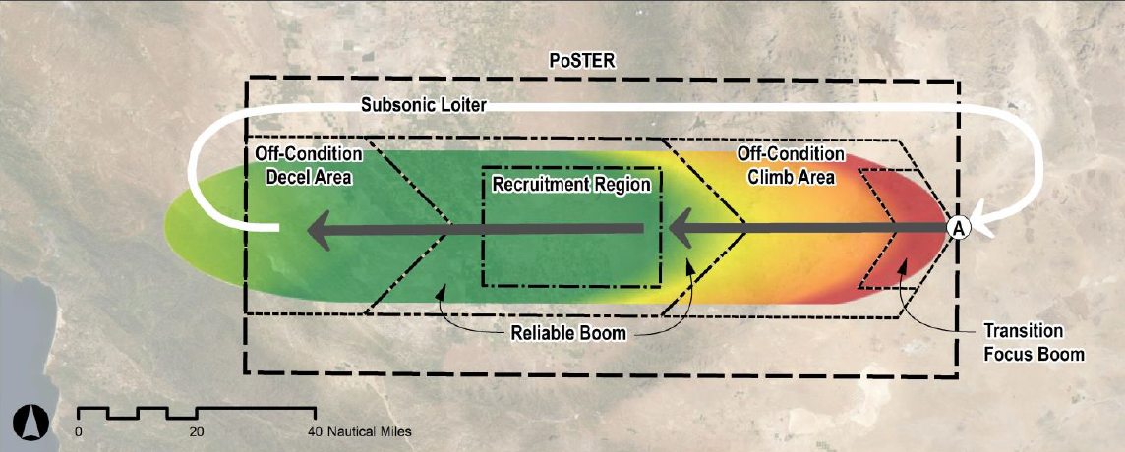
Airfield and Community Test Site Selection
4-6 Tests planned for 2025-2027
  Test #1 from NASA Armstrong
  Subsequent test locations TBD
Technical and aircraft-related constraints
  Runway, airfield infrastructure
  Emergency/alternate landing sites
  Available population centers
Ensuring representativeness
  Sampling approaches and statistical validity
  Geographic and climate zone variation
  Survey participant demographic diversity
  Variation in urbanization level
Notes:
In terms of selecting airfields and community test sites, the top right graphic shows potential extent of the baseline exposure region, which is 50 x 120 nm. The smaller 20 x 30 nm rectangle inside has consistent, reliable noise exposure. This is the region from which participants will be recruited for the survey. The bottom right graphic shows candidate airfields that meet the stringent technical requirements for X-59 operations. To minimize operational risks, the first test will be flown from NASA Armstrong in Southern California. The subsequent tests will be drawn from other airfields to ensure geographic and climate zone variation.

Slide 8
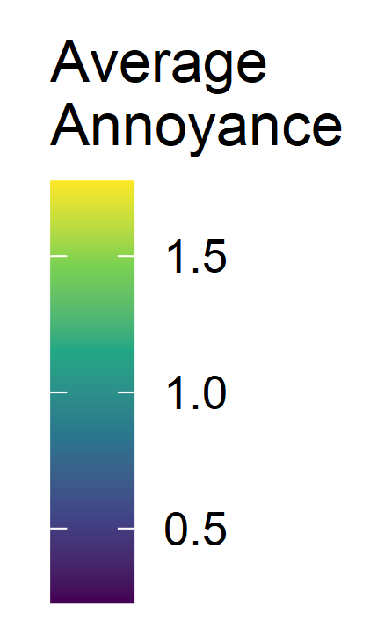
Survey Design and Analysis
Development of dose-response simulation dataset
Survey methods and analysis plans developed
  Proposed methods are generally robust with high likelihood of success
  Addressing / Refining challenge areas
    Sparse data / data sufficiency
    Dose error mitigation
    Combining data from multiple communities
Research on effect of dose error on dose-response curve
  Dose error creates a bias in dose-response curve
  Bias not alleviated by increasing number of survey participants
  Accuracy requires emphasis on quantifying, minimizing, and mitigating error
Study of potential for carryover effects in survey results
Feedback from Independent Expert Panel on survey plans
No Carryover
5
4
3
2
1
 | 1 | 2 | 3 | 4 | 5
Previous Dose
Current Dose
W/ Carryover (example)
5
4
3
2
1
 | 1 | 2 | 3 | 4 | 5
Previous Dose
Current Dose
Notes:
Recent progress on the survey design and analysis includes the development of dose-response simulation datasets for exercising the analysis tools. The survey methods and analysis plans have been developed and are generally robust, with a few areas for further refinement. NASA has been conducting research into the effects of dose error (measurement error) on dose-response relationships and also studying the potential for carryover effects in the survey results. Last summer NASA received feedback on survey plans from an independent expert review panel.

Slide 9
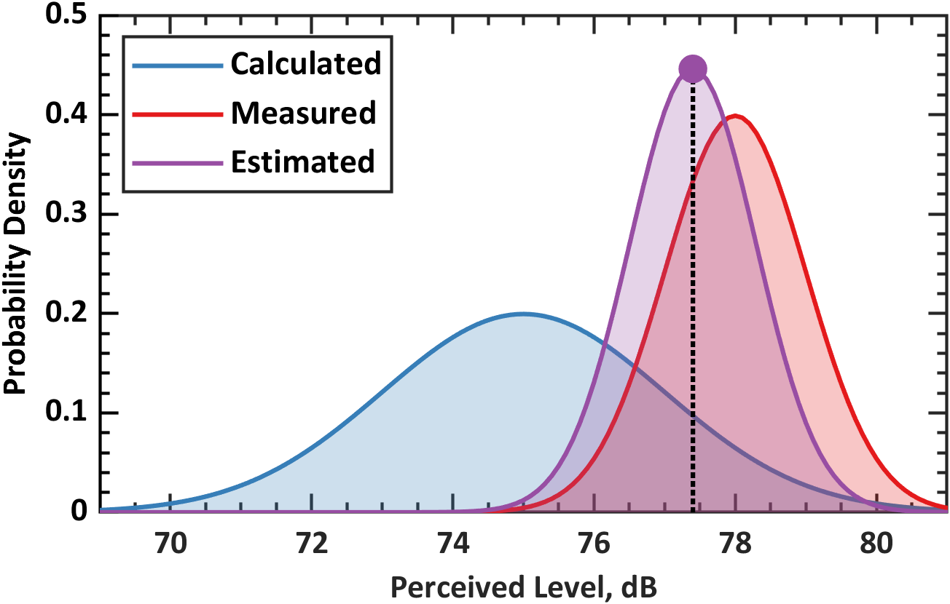
Noise Exposure Design, Estimation, and Analysis
Estimation and refinement of attainable range of boom levels
Noise Exposure Scheduling Tool Developed
  Automated, adaptable dose scheduling for Phase 3
  Inputs for dose range, operational constraints (X-59, crew rest, etc.)
Meteorological data needs identified
  Hardware selection with data-based assessment of resolution
  Validation cases finalized for regional forecast model
  Method to extract turbulence parameters from atmospheric models
Progress of Ground Recording System towards Phase 3 use
  Prototype units evaluated
  Initial operations procedures for community test usage developed
Key components of dose and uncertainty calculation assembled
  Algorithms to identify measured boom, mitigate ambient noise, compute metrics
  Combine measurements with calculated doses at participant locations
Ground Recording System Unit
Probability Density
Uncertainty reduced for final estimated dose
Perceived Level (dB)
Combining calculated and measured levels
(Notional Example)
Notes:
In terms of noise exposure design, estimation, and analysis, there have been recent refinements to the estimates of the range of boom levels. A noise exposure scheduling tool has been developed for automated and adaptable design/scheduling of noise exposure levels to achieve a targeted distribution of noise doses. The meteorological data needs have been identified, which are needed as inputs to noise exposure calculations. The Ground Recording System (acoustic monitors) continues through the evaluation of prototype units. The team has also assembled key components to estimate dose and dose uncertainty.

Slide 10
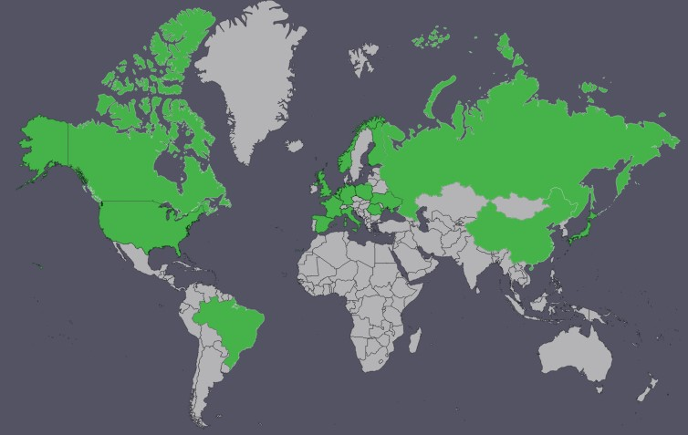
International Engagement / Feedback
International Community Test Workshop 2 – December 2021
  First major dissemination of scope of NASA plans
  General concurrence from attendees with overall technical approach
  Concerns expressed and discussed during workshop included:
    Applicability of dataset; methods to expand representativeness
    Characterization of annoyance relationship to rattle/vibration
  NASA is incorporating inputs to survey and exposure design/analysis
  plans as appropriate
  Ongoing follow-up/engagement with key SMEs
Additional international engagement
  Aug 2022, Internoise Conference, Glasgow
  June 2023, ICBEN Congress on Noise as a Public Health Problem, Belgrade
  Aug 2023, Internoise Conference, Chiba, Greater Tokyo
  Ongoing, International Civil Aviation Organization, Committee on Aviation Environmental Protection, Working Group 1 (Noise)
Broad International Participation
18 Countries
120+ attendees
50+ organizations
  Research
  Regulatory
  Government
  Academia
  Industry – technical
  Industry - OEM
Notes:
NASA’s engagement with the international community continues. Just over a year ago NASA hosted a second Community Test Workshop. It was the first major dissemination of the scope of NASA’s community test plans. The goals were to communicate status, obtain feedback and identify any significant concerns on the suitability of the proposed approaches and dataset as a basis for international standards. The workshop had robust interchanges and discussions and the feedback is being considered for incorporation into NASA’s plans. The workshop had broad participation from many countries and organizations representing research, academia, government, and industry.

Slide 11
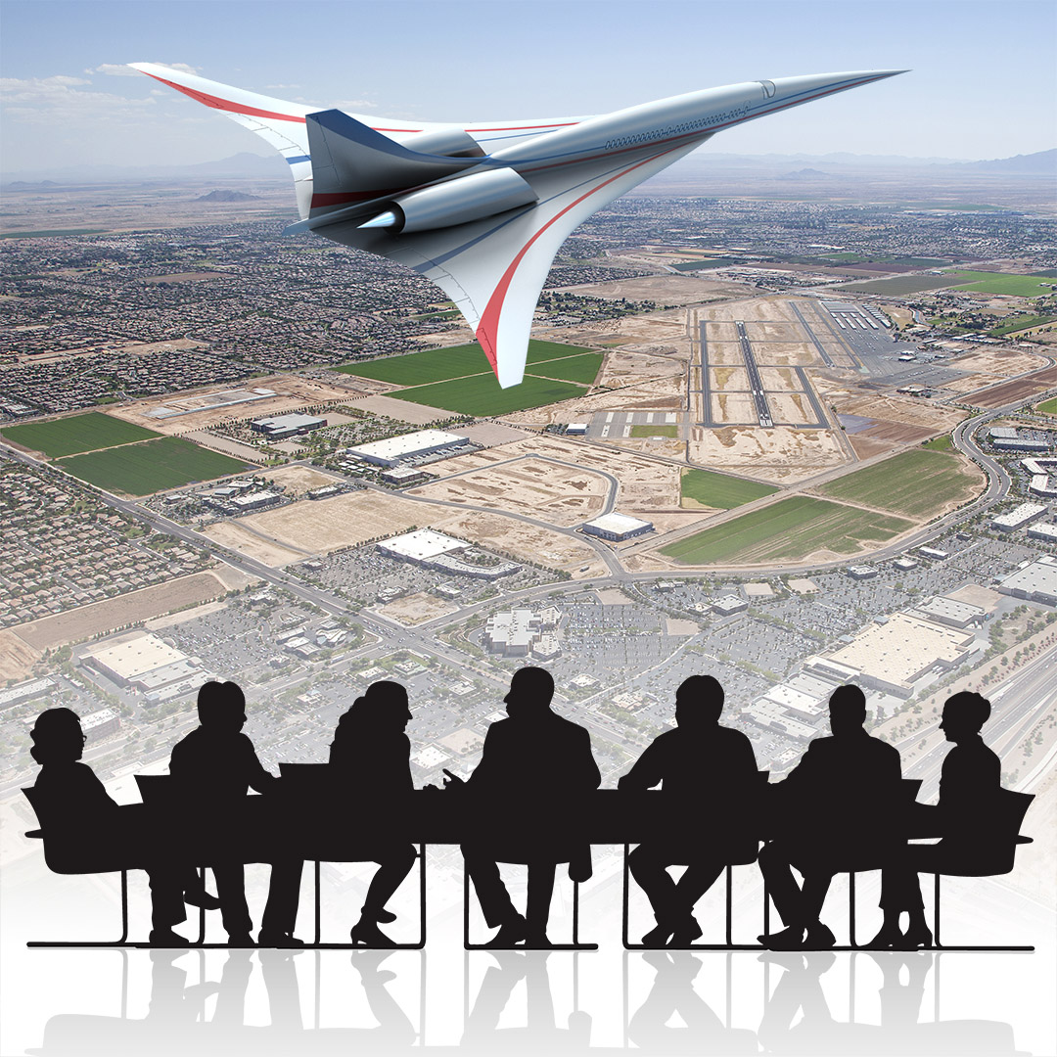
Organizational Challenges
Challenge
Strategy
Long Time Span
Many resources to manage
Contractor Teams
  Ground Recording System
  Community Response Testing Support (7 companies)
Diverse Stakeholders
  Multiple NASA Centers
  International Civil Aviation Organization and Federal Aviation Administration
  Federal, state, and local government
  The public
Communication
Active stakeholder engagement
Notes:
The next two talks will delve into the technical challenges. Here, I want to emphasize some of the non-technical, organizational challenges, including a long timespan, many resources to manage, and diverse stakeholders.
The long time span means that organizational requirements change and that approvals need to be renewed. Anyone who has ever needed an “Authority to Operate” for a contractor IT system can relate.
Just within NASA, the project is being worked at multiple NASA centers. There are also a number of contractor teams involved. One contractor team is building the ground recording system, a unique and state-of-the-art network of acoustic sensors specifically designed for the Quesst mission. A separate contractor team is supporting NASA to plan and execute community tests. The community test contractor team involves 7 companies with diverse skillsets such as conducting surveys and estimating noise exposure by combining measurements and predictions.
In terms of regulatory bodies, not only is the Federal Aviation Administration a stakeholder, but also its international counterpart, the International Civil Aviation Organization.
To execute community response tests, coordination is required with all levels of government, including federal, state, and local.
Most importantly the public is a stakeholder, because the public will not only participate in community response tests, but will live beneath future supersonic flight paths and fly on future commercial supersonic aircraft.
The primary strategy for the organizational challenges is communication, early and often. Active stakeholder engagement is necessary to keep everyone informed well in advance. Points of contact change over time so it’s important to identify new stakeholders early and bring them up to speed.

Slide 12
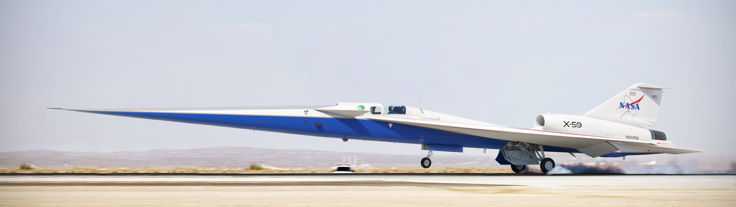
Summary
The NASA Quesst Mission will provide key community response data
  NASA seeks broad international engagement to ensure acceptance of the test results
Key technical areas include site selection; survey design and analysis; noise exposure design, estimation, and analysis; and dose-response modeling
Organizational challenges and strategies for managing a project of this scope
Notes:
To summarize, NASA’s Quesst mission will provide key community response data that is needed to define standards for low noise supersonic flight overland
NASA is seeking broad interaction and engagement with the international community to ensure that the results are acceptable and lead to the adoption of international standards.
This presentation gave an overview on the key technical areas of community response testing, including site selection, survey design and analysis, noise exposure design/estimation/analysis, and dose-response modeling.
We shared some organizational challenges associated with a project of this scope--including multiple assets like an experimental aircraft, ground recording system, and surveys--as well as some mitigation strategies for those challenges.

Slide 13

Quesstions?
https://www.nasa.gov/quesst
jonathan.rathsam@nasa.gov
Notes:
Thank you for your attention. The team has more technical information to share about the community tests in the next two presentations. Before we proceed, do you have any general questions about what has been presented so far?

