Slide 1





01
Introduction
STAR
A Cloud-based Innovative Tool for Software Quality Analysis
02
Background
03
STAR Demo
Kazuhira (Kazu) Okumoto
Sakura Software Solutions LLC
Reference:
STAR Technical Info & Guide
Naperville, IL, USA
04
kokumoto@sakurasoftsolutions.com
DATAWORKS 2023

Slide 2

Introduction
Kazuhira (Kazu) Okumoto, Ph. D.
Former Bell Labs Scientist with 40 years of experience in the field
Pioneer in Software Reliability Engineering
Creator of Goel-Okumoto Reliability Model
Co-author of a book, Software Reliability: Measurement,
Prediction, Application
Former Professor @ Rutgers University
Previous Experience with Air Force, Navy, NSF projects
Developed and productized an innovative software quality assessment tool for Nokia - BRACE
Creator of an innovative on-line tool for software quality assurance, STAR

Slide 3

Introducing STAR
Software Quality Assurance-as-a-Service
SaaS
Automated Prediction Model
Visualization
Cloud-based tool available anytime, anywhere, to anyone!
Proven Automation & Innovative Analytics
Several output views to suit all users from developers to executives
At the forefront of digital engineering practices aimed at delivering high-quality products on time.
Base your decisions on data-driven prediction methods and improve customer satisfaction!
3

Slide 4




A revolutionary approach to software reliability modeling & software quality assurance. The prototype of STAR has been customized and is still being used by Nokia today.
We continue our collaboration with experts from the industry and academia to advance and improve STAR for real-world applications in
the field.
STAR is currently going through an extended trial with NASA.

Slide 5
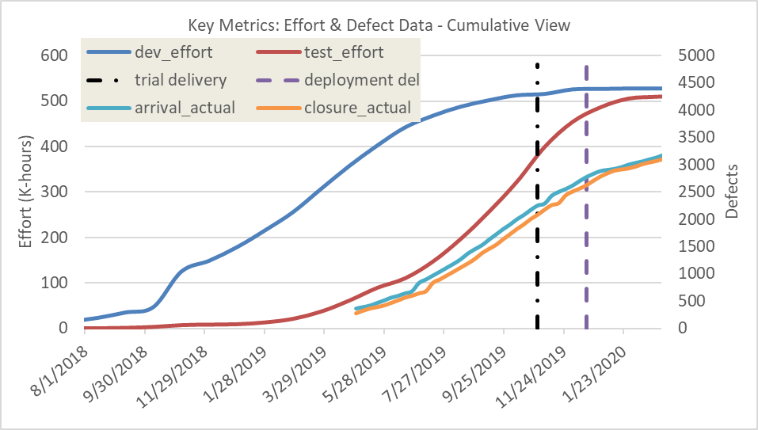
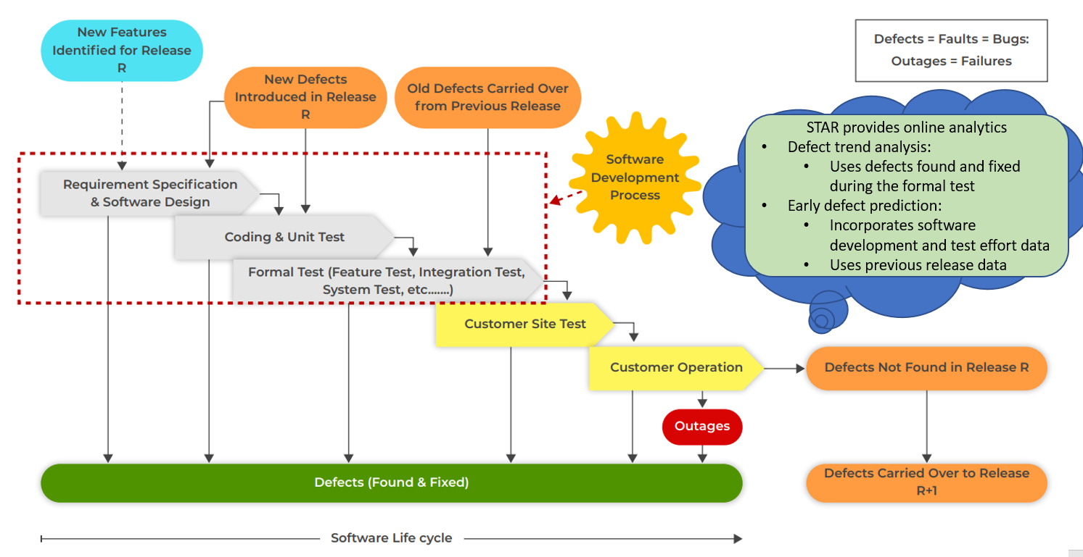
Background
Software Development Process vs. Defect Injection & Removal

Slide 6

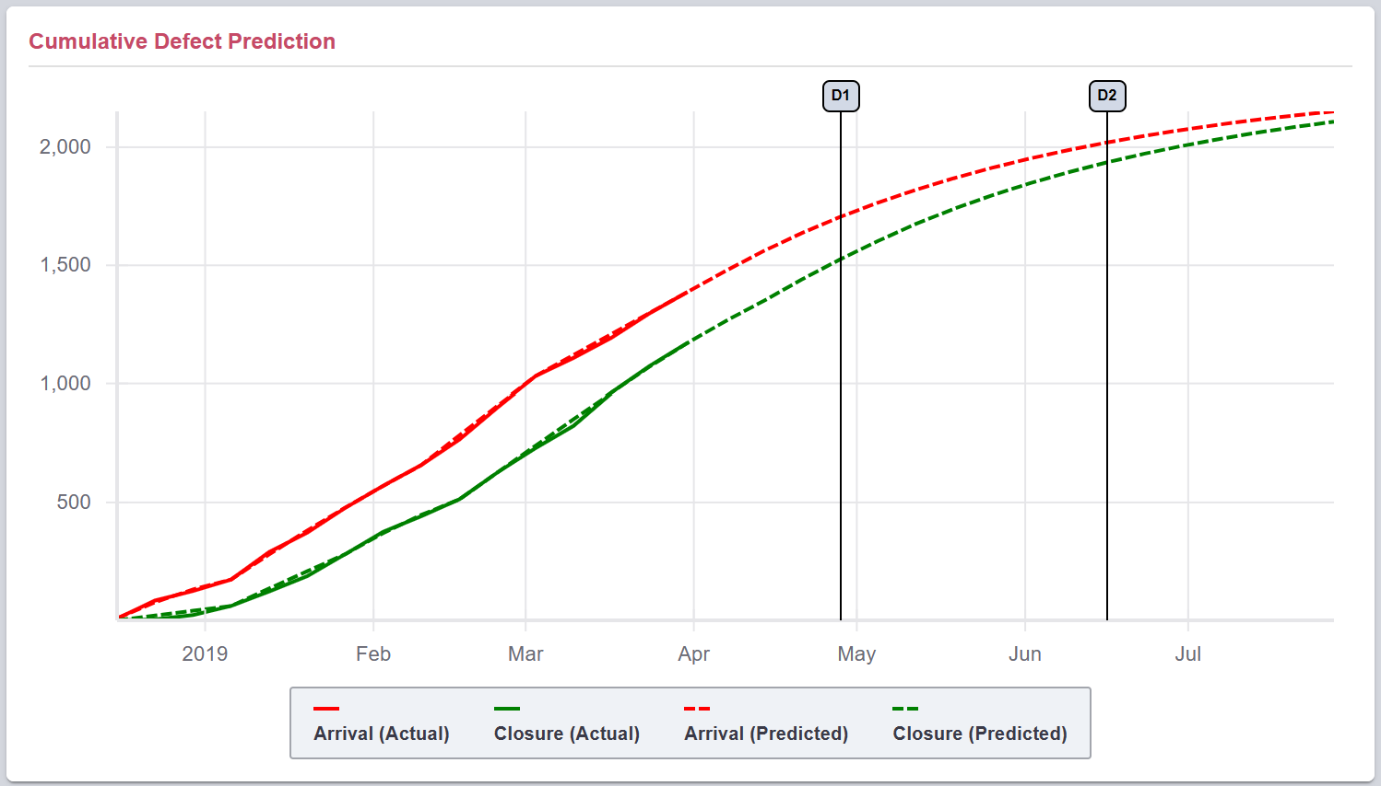
Background
Challenges of Current Software Reliability Modeling
Focusing on the arrival curve prediction
Use of a single curve fitting (e.g., S-curve, exponential)
The goodness of fit is used for model comparison
Mathematical complex modeling with little practical use
Previous release experience is not yet incorporated
Development & test effort data is not yet incorporated
STAR’s New Innovative Approach Overcomes Challenges of
Current Software Reliability Modeling
6

Slide 7


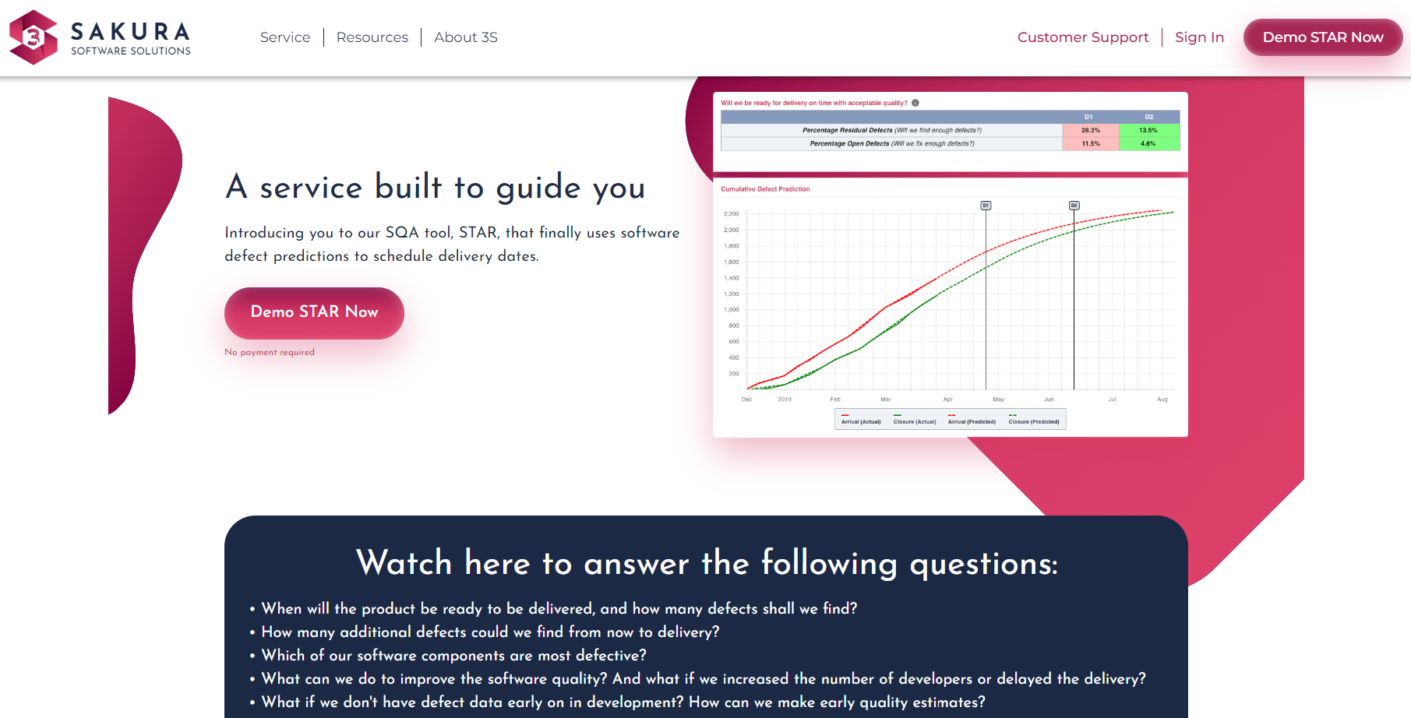
STAR Demo
3S |(sakurasoftsolutions.com)
7

Slide 8

Reference
STAR Technical Information & Guide

Slide 9

STAR Breakdown
01
STAR Core Engine
Defect trend analysis
Early defect prediction
Closure curve prediction
Prediction stability and accuracy
Corrective actions
02
STAR User Input
03
STAR Sample Output
9

Slide 10

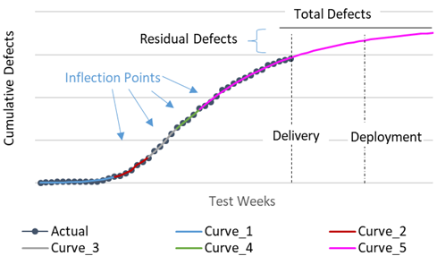
STAR Core Engine (1)
Defect trend analysis STAR automatically identifies inflection points to generate multiple curves to describe the entire defect trend
No more single curve fitting!
Software Defect Trend Analysis
STAR Defect Prediction
vs. Actual
STAR automatically identifies the inflection points and generates a series of piece-wise exponential models: m(t)=a {1-exp⁡(-b t)}

Slide 11

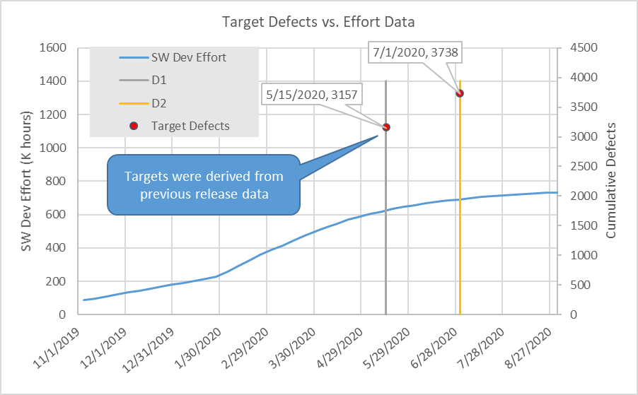
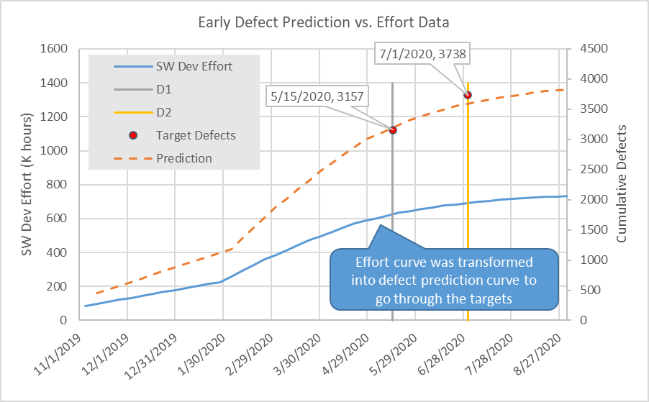
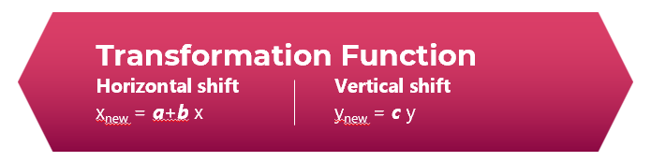
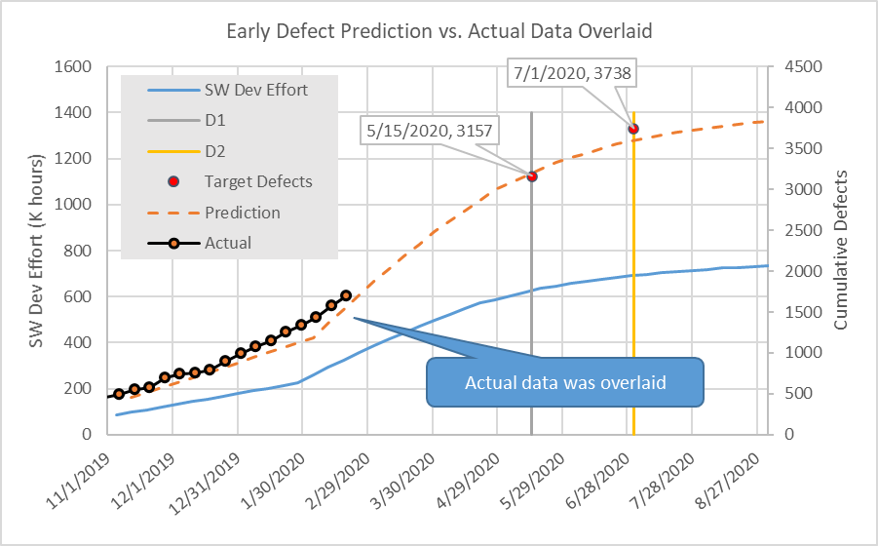
STAR Core Engine (2) –
Early defect prediction
STAR Automatically Generates An Early Defect Prediction Curve
Target Defects
vs. Effort Data
Calculates defect densities
(defects / effort) at D1 & D2 from previous release and derive targets at D1 & D2 for current release
Transform the effort curve into a defect prediction curve using a non-linear optimization method
Early Detect Prediction vs. Effort Data
Early Defect Prediction vs. Actual Data Overlaid
11

Slide 12
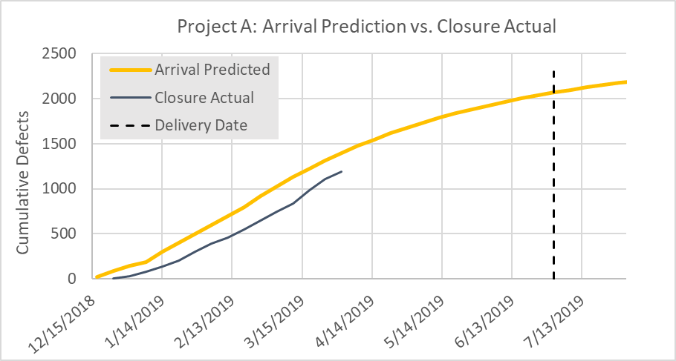
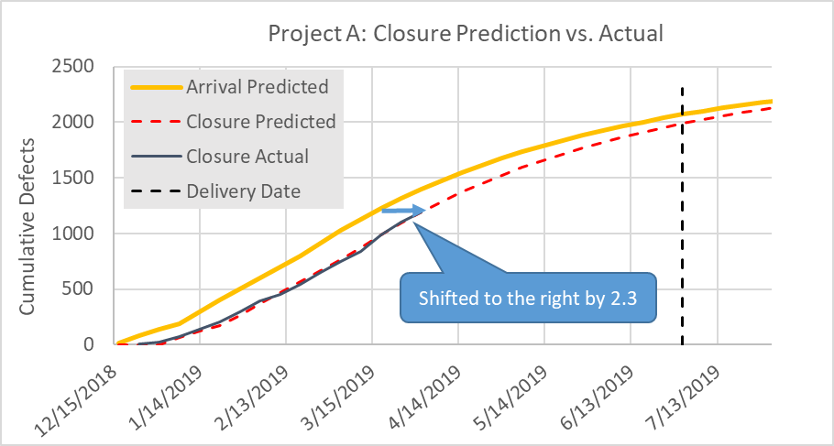
STAR Core Engine (3) – Closure Curve prediction
STAR Automatically Generates A Closure Prediction Curve
Project A:
Arrival Prediction vs. Closure Actual
Apply the same transformation algorithm using an arrival curve as the leading data
This is a special case where b = 1 & c = 1
Project A:
Closure Prediction vs. Actual
12

Slide 13
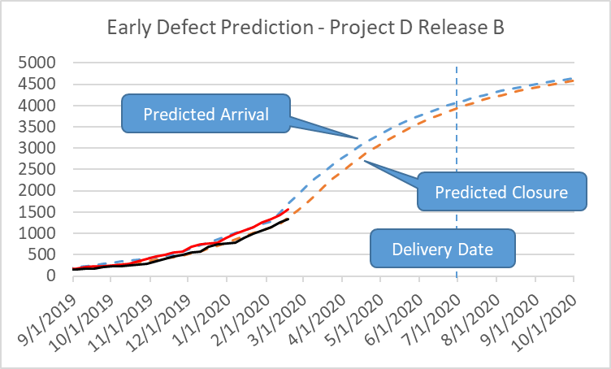
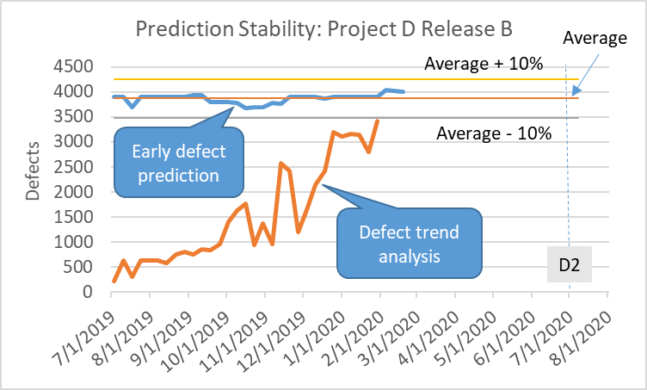
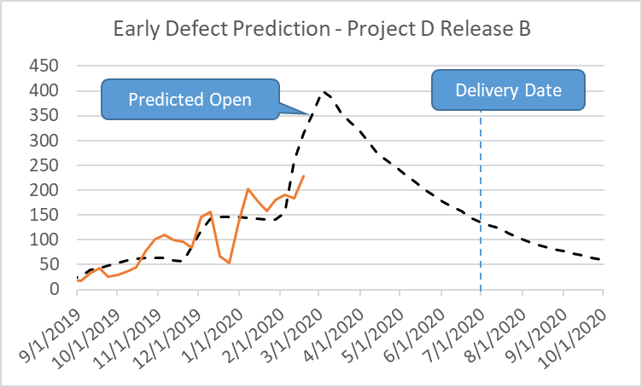
Prediction Stability And Accuracy
Overlaying Actual Data
The power of development and test effort data with previous release data to improve the prediction stability and accuracy
Tracking defects predicted at D2 as new data becomes available
Arrival & Closure Defect Predictions
Open Defect Prediction

Slide 14
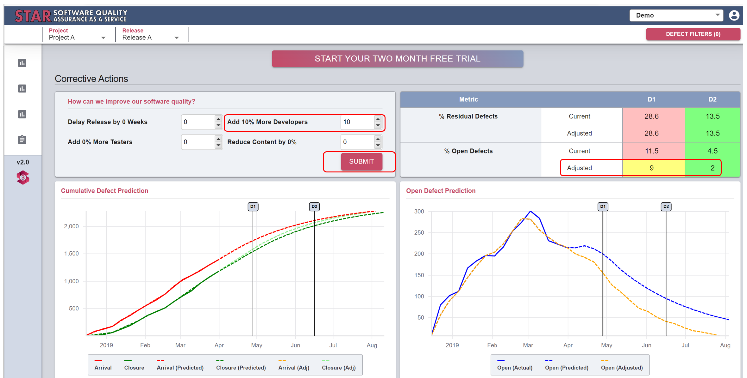
Corrective Actions
What can you do to improve your software quality?
STAR quantifies
the quality impact of four corrective actions in real-time

Slide 15
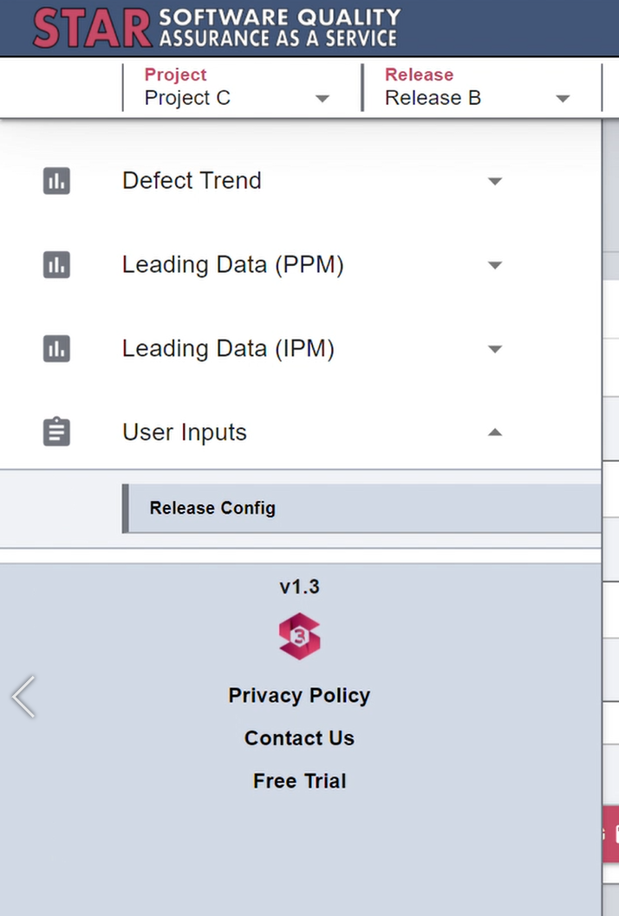
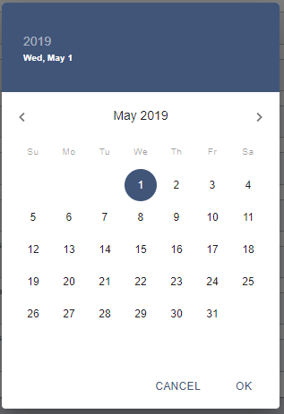
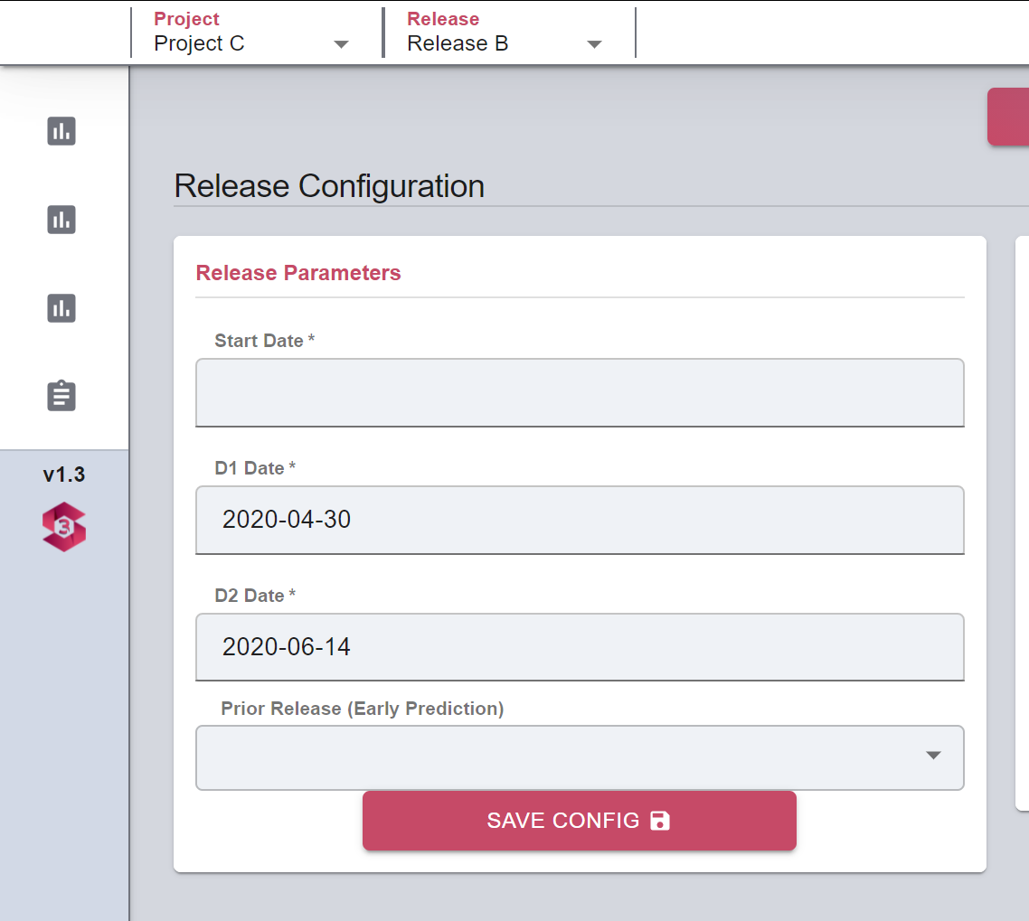
User Inputs - Release Parameters
Under our User Input Menu, follow our Release Config tab to enter your release parameters
By clicking under the “D1 Date” or “D2 Date” fields you will be prompted with a calendar box which will help you specify the desired dates. (You can manually enter the dates as well)
By clicking under the “D1 Date” or “D2 Date” fields you will be prompted with a calendar box which will help you specify the desired dates. (You can manually enter the dates as well)

Slide 16
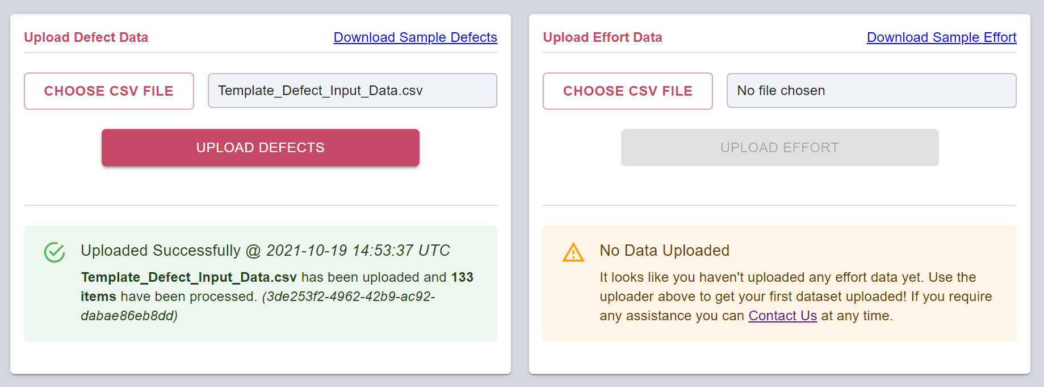
User Inputs - Uploading Defect & Effort Data
Create a .csv file with your own defect data following the template format.
01
Download sample Defect/Effort data with template formatting here
02
Click “Choose CSV File”.
Following the instruction, identify the folder location and select the csv file to upload.
03
Click “Open” & “Upload Defects/Effort” for STAR to upload the csv file(s).
04
Consolidate the data you’re importing into an CSV file then upload it here
You are now ready to specify D1 & D2 dates in Input Parameters if it’s not done so.
05
Under our User Input Menu you will find our Release Config page

Slide 17
User Inputs – Sample Defect Data Format

Slide 18
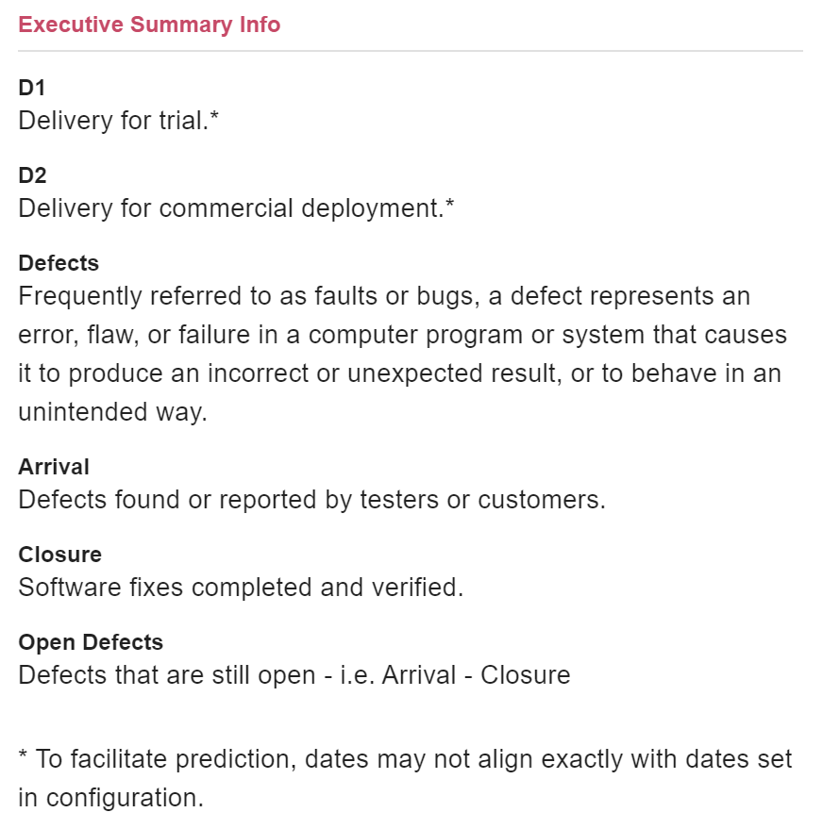

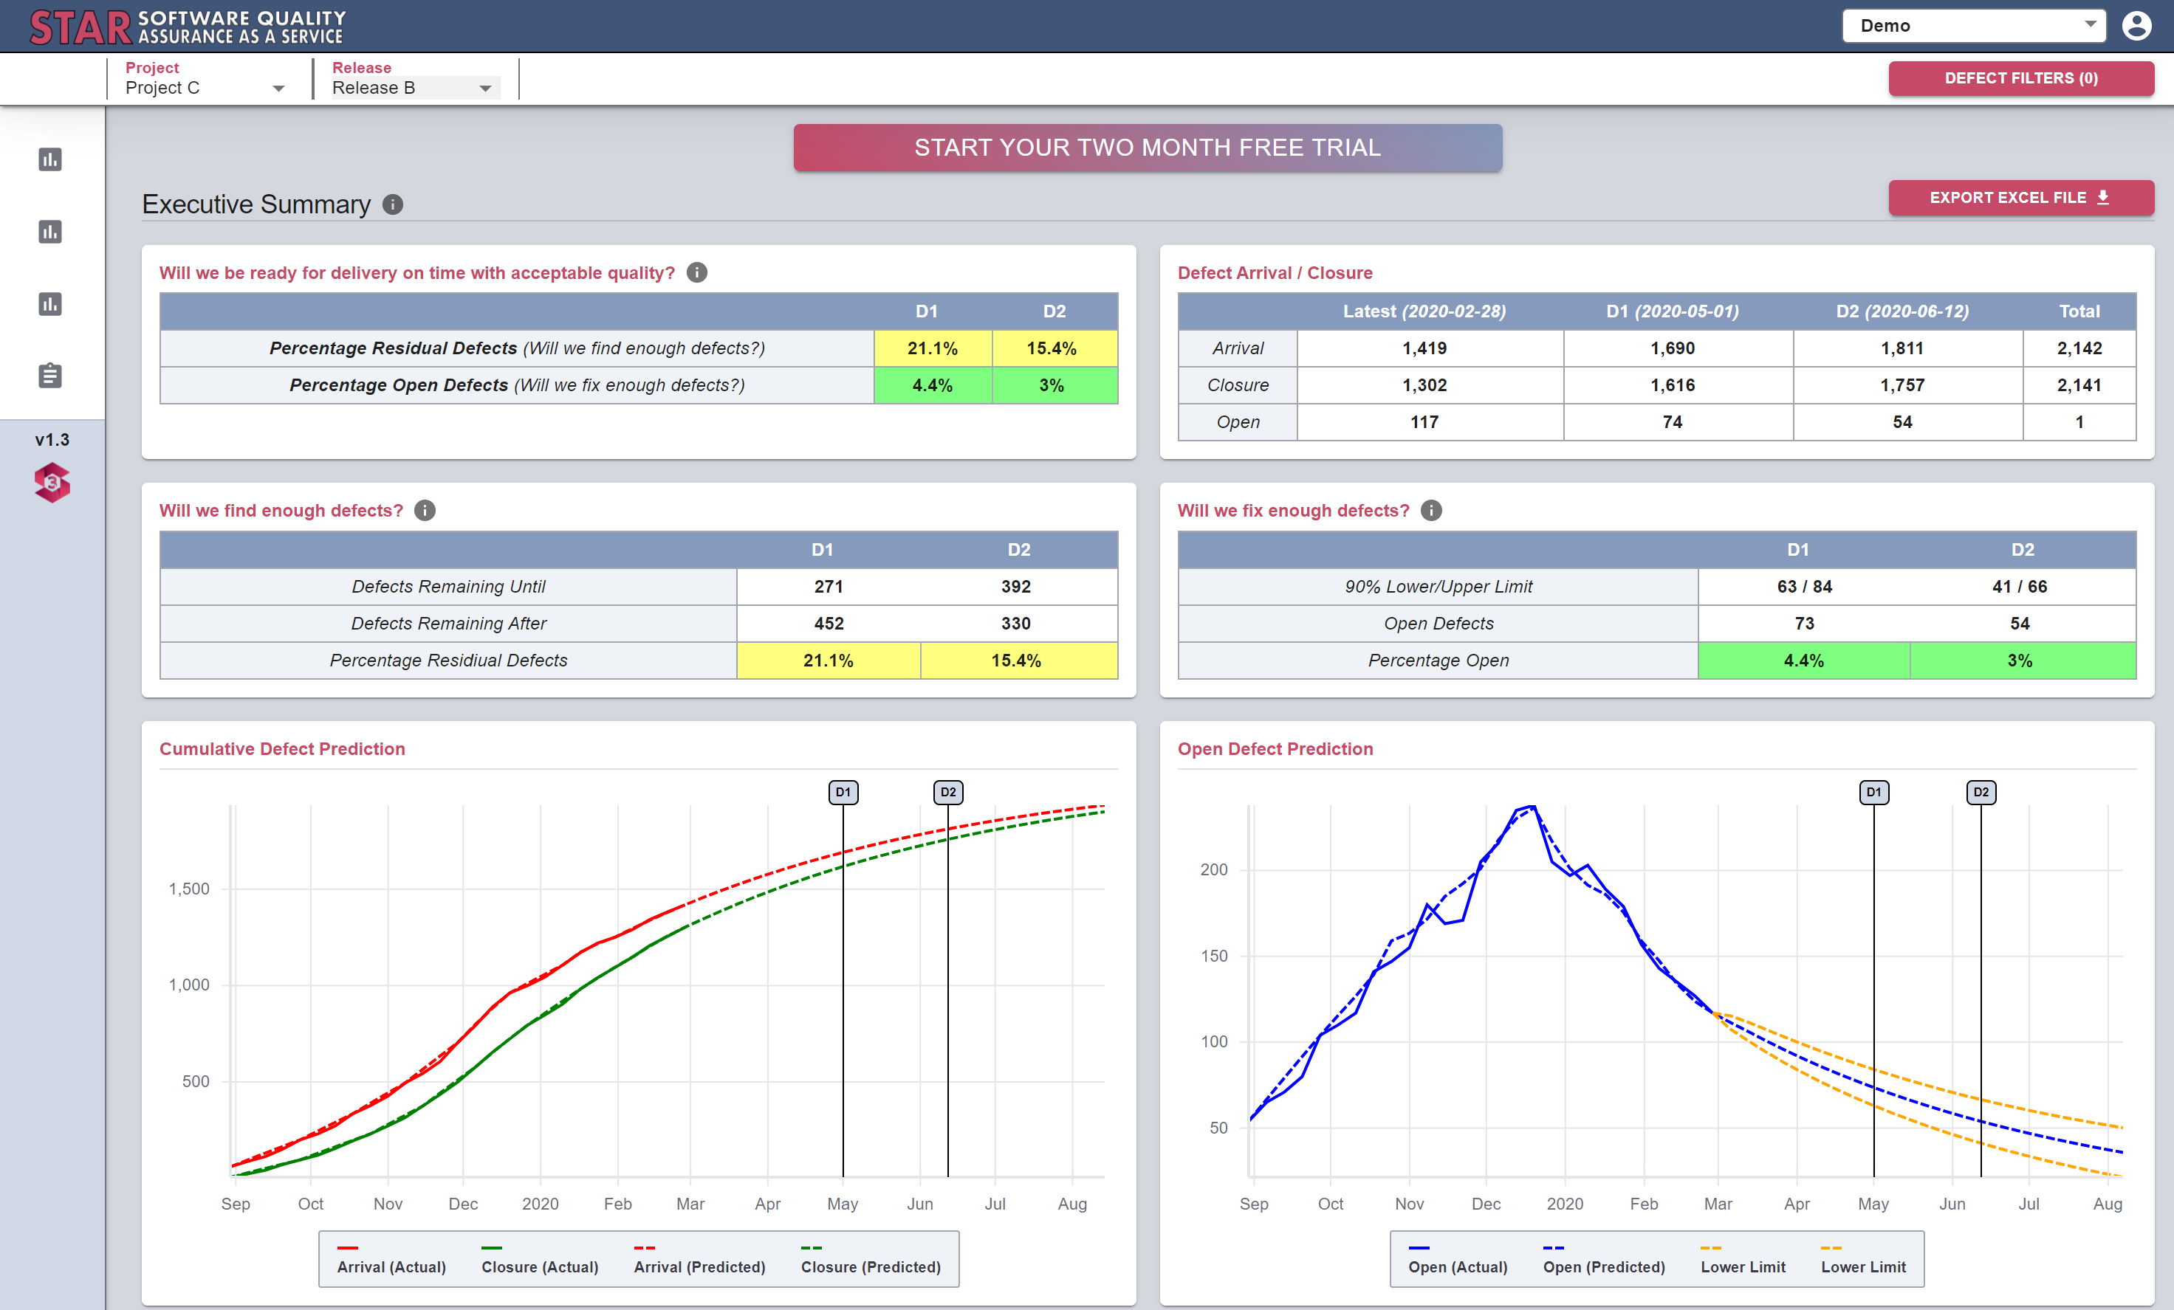
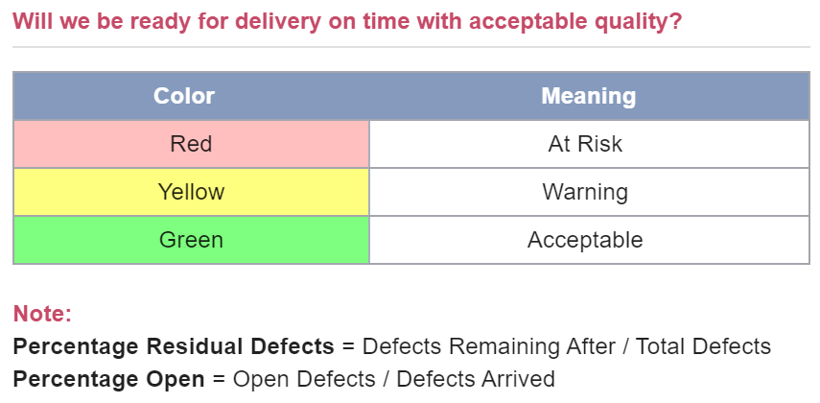
STAR in Action – Sample Outputs
Main Page - Executive Summary
Select your company. By default, every user has access to the Demo company data. After signing up for an account you will have the ability to try STAR with your own company data.

Slide 19
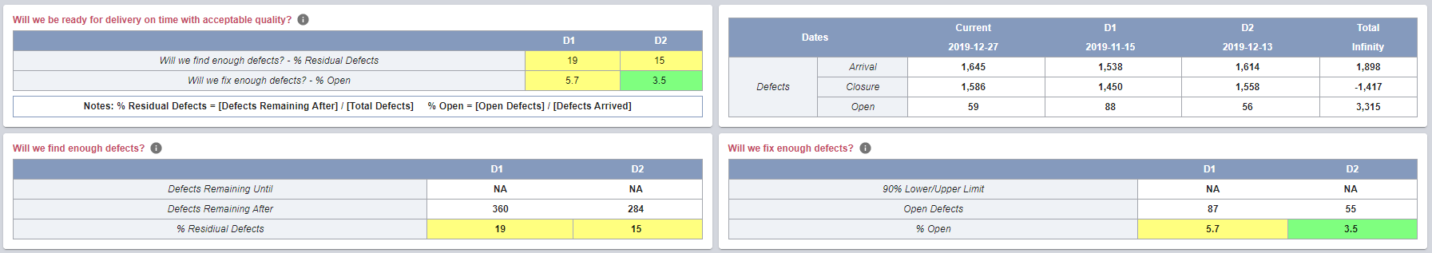
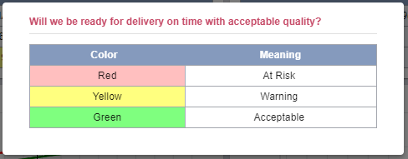
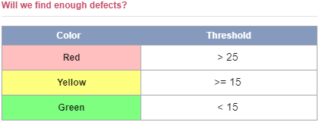
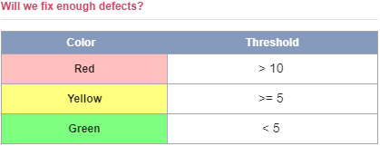
STAR in Action
Main Page - Executive Summary (Continued…)
Target values for ”Green (Acceptable)”, “Yellow (Warning)” and “Red (At Risk)” in %Residual and %Open are chosen based on our past experience with various projects and releases. These target values can be adjusted based on specific project expectations.
A table with an overall quality summary: It summarizes an overall assessment of release quality based on currently available data
%Residual defects and %Open defects at delivery are used to compare against the target values, where we use two delivery milestones (D1 & D2):
Visual presentation of defect arrival, closure and open will help capture the trends and the tables will help identify values at key milestones.
Software Quality
Assurance Metrics:

Slide 20
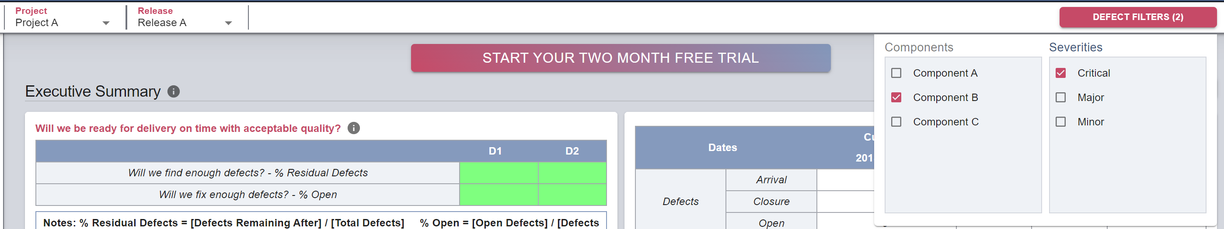

STAR in Action
Defect Filters for Components & Severity
For each view, additional filters for component and severity are provided for a given project & release to Suit All Users from Developers to Exec.
20

Slide 21
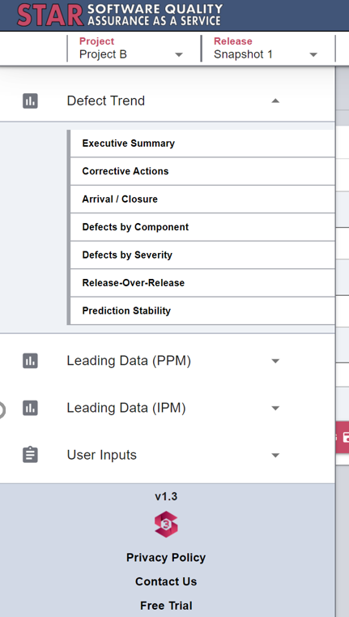
STAR in Action
Defect Trend Menu - Multiple Output Views Available
Executive summary
Provides a summary of key software quality assurance metrics
Corrective actions
Includes two corrective actions: delay delivery date and add developers for bugfixes. It will interactively quantify the improvement in %Residual and %Open for respective actions.
Arrival/closure
Provides a weekly view of arrival and closure defects with actual and prediction.
Defects by component
Provides a breakdown to help identify problematic components.
Defects by severity
Provides a breakdown to help focus on critical and major defects.
Release over release
Provides the previous and current release defect data that is normalized by the delivery date. We will provide a visual output for users to compare the Current vs. Previous release data.
Prediction stability
This showcases the accuracy of the STAR model. It should show that our predictions for the final number of defects in your software on deployment becomes very close to the final actual value many weeks before the actual deployment.
01
02
03
04
05
06
07

Slide 22
Thank you!
3S (sakurasoftsolutions.com)

