Slide 1
Enhancing Multiple Regression-based Resilience Model Prediction with Transfer Function
Fatemeh Salboukh, University of Massachusetts Dartmouth, MA, USA Priscila Silva, University of Massachusetts Dartmouth, MA, USA
Lance Fiondella, University of Massachusetts Dartmouth, MA, USA Mindy Hotchkiss, Aerojet Rocketdyne, FL, USA

Slide 2
Introduction
Resilience engineering
Creating and maintaining systems capable of efficiently mitigating disruptive incidents.
Resilience concept
The notion of performance varies by domain but is typically defined as the extent to which a system or task achieves its goals, quantified as a percentage of a predefined baseline performance under standard conditions.
Relevant past studies
Discrete model based on linear regression to predict changes in systems affected by one or more shocks.
Contributions
An advanced form of time series modeling, the transfer function, is utilized that allows for the incorporation of explanatory variables vs standard time series.
Results
The transfer function exhibited improvements in root mean squared error, predictive mean squared error, and R-squared adjusted.

Slide 3
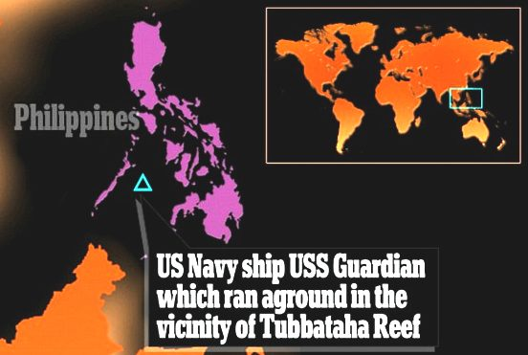
Motivation
Lack of Resilience is dangerous
For example, USS Guardian Grounding Incident (2013),
caused by ship's digital navigation system errors
2,345 square meters of coral destroyed
Loss of the USS Guardian, as the ship had to be dismantled to be removed from the reef
Millions of dollars damage to the ship and the environment

Slide 4
A. Regression with Interaction
the predictor variables at time t
the error term capturing the random variability not explained by the model
the change in
performance at time t
$$ΔP\left(t\right)=β_{0}+\sum_{i=1}^{n}{β_{i}X_{i,t}}+\sum_{i=1}^{n}{\sum_{j=i+1}^{n}{β_{ij}}\left(X_{i,t}⋅X_{j,t}\right)+ε}$$
the intercept of the model
the coefficient for the interaction term between predictors
the coefficients for the individual predictor variables

Slide 5
B. Transfer Function
the Auto-regressive and moving average part of the model error term
the change in performance at time t
$$ΔP\left(t\right)=\frac{ω_{1}\left(B\right)}{δ_{1}\left(B\right)}X_{1,t−d_{1}}+…+\frac{ω_{m}\left(B\right)}{δ_{m}\left(B\right)}X_{m,t−d_{m}}+\frac{θ\left(B\right)}{φ\left(B\right)}e_{t}$$
the white noise (i.e., random error),
in which $e_{t}$ ∼ N (0, σ2)
the numerator and denominator factors or polynomials and (B) is a backshift operator
the predictor variables and
$X_{i,t−d_{i}}$indicates the $j^{th}$ series $X$ at time t with a d lag

Slide 6
Goodness of Fit Measures
3. R-Squared Adjusted ($r_{adj}^{2}$)
1. Root Mean Squared Error (MSE)
2. Predictive Root Mean Squared Error (PMSE)
$$RMSE=\sqrt{\frac{1}{n−P}\sum_{i=1}^{n}{\left(ΔP(i\right)}−Δ\hat{P}}{\left(ⅈ\right))}^{2}$$
$$PRMSE=\sqrt{\sum_{i=n−ν+1}^{n}{\left(ΔP(i\right)}−Δ\hat{P}}{\left(ⅈ\right))}^{2}$$
$$r_{adj}^{2}=1−\left(1−\frac{SSY−SSE}{SSY}\right)\left(\frac{n−ν−1}{n−ν−p−1}\right)$$
SSY $=\sum_{i=1}^{n−ν}{\left(ΔP(i\right)}−\overline{ΔP}{\left(ⅈ\right))}^{2}$
$n$: number of observation
$ν$: number of observation for testing
$p$: number of model’s parameters
SSE =$\sum_{i=1}^{n−ν}{\left(ΔP(i\right)}−Δ\hat{P}{\left(ⅈ\right))}^{2}$

Slide 7
To evaluate the effectiveness of the resilience model based on regression with interaction and transfer function methods the 1980 U.S. recession data set possessing ten covariates. This particular recession was chosen to evaluate the models’ ability to track and forecast multiple economic shocks.
Illustrations
Table1. the 1980 U.S. recession data set
Covariates | Name
X1 | Treasury Yield Curve Index
X2 | New Order Index
X3 | Federal Funds
X4 | Mortgage Rate
X5 | Personal Consumption Expenditures
X6 | Industrial Production
X7 | Consumer Price Index
X8 | Crude Oil Price
X9 | NASAQ Composite Index
X10 | Capacity Utilization

Slide 8
Table 2: Goodness of fit of measures
Data split | Model | Covariates | lags | Parameters | RMSE | PRMSE | $$r_{adj}^{2}$$
70-30 | Transfer function | X9, X10 | 3 | 16 | 0.002 | 0.003 | 0.65
 | Interaction regression | X6, X7, X8, X9 | 0 | 11 | 0.003 | 0.004 | 0.53
80-20 | Transfer function | X1, X4, X9 | 3 | 24 | 0.002 | 0.003 | 0.77
 | Interaction regression | X6, X9, X10 | 0 | 7 | 0.003 | 0.003 | 0.29
90-10 | Transfer function | X4, X8, X9, X10 | 3 | 32 | 0.001 | 1.7$e^{−5}$ | 0.73
 | Interaction regression | X4, X8, X9, X10 | 0 | 11 | 0.002 | 0.002 | 0.34
*Different splits of data were considered to show the effectiveness of transfer function in resilience prediction.
*Transfer function achieved better overall goodness-of-fit compared to regression with interaction, improvements in RMSE of approximately 1.5 to 2 times, in PRMSE by 1.33 to 235 times, and in $r_{adj}^{2}$ by 12 to 48%.

Slide 9
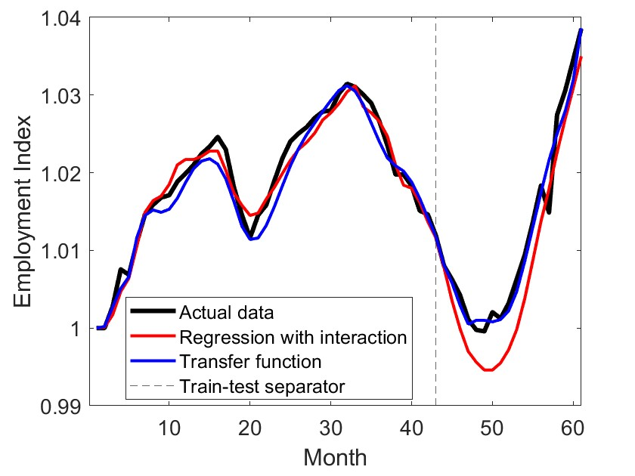
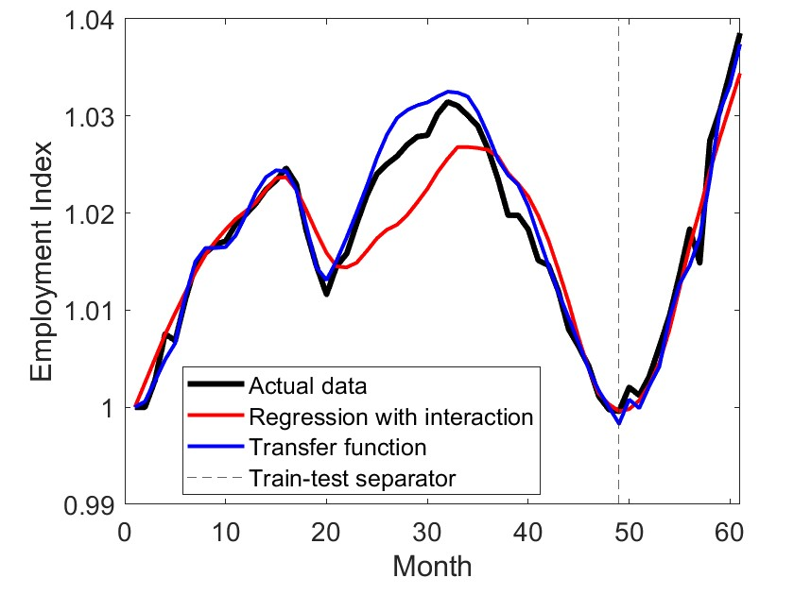
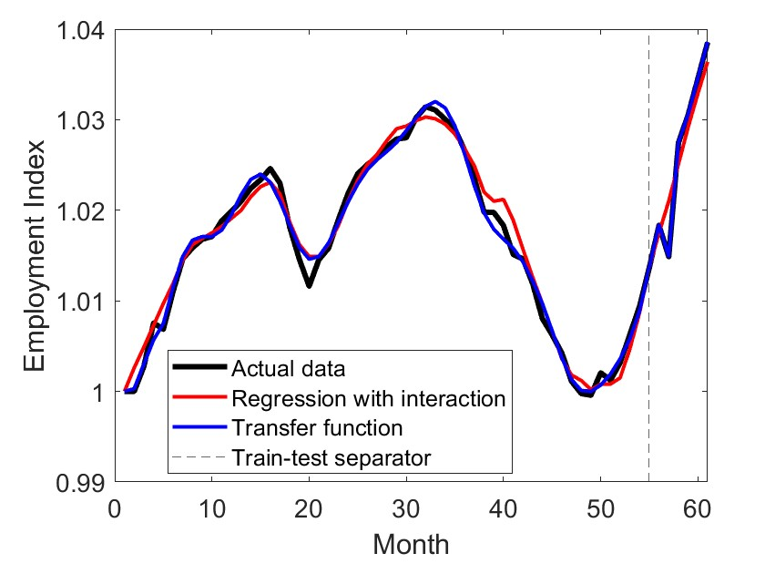
Figure 1: Models fitted through two techniques including transfer function and interaction regression. From left to right: (a) 70% of data used for model fitting, (b) 80% of data used for model fitting, and (c) 90% of data used for model fitting
*With increasing the available data for fitting, the $r_{adj}^{2}$ value increases.

Slide 10
Conclusion
Summary
This study presented the transfer function to predict the resilience recovery and the results were compared with the regression with interaction model.
Results
The transfer function outperformed compared with the regression with interaction model.
Future Research
Examine the effect of time-varying covariates to track and predict changes in system performance when subjected to multiple shocks and stresses.

Slide 11
ACKNOWLEDGMENT
This research was supported by the Homeland Security Community of Best Practices (HS CoBP) through the U.S. Department of the Air Force under contract FA8075-18-D-0002/FA8075-21-F-0074. Any opinions, findings, and conclusions or recommendations expressed in this material are those of the authors and do not necessarily reflect the views of the U.S. Department of Homeland Security or the U.S. Department of the Air Force.

