Slide 1
Topological Data Analysis involving Cybersecurity
Researcher: Cadet Anthony Cappetta
Advisor: Dr. Elie Alhajjar

Slide 2
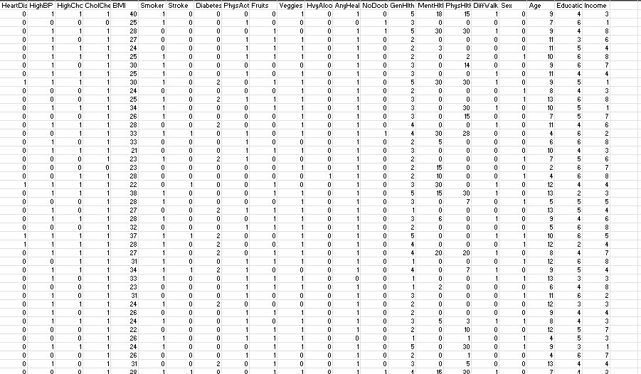
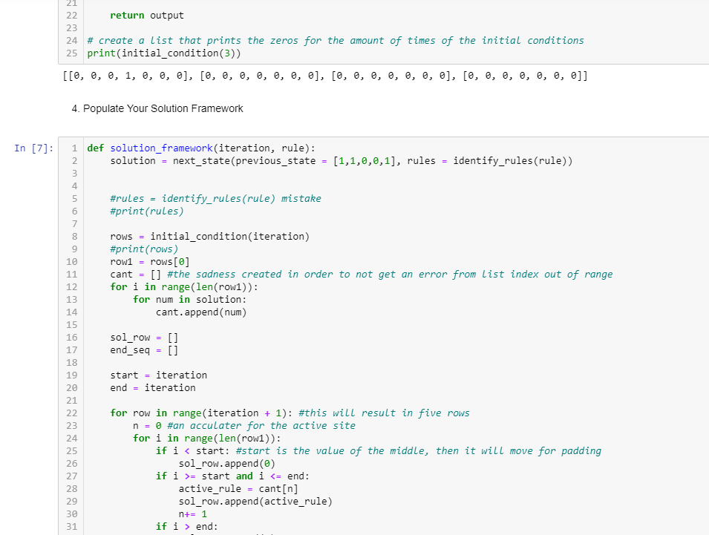
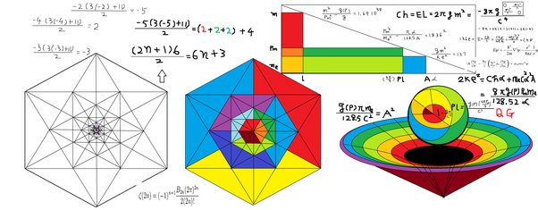
Background
How did I get here??
Where do I go next?
Large Datasets

Slide 3
Background

Slide 4
Background
Image from: Shawhin Talebi

Slide 5
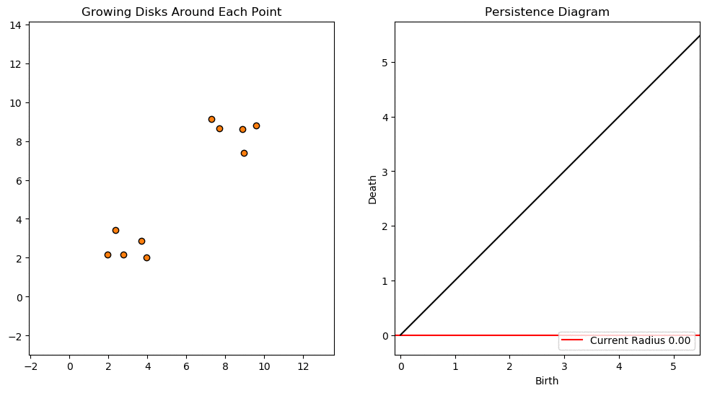
Background
Image from: Gary Koplik

Slide 6
RQ
Research Question: Is there a way to find outliers and detect overlap using a cybersecurity data set for Topological Data Analysis (TDA)?
My Goals to do this:
Use different Python interfaces to conduct data exploration
Using the same python methods to obtain results
Formulate results and future work
6

Slide 7
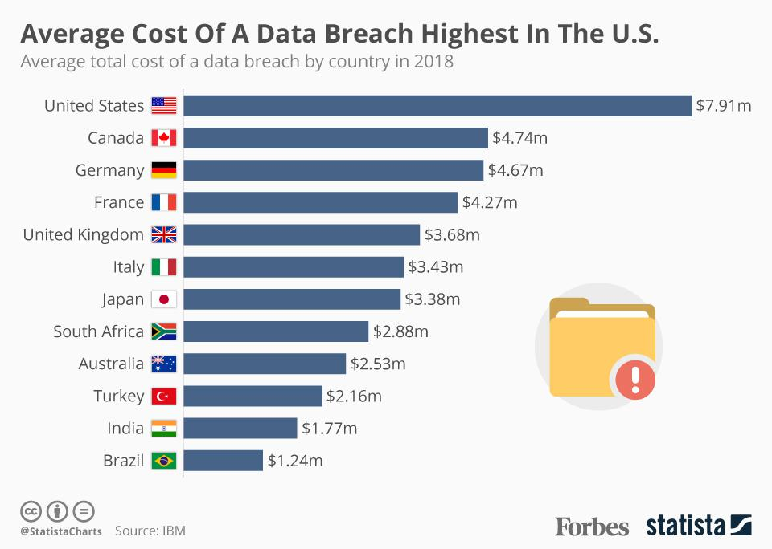
Motivation
Why Cybersecurity?
Background: compromises from Uber, Google, Slack, and Github are personal and costly
7

Slide 8
Coffee-Donut example

Slide 9
Data Exploration
National Security Laboratory – Knowledge Discovery and Databases dataset
Explanatory Variables:
Same Host Server rates
Different Host Server rates
Connections from same services error rates
Connections from different services error rates
Response Variable:
Difficulty level of attack
Categorical Variable:
Type of cyber attack

Slide 10
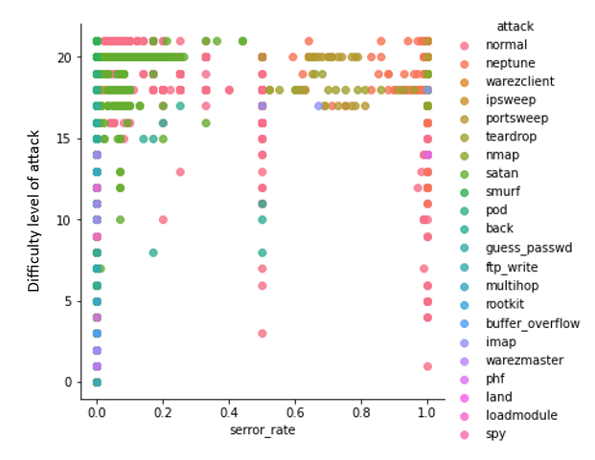
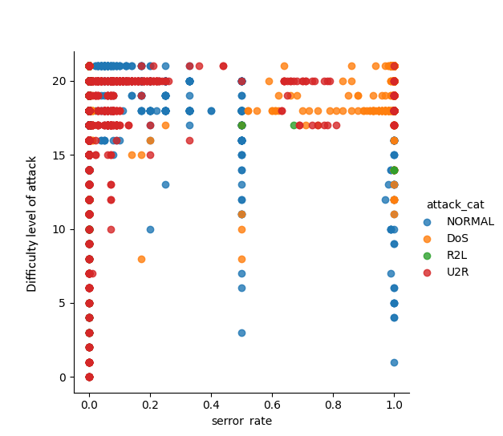
Data Exploration
Types of attacks
Denial of Service (DoS)
Remote to Local (R2L)
User to Root probe (U2L)
Probe (Normal)

Slide 11
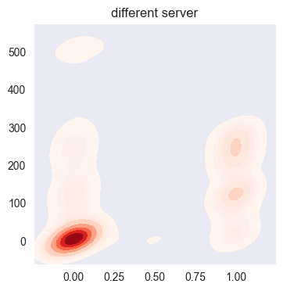
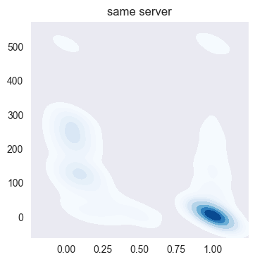
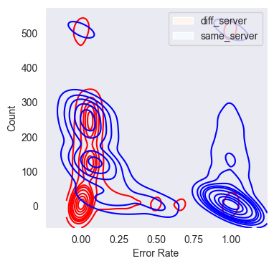
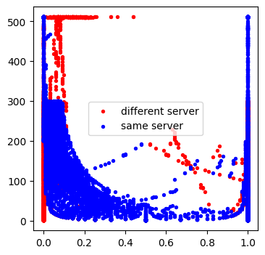
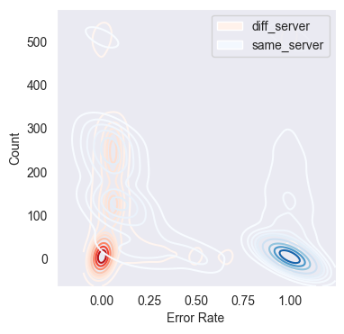
Methodology

Slide 12
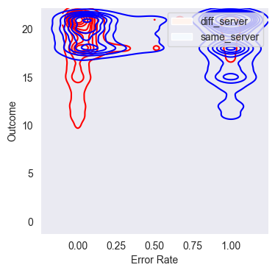
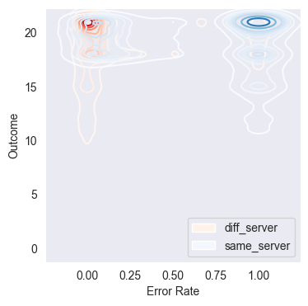
Methodology

Slide 13
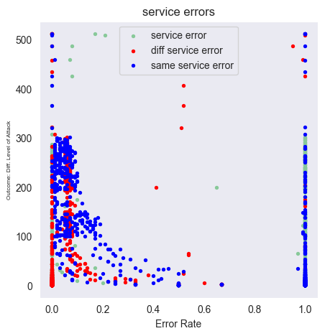
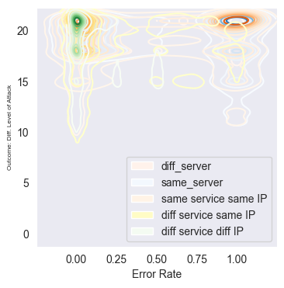
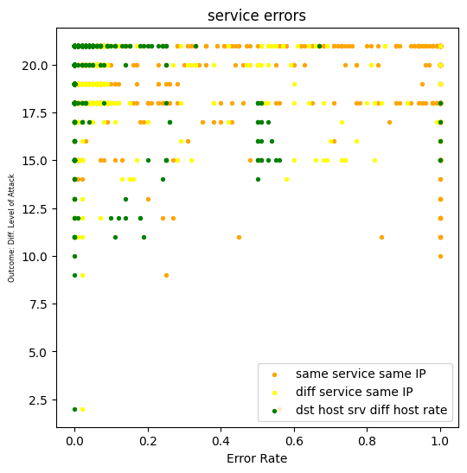
Methodology
Same methodology over and over with different attributes associated with the NSL-KDD dataset
Same service same IP address
Different service same IP address
Different service different IP address

Slide 14
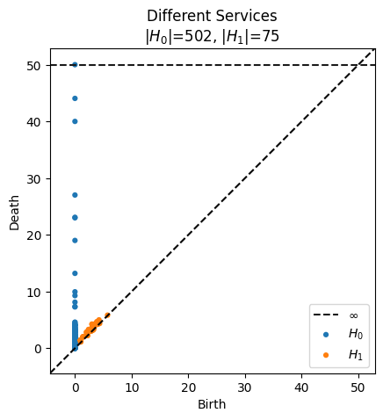
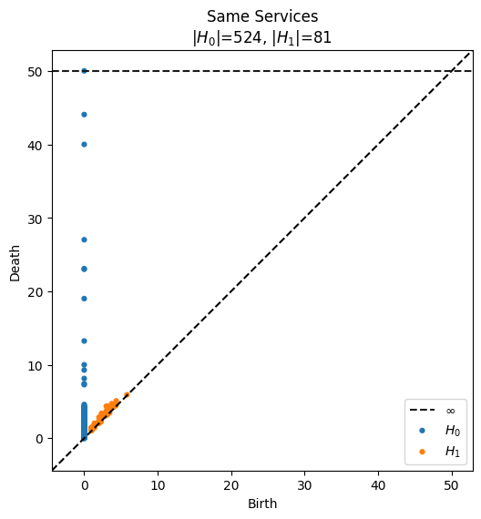
Results
TDA – Build Rips Complex from shape of data
- multi-demensional
Then – Persistence Diagrams are built

Slide 15
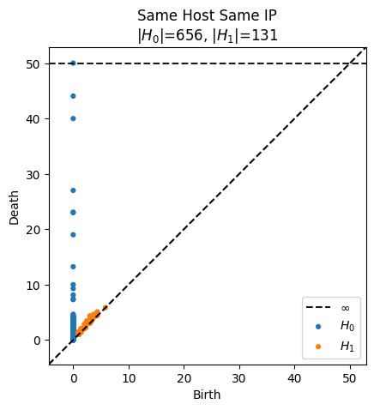
Results

Slide 16
Results
Results: the most H0 have the most edges
Results: the most H1 have the most holes
16

Slide 17
Conclusions
The most edges (H0) in a Viteros-Rips complex are from cyber networks with the same host and the same IP address
The most holes (H1) in a Viteros-Rips complex are from cyber networks with different hosts and different IP address
These Persistence diagrams are not a simple x-y, they take into account all dimensions of data (type of attack, outcome, etc…)

Slide 18
Conclusions
By locating where these are in the Rips Complex (not pictures), we can target those specific areas
(ex: at error rate 3.50, those attributes cause it to fail there but not at 3.49 or 3.51)

Slide 19
Future Work
The results are correlation, there is no way to have statistical significance in TDA
Using different TDA complexes (Cech Complex vs Rips Complex) to construct different models
Building on this work to find more attributes or rates that signal cyber attacks
19

Slide 20
Questions?
20

